Slide 1
WiHawk - Router Vulnerability Scanner
By - Anamika Singh

Slide 2
Product Analyst @ IronWASP Information Security Service Pvt. Ltd.
Author of the WiHawk- Router Vulnerability Scanner.

Slide 3
Conferences

Slide 4
Agenda
Introduction
Networks Basics
Router & functionality
Sample Router Analysis
Vulnerabilities in Router
Exploited Vulnerabilities
Impact of Vulnerabilities
Open Source Tools
Vulnerable Router Detection using WiHawk
Demo

Slide 5
Network Architecture

Slide 6
Secure Network..??
Firewall
Antivirus

Slide 8
Key Functionality of Router
Route processing
Packet Forwarding
Special Service

Slide 9
Route Processing
Route path computation
Routing table construction
Routing table maintenance

Slide 10
Packet Forwarding
IP packet Forwarding requires:
IP packet validation
Destination IP address Parsing & table lookup
Packet lifetime control
Checksum calculation

Slide 11
Special Services:
Packet translation
Encapsulation
Authentication
Packet Filtering for Security/Firewall purpose
Possess network management component(Ex: SNMP etc)

Slide 12
Routers Actually Secure?
How Many of you take routers into the real penetration testing?
Regular Firmware upgrade? Alternative firmware?
Remote Management Enabled?
Support from These companies on the security issue is pathetic.

Slide 13
Support Contact

Slide 14
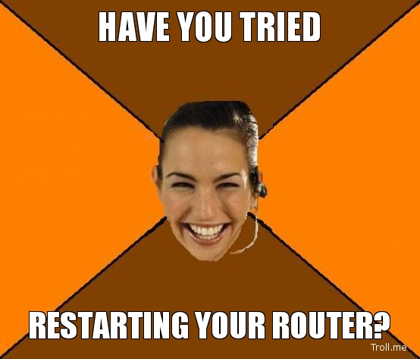
Only Response you Get..!!!

Slide 15
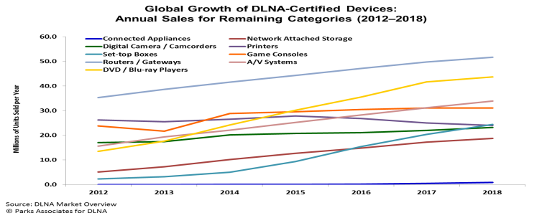
Introduction

Slide 16
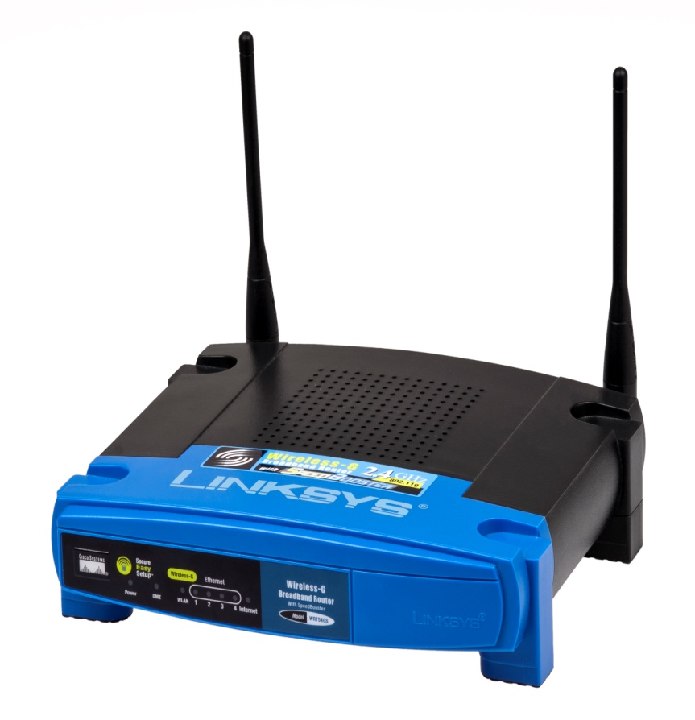
Router is also important element to secure your network.

Slide 17
Post sales

Slide 18
Tools for Code Analysis
Linux – Strings / HexDump
Interactive Disassembler
ObjDump (GNU toolchain)
Radare2
FRAK
Retargetable Decompiler

Slide 19
Best Tools to Analyse
Binwalk Firmware Analysis tool
Binwalk.org
Least False Positives and Magic File Headers.

Slide 20
Let’s Analyze

Slide 21
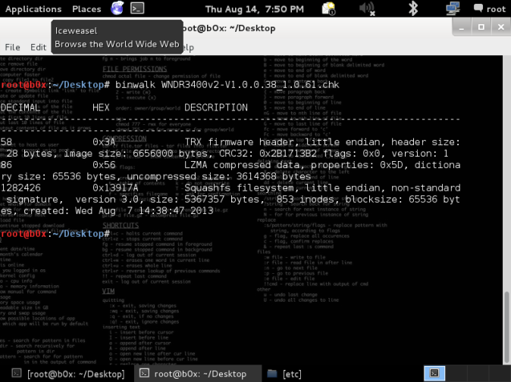

Slide 23
Owned..!!

Slide 24
Vendor Response
End of Life for the Product?
Couldn’t Identify the issue.
Change Router?
Netgear WNR1000 is also affected

Slide 25
Outcome of Analysis
Following Firmware are affected Billion, Tplink, Sitecom, Michelangelo, Edimax, Trust, Airline, Topcom (rompager 4.7 exploit).
No patch for certain devices ( EOL)
Some didn’t even bother to respond
Around 25 Million router still vulnerable

Slide 26
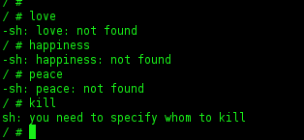

Slide 27
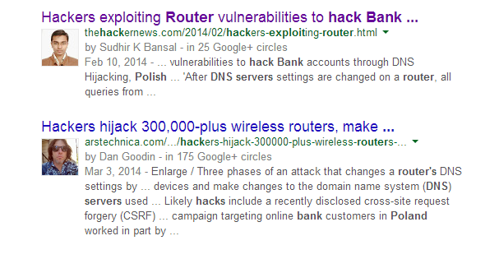
Attacker’s POV
Modify default Admin Username and Password
Port Forwarding
DNS server settings

Slide 28
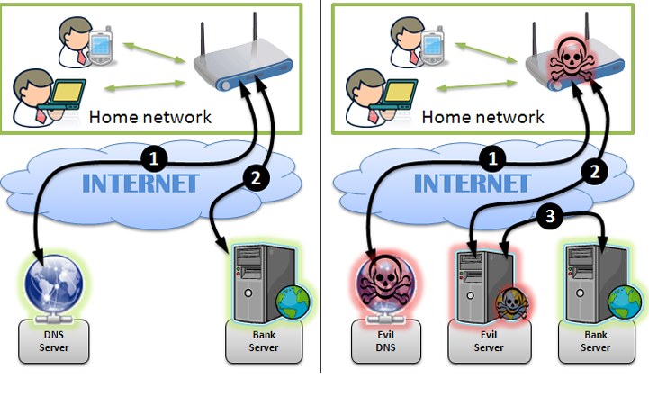

Slide 29
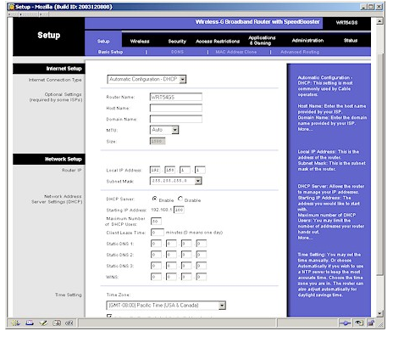
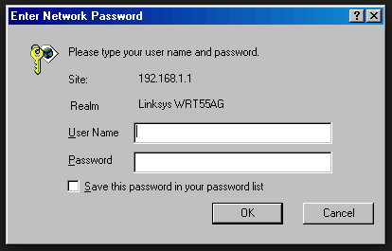
Lets do it..!!!

Slide 30
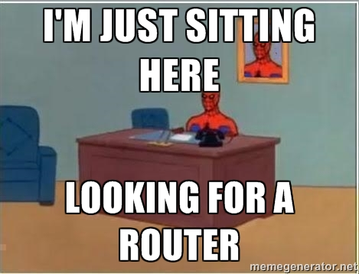
Default Configuration

Slide 31
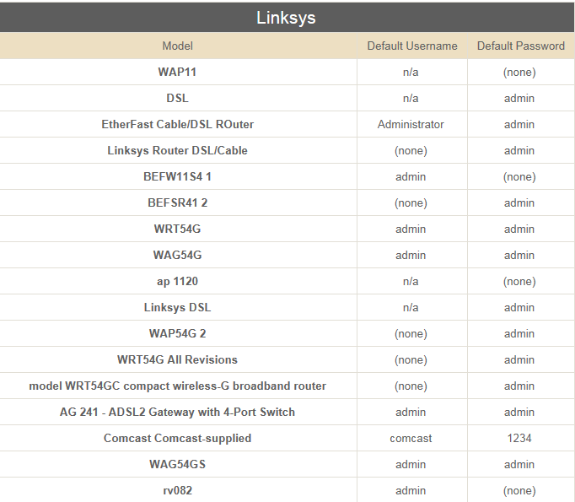
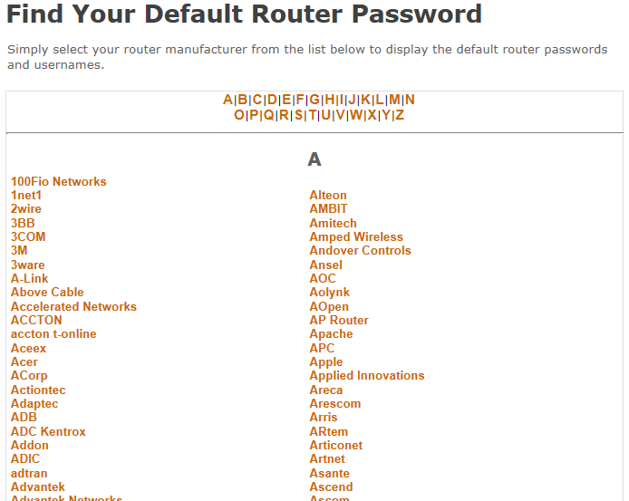
Lots of unique default usernames & passwords are on web.

Slide 32
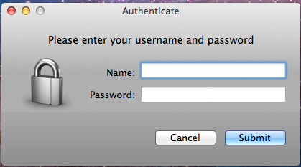
Bypass Authentication

Slide 33
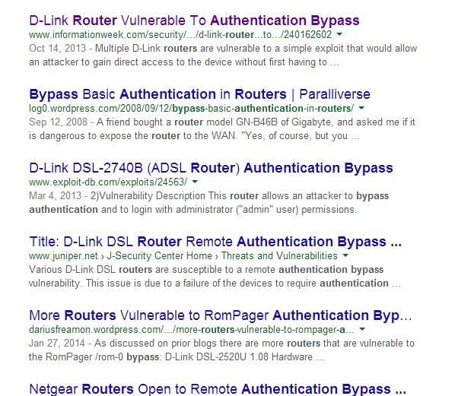
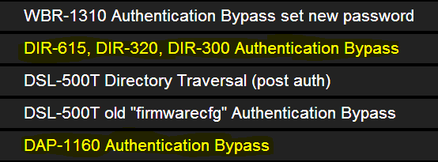
Multiple Routers are vulnerable to bypass Authentication

Slide 34
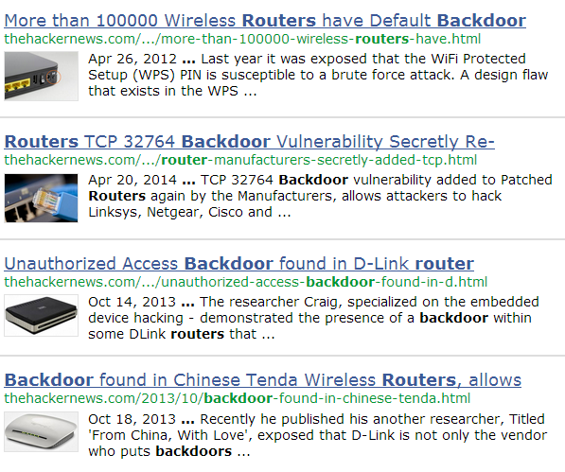
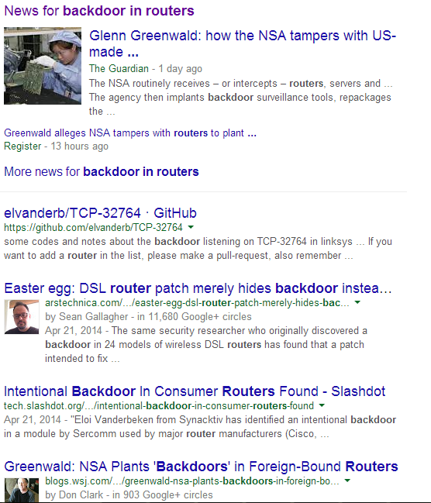
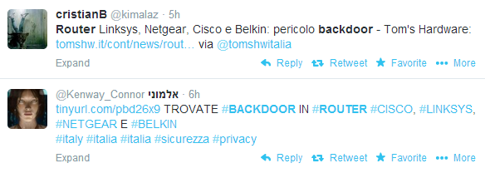
Backdoor

Slide 35
ROM-0 Vulnerability
ROM-0 file is kept in IP/rom-0 path.
Directory is not password protected.
ROM-0 file contains configuration data of routers.

Slide 36
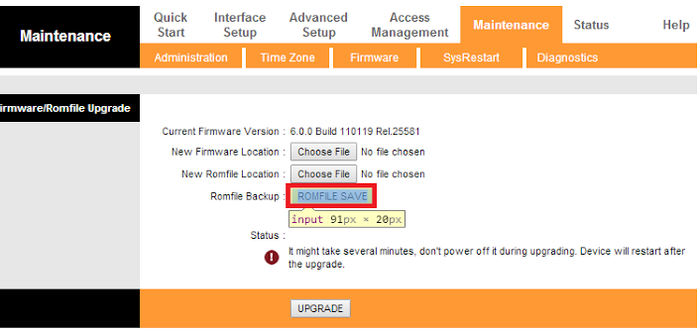
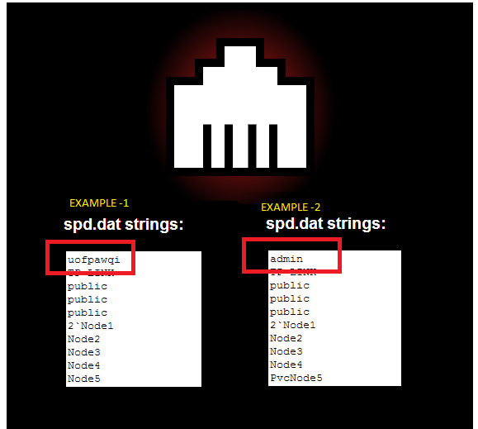
Download the R0M-OFile
Upload it http://50.57.229.26/zynos.php
get the reply back and extract the admin password from it.

Slide 38
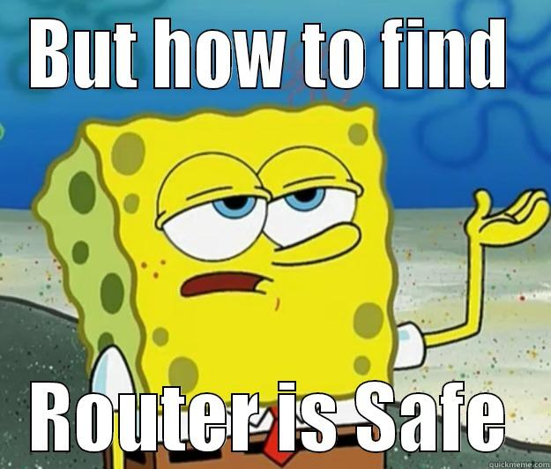

Slide 39
Router Vulnerability Scanner

Slide 40
WiHawk – Router Vulnerability Scanner
Single IP (192.168.1.1)
Range of IP (192.168.1.1-25 or 192.168.1.1/25)
Shodan API
Geo Location
City
Country

Slide 41
WiHawk
Default Configuration
Bypass Authentication
TCP–32768 / TCP-32767 Backdoor
Edit by Joel (Joel’s Backdoor)
CSRF (VIP)
XSS (VIP)
Buffer and Stack Overflow (Beta)
ROM-0

Slide 42
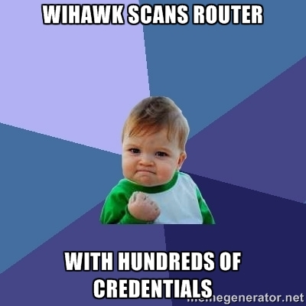
WiHawk – Default Credentials
Maintains a file of unique usernames and passwords.
Covers variety of models from different routers like
Linksys
Netgear
ASUS

Slide 43
WiHawk – Default Credentials
WiHawk
Target IP
Response 401
Request
Response 200
BINGO!
Username : User
Password : pass

Slide 44
WiHawk – ByPass Authentication
WiHawk scans Routers for ByPass Authentication Vulnerability
Appends IP with bypass String
If vulnerability found prints IP with bypass string

Slide 45
WiHawk - Backdoor
Allows a free access to many hosts on the Internet.
Allows various remote commands like:
Remote access to root shell of routers
File copy
WiHawk checks for Backdoors like:
TCP backdoor 32764
Edit By Joel Backdoor

Slide 46
Port 32764 open.?
NO
Port 32764 is not Vulnerable
YES
Create Socket
Write Socket
NO
Data found .?
Check for response data starts with “MMcS” or "ScMM"
YES
Port 32764 is vulnerable

Slide 47
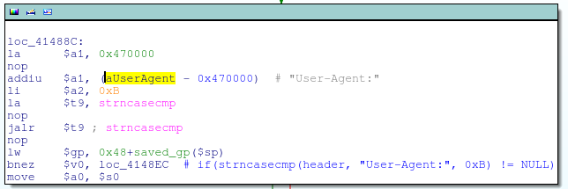
Joel’s Backdoor

Slide 48
Netis/Netcore Backdoor
This one was detected back in August 2014.
It has this mysterious service running at port 53413.
We check if the service is running then try to connect it to using udpconnect.

Slide 49
WiHawk – Rom-0 attack
Rom-0 is a router Configuration file.
Located in “IP/rom-0″ & directory isn’t password protected.
Configuration file which contains the “admin” password.
WiHawk:
Checks whether router is vulnerable to rom-0 attack
Downloads rom-0 file

Slide 50
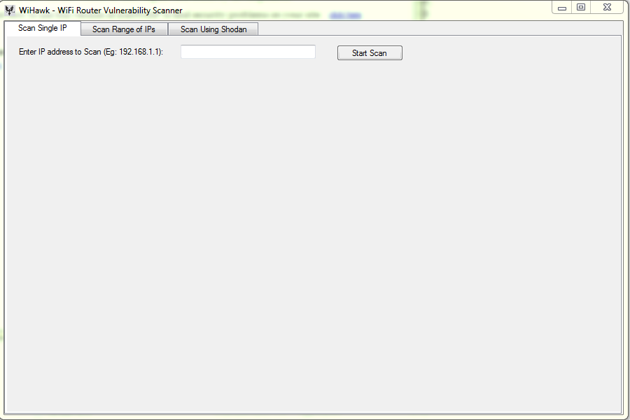
WiHawk – Interface
Single IP

Slide 51
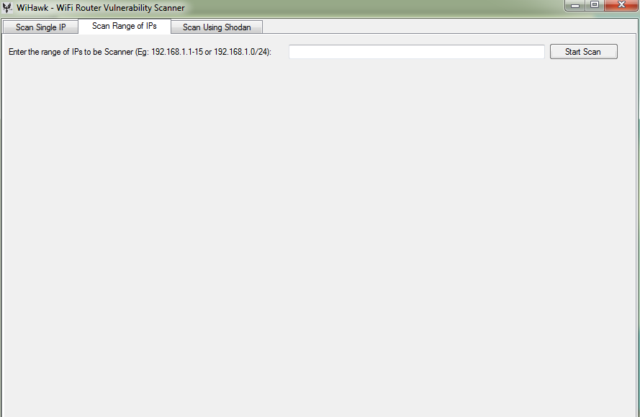
WiHawk – Interface
Range of IP(192.168.1.1-25)
or (192.168.1.1/25)

Slide 52
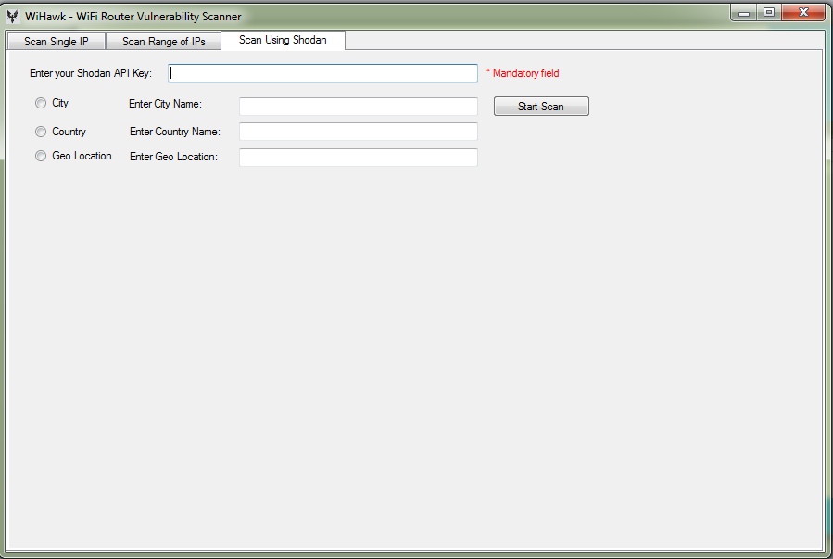
WiHawk – Interface
Shodan API

Slide 53
IronWASP
IronWASP is an open source Web Security Scanner.
IronWASP is one of the world's best open source web security scanners and is Asia's largest open source security project.
Checks for more than 25 Vulnerabilities.
It stands better than commercial scanner in some parameters.

Slide 54
IronWASP is one of the best Scanner

Slide 57
Special Thanks
Lava Kumar Kuppan
Founder of IronWASP.
lava@ironwasp.net
@lavakumark
http://www.linkedin.com/in/lavakumark

Slide 58
Special Thanks
Santhosh Kumar.
A Independent Security Research Working on various domains.
Contributor to the WiHawk Router Vulnerability Scanner.
@ security_b0x
in.linkedin.com/pub/santhosh-kumar/6a/974/8b9

Slide 59
References
IronWasp
www.ironwasp.org
Links:
www.ripe.net
Cve.mitre.com
www.BCP38.info
https://github.com/elvanderb/TCP-32764
https://github.com/devttys0/binwalk
1337day.com
www.exploit-db.com

Slide 60
Thanks.!!
anamika@ironwasp.net
@ _Anamikas_
in.linkedin.com/pub/anamika-singh/80/4a5/5b5/

