Slide 1
How I’ve Broken Every Threat Intelligence Platform I’ve Ever Used (and settled on MISP)

Slide 2
Introduction
Manager of Threat Systems with Fidelis Cybersecurity
Handler with SANS Internet Storm Center
Part-Time Faculty at University of Illinois in CS
Provider of open-source intelligence feeds
Run several takedown oriented groups and surveil threats

Slide 3
The Problem Illustrated (from Virustotal)

Slide 4
The Reality
There is a much smaller set of actual malware tools, many are used by multiple people.
Problem: How to disambiguate the actual malware operator from the tool being used generally?
How to manage large data sets to correlate behavior over time?

Slide 5
Data Set #1 - DGAs
Lots of surveillance possibilities. DNS must resolve.
Still can play games, for instance, necurs.
Lots of intelligence possibilities.
Often adversary will put SOMETHING in WHOIS info instead of privacy protect.
Can provide an accelerant to investigations.
If you know the algorithm and it doesn’t change, can flip new C2s to LE almost as soon as they appear.
Can do bulk takedowns.

Slide 6
Data Set #1 - DGAs
Pre-generate all domains 2 days before to 3 days in future.
Pipe all those domains into adnshost using parallel to limit the number of lines.
Able to process over 900,000 domains inside 15 minutes.
parallel -j4 --max-lines=3500 --pipe adnshost -a -f < $list-of-domains | fgrep -v nxdomain >> $outputfile
Sits behind a Farsight Passive DNS sensor, so they get access to the data behind these resolutions.

Slide 7
Data Set #1 - DGAs
All this is published to http://osint.bambenekconsulting.com/feeds
50 families processed at present / 5 feeds produced per family.
List of resolving domains, List of resolving IPs, Nameservers used, Nameserver IPs used, and a “master” feed that has all 4 data points (pipe ‘|’ delimited when multiple values exist for same element.
There is also a C2 master feed:
List of all C2 IPs, C2 Domains, and a C2 “master” feed for all 4 data elements.
Also a list of “high-confidence” families.
Last there is a raw list of all possible DGA domains (dga-feed and dga-feed-high for high confidence)

Slide 8
Data Set #1 - DGAs

Slide 9
Data Set #1 - DGAs
This is for Tinba.
$Domain, $IP, $nameservers, $nameserver IPs, $comment, $helpfile
newfandultimati.cc,69.64.147.28,ns1.renewyourname.net|ns2.renewyourname.net,64.98.148.18|64.99.97.38,Master Indicator Feed for tinba non-sinkholed domains,http://osint.bambenekconsulting.com/manual/tinba.txt
ybguvvvvcduv.trade,195.54.162.187,dns1.registrar-servers.com|dns2.registrar-servers.com,216.87.152.33|216.87.155.33,Master Indicator Feed for tinba non-sinkholed domains,http://osint.bambenekconsulting.com/manual/tinba.txt

Slide 10
Data Set #2 - Malware Configs
Every malware has different configurable items.
Not every configuration item is necessarily valuable for intelligence purposes. Some items may have default values.
Free-form text fields provide interesting data that may be useful for correlation.
Mutex can be useful for correlating binaries to the same actor.

Slide 11
Sample DarkComet Data
Key: CampaignID Value: Guest16
Key: Domains Value: 06059600929.ddns.net:1234
Key: FTPHost Value:
Key: FTPKeyLogs Value:
Key: FTPPassword Value:
Key: FTPPort Value:
Key: FTPRoot Value:
Key: FTPSize Value:
Key: FTPUserName Value:
Key: FireWallBypass Value: 0
Key: Gencode Value: 3yHVnheK6eDm
Key: Mutex Value: DC_MUTEX-W45NCJ6
Key: OfflineKeylogger Value: 1
Key: Password Value:
Key: Version Value: #KCMDDC51#

Slide 12
Sample njRat config
Key: Campaign ID Value: 1111111111111111111
Key: Domain Value: apolo47.ddns.net
Key: Install Dir Value: UserProfile
Key: Install Flag Value: False
Key: Install Name Value: svchost.exe
Key: Network Separator Value: |'|'|
Key: Port Value: 1177
Key: Registry Value Value: 5d5e3c1b562e3a75dc95740a35744ad0
Key: version Value: 0.6.4

Slide 13
All the fields…
ActivateKeylogger,ActiveXKey,ActiveXStartup,AddToRegistry,AntiKillProcess,BypassUAC,CONNECTION_TIME,Campaign,ChangeCreationDate,ClearAccessControl,ClearZoneIdentifier,ConnectDelay,CustomRegKey,CustomRegName,CustomRegValue,DELAY_CONNECT,DELAY_INSTALL,Date,DebugMsg,Domain,EnableDebugMode,EnableMessageBox,EncryptionKey,Error,ExeName,FTPDirectory,FTPHost,FTPInterval,FTPKeyLogs,FTPPassword,FTPPort,FTPRoot,FTPServer,FTPSize,FTPUser,FireWallBypass,FolderName,Gencode,GoogleChromePasswords,Group,HKCU,HKLM,HideFile,ID,INSTALL,INSTALL_TIME,Injection,InstallDir,InstallDirectory,InstallFileName,InstallFlag,InstallFolder,InstallMessageBox,InstallMessageTitle,InstallName,JAR_EXTENSION,JAR_FOLDER,JAR_NAME,JAR_REGISTRY,JRE_FOLDER,KeyloggerBackspace=Delete,KeyloggerEnableFTP,KillAVG2012-2013,MPort,MeltFile,MessageBoxButton,MessageBoxIcon,MsgBoxText,MsgBoxTitle,Mutex,NICKNAME,NetworkSeparator,OS,OfflineKeylogger,Origin,P2PSpread,PLUGIN_EXTENSION,PLUGIN_FOLDER,Password,Perms,Persistance,Port,PreventSystemSleep,PrimaryDNSServer,ProcessInjection,RECONNECTION_TIME,REGKeyHKCU,REGKeyHKLM,RegistryValue,RequestElevation,RestartDelay,RetryInterval,RunOnStartup,SECURITY_TIMES,ServerID,SetCriticalProcess,StartUpName,StartupPolicies,TI,TimeOut,USBSpread,UseCustomDNS,VBOX,VMWARE,Version,_raw,_time,adaware,ahnlab,baidu,bull,clam,comodo,compile_date,date_hour,date_mday,date_minute,date_month,date_second,date_wday,date_year,date_zone,escan,eventtype,fprot,fsecure,gdata,host,ikarus,immunet,imphash,index,k7,linecount,magic,malw,mc,mcshield,md5,nano,norman,norton,outpost,panda,product,proex,prohac,quickheal,rat_name,resys,run_date,section_,section_.BSS,section_.DATA,section_.IDATA,section_.ITEXT,section_.RDATA,section_.RELOC,section_.RSRC,section_.TEXT,section_.TLS,section_AKMBCZMH,section_BSS,section_CODE,section_DATA,section_ELTQHVWF,section_VDOJLYFM,section_YRKCHNMU,sha1,sha256,source,sourcetype,splunk_server,splunk_server_group,spybot,super,tag,tag::eventtype,taskmgr,times_submitted,timestamp,trend,uac,unique_sources,unthreat,vendor,vipre,windef,wire

Slide 14
Future Dataset - Yalda
https://github.com/fideliscyber/yalda
Process a statistically significant portion of global spam, extract interesting pieces out of and store the history.
Extracting IoCs is nice.
Would prefer to extract correlations and intelligence.

Slide 15
Starting Point
Threat Intel Level 1
There are generally only specific indicators we can action:
IPs, hostnames, domains, URLs, e-mails, hash
A few years ago, I focused on that and there’s a great product for that:
Collective Intelligence Framework

Slide 16
Collective Intelligence Framework
Available at: http://csirtgadgets.org
Take all of the various open feeds (and even those with some “easy” APIs) and put them all in one query-able ELK stack.
Focuses on the easy to operationalize indicators

Slide 17
Example

Slide 18
Example #2

Slide 19
Putting DGA feeds into CIF
CIF can do IPs and Domains with a description, originally did those feeds explicitly to integrate with CIF.
If you do the resolution feeds, you ONLY have data for domains that resolved, NOT data for domains that resolved outside the window I check.
But what if you throw the entire raw list of malicious DGA domains in there?
Dga-feed is ~900,000 unique entries a day.
~10Million unique domains a year.

Slide 20
Oops. I broke it.

Slide 21
Now thinks get really weird

Slide 22
A Wild Correlation Problem Appears
CIF has an indicator focus, which means relating domains, IPs, and other config items back to a discrete binary is difficult.
A description field is not good enough.
Most TIPs focus on indicators
Most customers WANT indicators
Do I list all njRat configs in a bucket of njRat IPs?
“Fake” data problem?

Slide 23
CRITS
What we originally were using.
Starts to map relationships between indicators.
Even has some enrichments…
Hasn’t changed much in a few years.

Slide 24
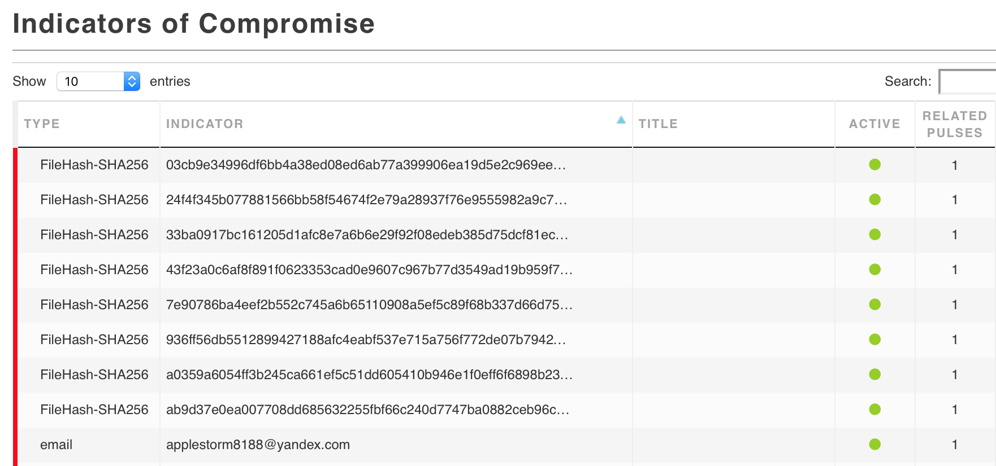
OTX
Suffers from same problem, an indicator focus.

Slide 25
ThreatConnect
Same problem

Slide 26
Malware Configs
My malware config MISP (barncat) has 235k events with full malware configs. I have 150k more I can put in soon.
Imagine 400,000 pulses in OTX or ThreatConnect, it’d be unusable.
(to be fair, I’m working with everyone I can to help make their stuff better)

Slide 27
But why don’t you use STIX/TAXII
Pro: XML lets you describe events in great detail however you want. (STIX 2.0 at least uses a modern format like JSON)
Con: XML lets you describe events in great detail however you want.

Slide 28
This is why I don’t use STIX/TAXII

Slide 29
What I Discovered I Needed?
Something more abstract than indicators as the organizing principle
Ability for external enrichment
Ability to do at least coarse-grained information sharing
Context of why I’m seeing this
Most of all... Some visibility into relationship of indicators
Looking at events instead of solitary indicators.

Slide 30
Misp Event #1

Slide 31
Misp Event #2

Slide 32
Misp Event #2

Slide 33
Why This Matters?
In the wake of the recent election-related hacking events in the US, DHS released indicators (Grizzly Steppe).
From Robert Lee - “All but the two hashes released that state they belong to the OnionDuke family do not contain the appropriate context for defenders to leverage them.”
Included tor exit nodes, commodity criminality incidental to the breaches.
That’s ok until things like this happen…

Slide 34
Why This Matters?

Slide 35
Examining Relationships
We like talking about classes of data (particularly in machine learning)
i.e. IP reputation, domains (RPZ), hashes, etc
Attacks cover lots of classes of data that relate with each other. (domains relate to IPs, relate to C2s in malware configs, relate to host-based behaviors, etc)
If we’re going to do real machine learning, it needs to be on overall behaviors, not single classes of data.

Slide 36
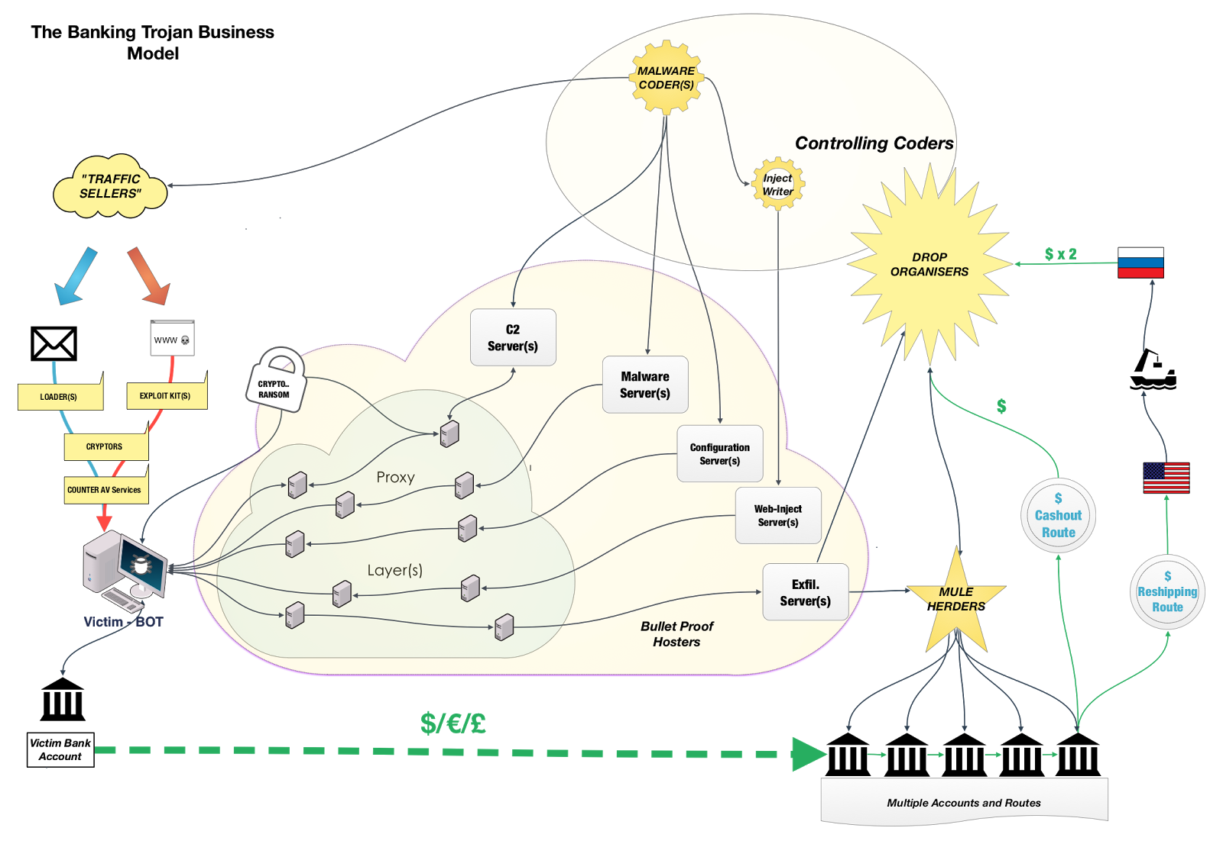
Cybercrime ecosystem

Slide 37
Cybercrime Ecosystem
Malware writers/operators
EK operators
Exploit writers
Traffic generators
Selling of compromised websites
“Marketplace” operators
The ecosystem behind malware (i.e. mules, carders, etc)
Bitcoin washing services ☺ ☺

Slide 38
So now what?
With these raw datasets that now are marked as related to specific attacks, can start to do the work of attributing actors.
Find a way to get this data in a place where it is protecting consumers on home networks.
Internally, we are building a Hive-Cortex-Misp system as our central repository, sharing, and enrichment system for “general” intelligence.
Political assassin anecdote.

Slide 39
Shameless Plug
I run a charity raising funds to build schools in rural Tanzania and to send medical supplies to rural Côte d’Ivoire, please donate ☺
http://thetumainifoundation.org/

Slide 40
Questions & Thank You!
John Bambenek / john.bambenek@fidelissecurity.com
For access to our malware config MISP instance, https://www.fidelissecurity.com/resources/fidelis-barncat or give me a business card
For DGA feeds, just go to http://osint.bambenekconsulting.com/feeds

