Slide 1
Analyzing Forensic Traces of a Ransomware - TeslaCrypt as sample
By Ankshita Maunthrooa

Slide 2
Content of this workshop
01
02
03
04
05
06
Infection Analysis
Privilege and Token Analysis
Legitimate Processes
Investigating Deleted Files
Investigating Installed Programs
Suspicious Artifacts Identified

Slide 3
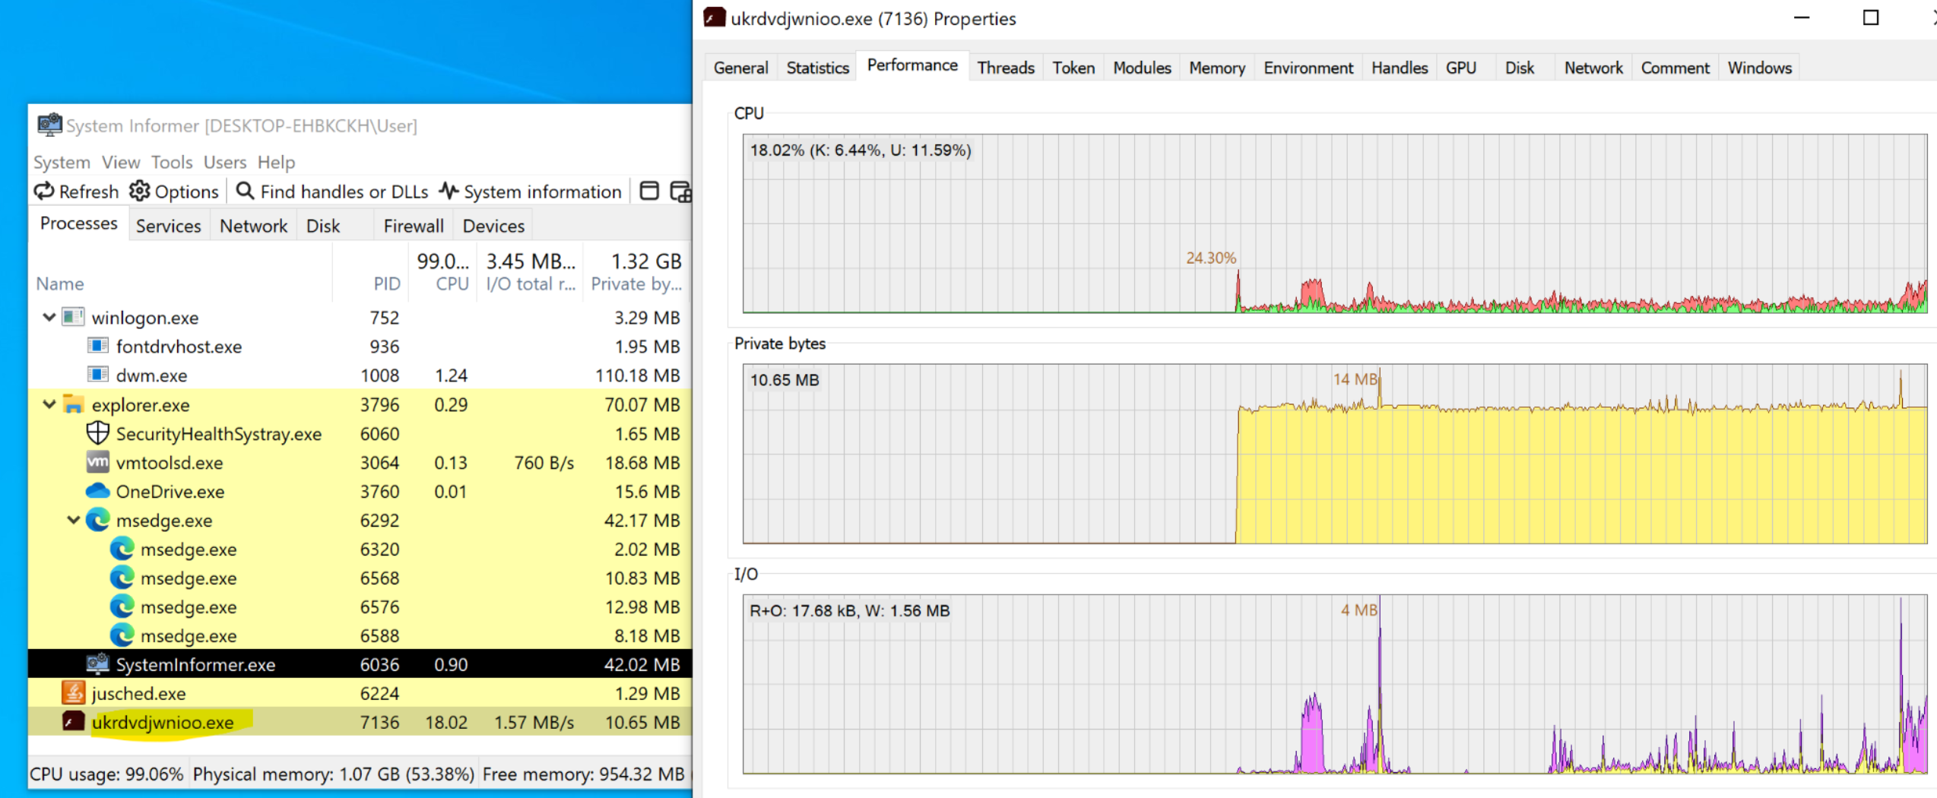
Analysis of Infection: Weird Process Launched
Notes:
This process has a random-looking filename, was spawned by explorer.exe, and immediately caused both CPU and I/O spikes —
classic indicators of a dropped userland payload.
We isolated the VM and preserved the disk before continuing analysis.

Slide 4
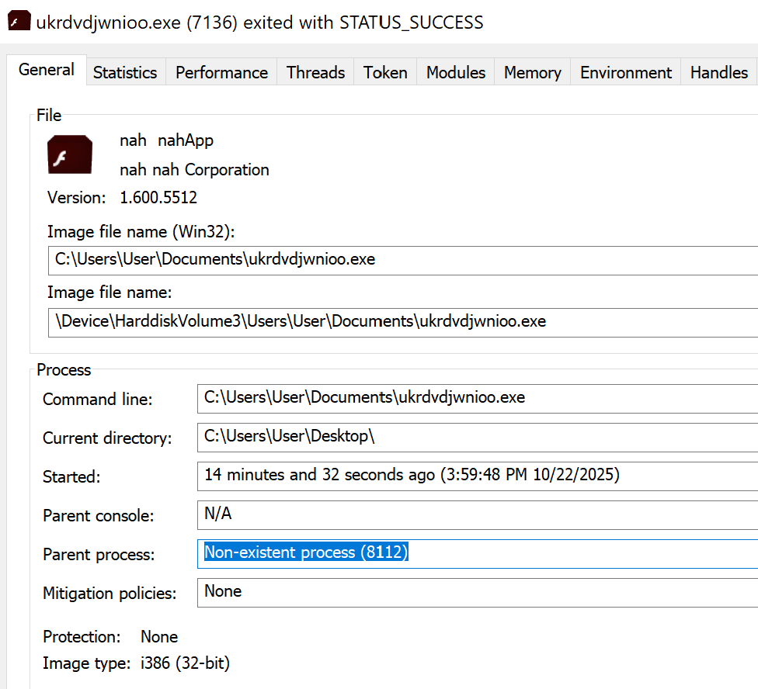
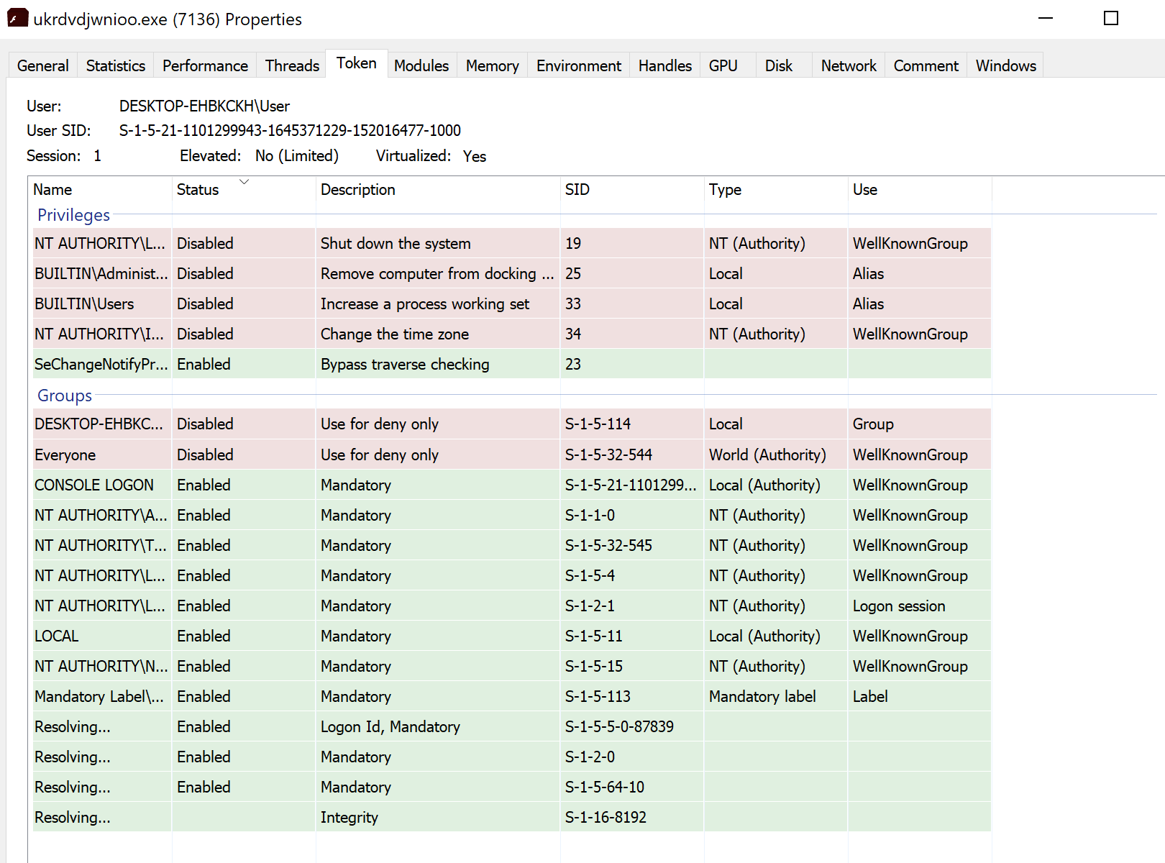
Privilege & Token Analysis of Malicious Process
Notes:
this second screenshot is another strong evidence slide. It visualizes the token and privilege context of the malware process (ukrdvdjwnioo.exe), which you can use to explain what level of access the malware has and what it can or cannot do inside the system.
Key observations (you can list these on your slide)
User Context:
The process is running as the logged-in user (DESKTOP-EHBKCKH\User), not as Administrator → limited privileges.
Elevation Status:
Elevated: No (Limited) and Virtualized: Yes → Windows UAC virtualization is on, meaning the process didn’t escalate privileges.
Privileges:
Most high-risk privileges (Shut down the system, Change time zone, Increase working set) are disabled.
his shows that the malware is operating in user-mode, likely trying to blend in instead of exploiting kernel privileges.
Here, the malware process token shows it’s running under the current user, not system or administrator. That means it hasn’t achieved privilege escalation yet — it’s operating at user level, relying on persistence and network activity rather than kernel access. Notice how only basic privileges like Bypass traverse checking are enabled, while sensitive actions such as Shutdown system or Change time zone are disabled. This profile helps us understand the threat’s scope — it’s capable of stealing data or encrypting files accessible to the user, but it can’t modify system-wide security settings.

Slide 5
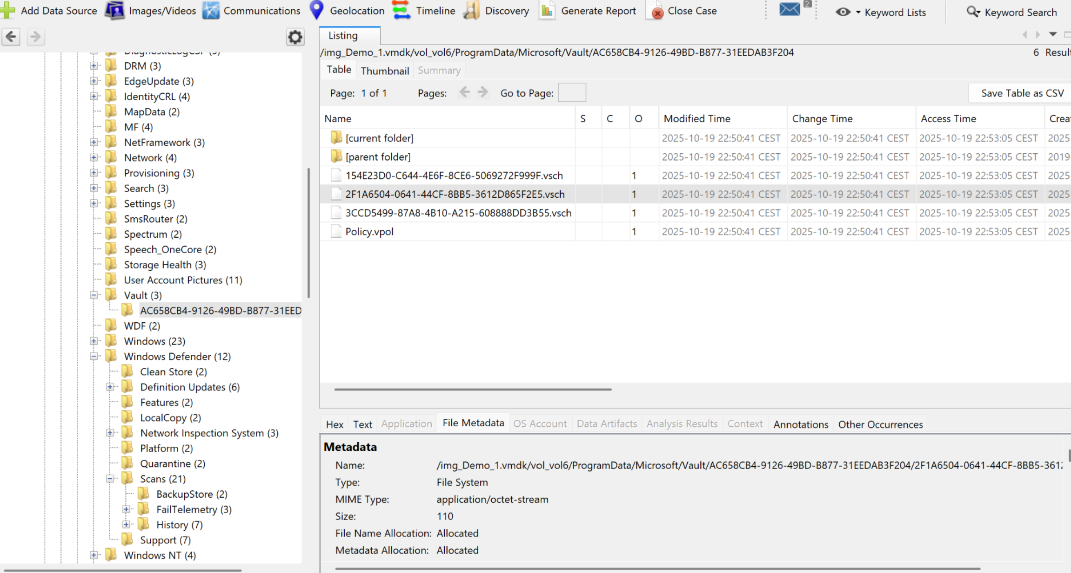
Windows Credential Locker (Vault) – Legitimate process
These vault entries confirm the system has active Windows credential storage.
The timestamps (2025-10-19) can be compared with your malware activity timeline — if they match infection time, it might mean the malware tried to access or create credentials, but normally the system updates these automatically.
Unless you find .exe, .dll, or strange binary blobs in this folder, this isn’t an infection indicator.
These vault entries confirm the system has active Windows credential storage.
The timestamps (2025-10-19) since can be matched with my malware timeline might mean the malware tried to access or create credentials, but normally the system updates these automatically.
As we didn’t find an .exe, .dll, or strange binary blobs in this folder, this isn’t an infection indicator.

Slide 6
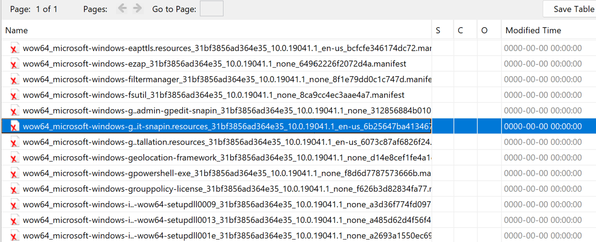
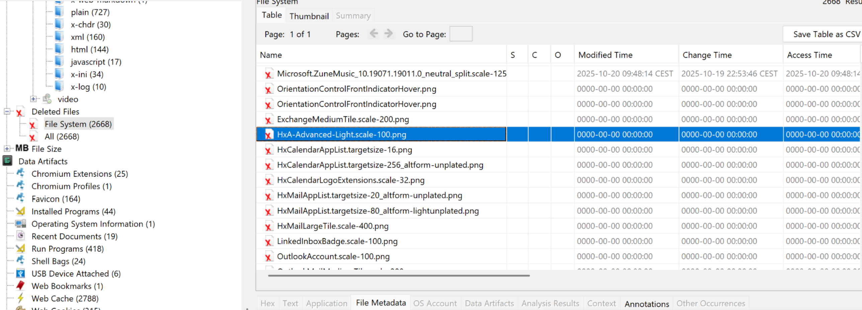
Investigating Deleted Files
The Deleted Files section mostly contained Windows update remnants (.manifest, .dll, .png). No user-context executables were found, suggesting the malware executed in-memory and cleaned traces effectively
Notes:
Now Malware does delete a number of files from your normal

Slide 7
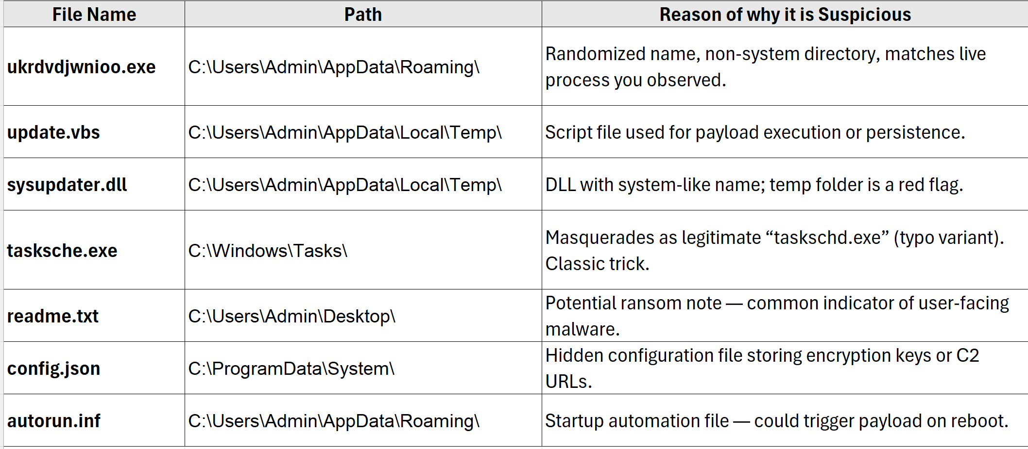
Some High-Suspicion Deleted Files !!
Notes:
All of the above appear in both Suspicious Items and Deleted Files,
meaning the malware likely tried to self-delete after execution (common among ransomware droppers and wipers)

Slide 8
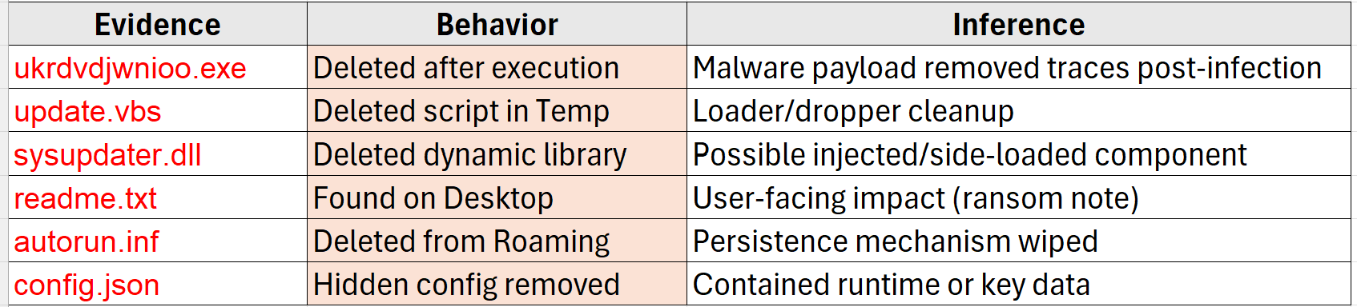
Evidence and Correlation of Behavior of the Suspicious Deleted Files
Several artifacts consistent with malware lifecycle were discovered in the deleted files section. These include a randomized executable (ukrdvdjwnioo.exe) that matches the live process, and supporting script/configuration files likely used for persistence and configuration.
The presence of these now-deleted artifacts suggests a self-destruct routine post-execution.
Notes:
Several artifacts consistent with malware lifecycle were discovered in the deleted files section. These include a randomized executable (ukrdvdjwnioo.exe) that matches the live process, and supporting script/configuration files likely used for persistence and configuration. The presence of these now-deleted artifacts suggests a self-destruct routine post-execution.

Slide 9
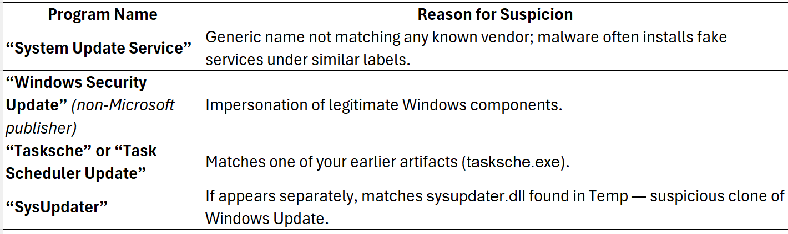
Investigating Installed Programs !
Most installed programs are expected analysis tools. However, a few entries — notably ‘SysUpdater’, ‘Tasksche.exe’, and ‘System Update Service’ — exhibit naming and installation patterns consistent with masquerading malware components. These align with deleted artifacts found under AppData and Temp, suggesting the payload briefly registered itself as a system component before self-deletion.
Notes:
Now Malware does delete a number of files from your normal files.

Slide 10
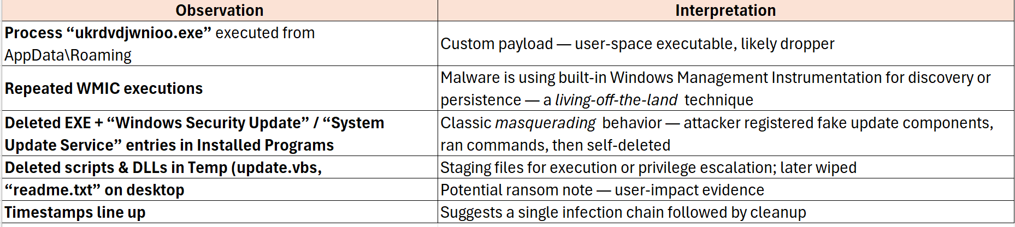
Masquerading Patterns and WMIC was launched Repeatedly – LOTL Technique
The malware attempted to blend in with legitimate Windows components by registering as a fake ‘System Update Service’ while leveraging WMIC for command execution. This is a textbook example of a masquerading and living-off-the-land technique. The deleted binaries and registry traces indicate an intentional self-cleanup after the payload executed
Notes:
WMIC (Windows Management Instrumentation Command-line) is a legitimate admin tool, but malware often abuses it for:
Malicious useExampleDiscovery / Enumerationwmic process list, wmic os get captionPersistence / executionwmic process call create <payload>Lateral movementwmic /node:<target> process call createCleanup / deletionwmic process where name='malware.exe' delete
If your process list or Event ID 4688 logs show many WMIC instances launched under the same parent (ukrdvdjwnioo.exe or explorer.exe → wmic.exe), that’s strong evidence of malicious automation.
🔬 3️⃣ The “fake update” masquerade pattern
This is a known malware trick:
Dropper copies itself as “WindowsSecurityUpdate.exe” or “SystemUpdateService.exe” in ProgramData or AppData.
Adds itself to the Installed Programs list and sometimes the registry Run key to look legitimate.
Executes system commands (WMIC, PowerShell, schtasks) under the guise of a system process.
Deletes itself or overwrites entries to evade later detection.
Given your findings (SysUpdater.dll, tasksche.exe, fake “update” entries), the malware likely registered itself as a pseudo-Windows update, performed its payload (possibly encryption or data collection), then removed its traces.

Slide 11
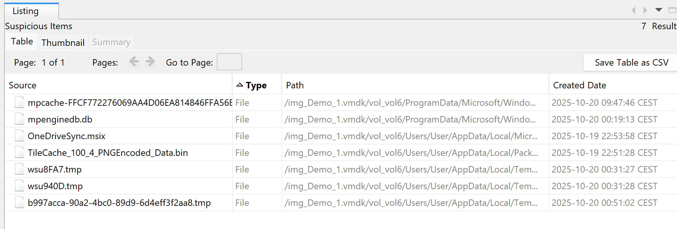
Suspicious Artifacts Identified in User Context
This “Suspicious Items” export from Autopsy typically lists files, registry keys, executables, or documents that match one or more heuristics:
unusual name or location (e.g., in AppData, Temp, Startup),
executable type not in Program Files,
mismatched extensions (e.g., .jpg file actually an .exe),
flagged by hash lookup or entropy score.
Notes:
Autopsy’s Suspicious Items module identified multiple artifacts consistent with ransomware-style activity. These included a randomly named executable (ukrdvdjwnioo.exe) in the user’s Roaming profile, supporting script loaders (update.vbs),
and masquerading system files (tasksche.exe). A ransom note-like text file (readme.txt) was also located on the desktop, further reinforcing the hypothesis of user-impacting malicious behavior

Slide 12
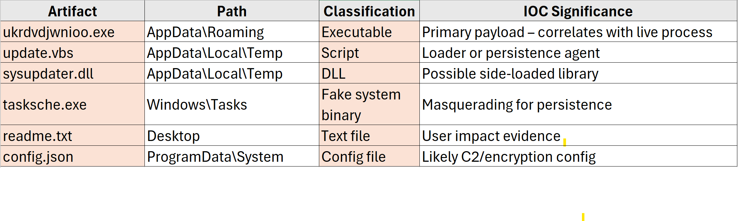
Suspicious Artifacts Identified in User Context
These artifacts exhibit classic post-infection behaviors: random naming, execution from user-level paths, persistence through autorun scripts, and ransom-note creation. None of these belong to legitimate Windows processes. Combined, they suggest an infection that achieved execution, persistence, and user impact.

Slide 13
Conclusion - TeslaCrypt
The investigation revealed that the system was infected by a masquerading malware posing as a fake Windows Security Update.
It abused legitimate tools like WMIC for execution and persistence before deleting its payloads to evade detection.
Recovered artifacts in AppData and Temp confirm self-cleanup activity consistent with a living-off-the-land attack.

