Slide 1
NEUROCTI - A CUSTOM FINE-TUNED LLM FOR CTI
BENCHMARKING, SUCCESSES AND LESSONS LEARNED
Aaron Kaplan

Slide 2
AI has hacked the OS of humans: language
Yuval Noah Harari
https://www.economist.com/by-invitation/2023/04/28/yuval-noah-harari-argues-that-ai-has-hacked-the-operating-system-of-human-civilisation

Slide 3
Intro speakers
Aaron Kaplan
Self-employed / EC-DIGIT-CSIRC
Previously 12 years @ CERT.at, Austria.
This work is done together with
Alexandre Dulaunoy
Jürgen Brandl
senior cyber security analyst at the Federal Ministry of the Interior, Austria
Paolo di Prodi
Founder PRIAM.AI, previously senior data scientist at Microsoft and Fortinet.
The AI SIG @ FIRST.org
Big thank you to Robert Haist / orkl.eu To David Durvaux and Benoit Rousille who believe in me.
Notes:
Aaron

Slide 4
Disclaimer
DISCLAIMER
Aaron
All errors are mine to keep
I present this here as a sole proprietor company under my own name
Notes:
Aaron

Slide 5
Overview of the talk
Motivation
Use-cases for LLMs in CTI
Ultra-short recap: how do LLMs actually work?
Inference, training, fine-tuning
Obstacles to using LLMs for CTI ➔ we need local LLMs
Needed: benchmarking- and training datasets
CTI.tools
Fine-tuning a local LLM: initial results on Mistral.ai
Integration with MISP

Slide 6
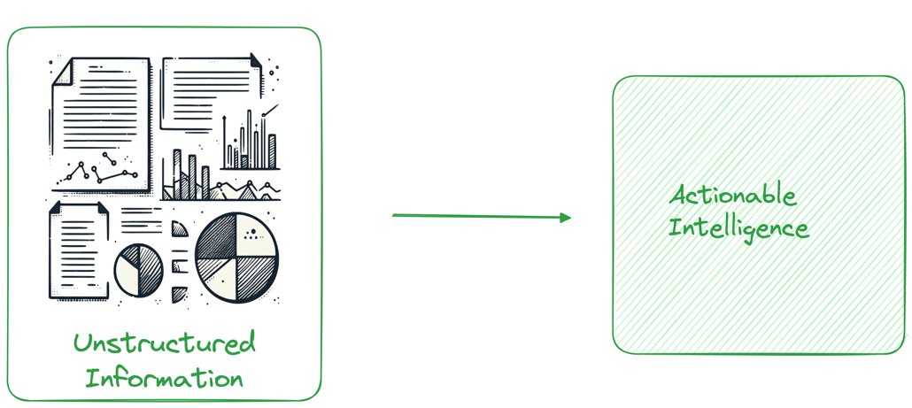
Motivation - useful things with AI – beyond the hype
CTI report
JSON

Slide 7
5 main uses cases for AI in CTI
Summarization: CTI analysts need to digest a lot of threat intel reports
RAG: Analysts might want to search (question-answering) on CTI reports
NER: Analysts would like to get the information out (“information extraction”) from CTI reports
T-Codes mapping: Extracting MITRE TTPs from text reports
Knowledge graph / STIX 2.1 / MISP standard: Extract relationships
Notes:
Aaron
We have many use-cases actually, but the main question always will be, … how well can we do it?

Slide 8
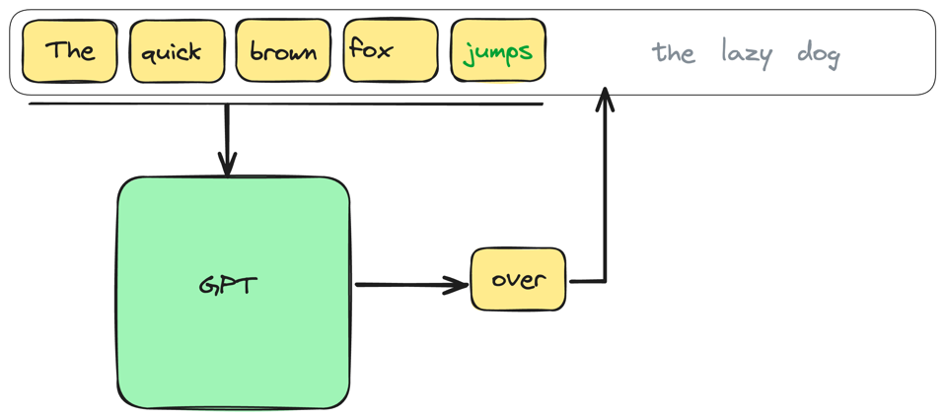
Can we do that locally? Yeah, maybe but first, how does an LLM actually work?

Slide 9
Next work/token prediction
LLMs get trained on “masked” input
Their goal: predict the next word (token)
Everything beyond that is an “emerging property” kinda like magic
…but it is not magic, just statistics

Slide 10
Obstacles to using LLMs for CTI
And possible solutions

Slide 11
https://www.theatlantic.com/technology/archive/2024/10/chatbot-transcript-data-advertising/680112/

Slide 12
Privacy: LLM interactions = gold mine
For API interactions → you leak your processes
Using it for coding (co-pilot)? → better use it only on open source.
For personal (web) interactions: you leak detailed and hour long personal conversations on
Relationships & breakups
Illnesses (or suspected ones)
Mental health
Your deepest sexual desires (think: AI boyfriend/girlfriend)
Etc.
This data is too juicy for advertisement to ignore.
Enshittification of the AI hype will follow (3 stages: good to for users, good for biz, good for itself only)
Enshittification: Cory Doctorow, https://www.ft.com/content/6fb1602d-a08b-4a8c-bac0-047b7d64aba5

Slide 13
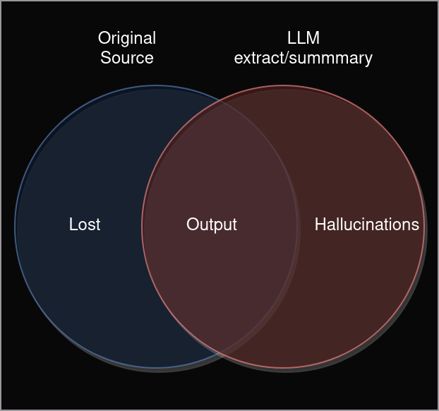
Other Problems with LLMs
Hallucinations
What are the risks for CTI reports?
Political / business decisions taken because the AI generated a wrong summary?
Start war because of wrong intel?
Notes:
Aaron
Starting a war after a wrong attribution?

Slide 14
Guardrails
Make the LLM adhere to a strict, smaller vocabulary
Use easier, smaller models to keep the LLM “in bay”
Mix of Experts (MoE)
Use RAG for limiting the context the LLM may even use
Few-shot prompting
Fine-tuning (LoRA)
Custom training (continuous pre-training)
Notes:
Aaron

Slide 15
Sending my CTI reports or requests to a third-party?
Data goes to AI providers
How is my data used?
For training updated models?
might end up in someone else’s output
Across users (session leakage)
Legal implication
TI feed providers don’t allow to re-share
→ breach of contract
Are you using VS Code for editing local files? Co-Pilot?
→ The files get uploaded !
PII and privacy-related regulation
Notes:
Aaron

Slide 16
➔ We need local models! But: can a local model do this just as well?
Local models FTW! … let’s see…
Notes:
Aaron

Slide 17
Training
pre-training → can we have a super computer plz? (openai). NO
continuous pre-training → same, just a continuous basis. NO
Reinforcement learning from human feedback (RLHF) . Yes
fine-tuning / adapters (LoRA). Yes

Slide 18
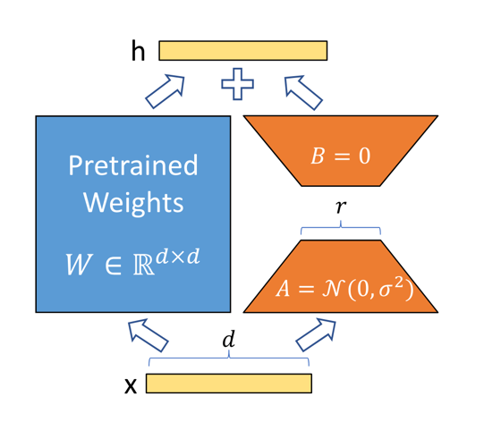
How to do fine tuned, local models?
Use a good, open base foundational LLM: mixtral, mistral, Llama-2, Llama-3
But can we do it? Are they as good?
Can we train them on our data?
Do we need a datacenter of GPUs?
No!
Use a solid base-model
Add a LoRA model “on top”

Slide 19
Datasets, benchmarking
the need for high quality data for training and benchmarking

Slide 20
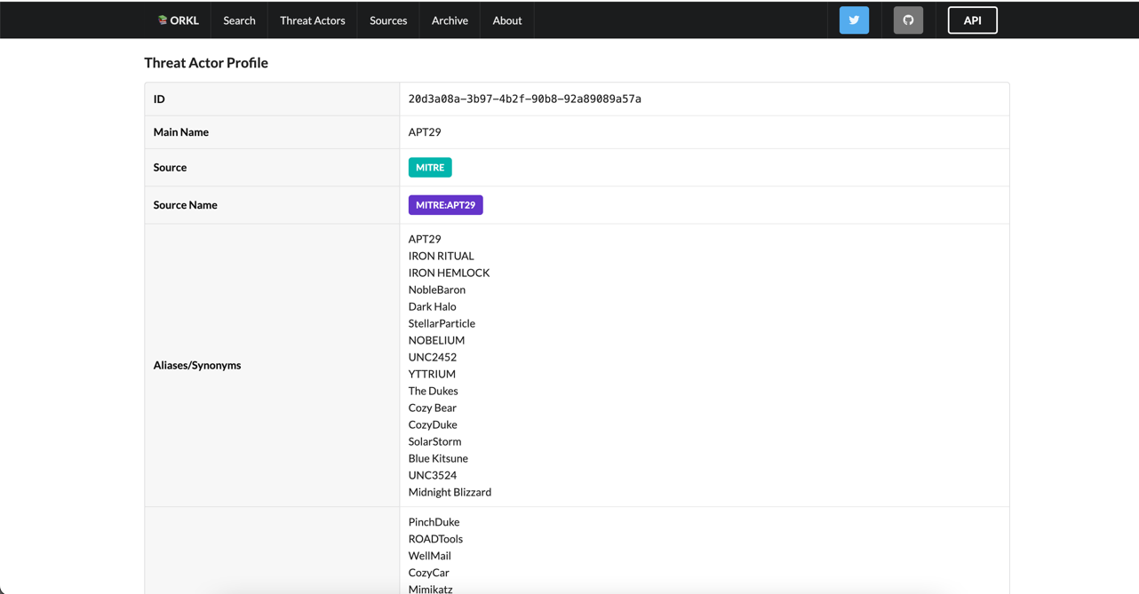
Related research & existing datasets
AnnoCTR (Bosch, CTI conf Berlin) – 400 reports
TRAM – on document level only
ORKL.eu ←
CyNER
Additionally: MISP Galaxies
Malpedia
So far, all NER annotators that we found, were not ideal
Therefore, ….
13000 reports
Mixed quality
Converted from PDF
Shout-out do Robert Haist! Thanks!

Slide 21
Problems with datasets
No clear standardized taxonomy of NER categories
Data is messy, hard to train on
Text from orkl.eu is not very useable as-is. PDFs are the master source PDF2text is a hard problem
No standard benchmark dataset for CTI LLMs

Slide 22
CTI.tools AI workbench
For annotation
Notes:
Jürgen

Slide 23
CTI.tools - overview
Goal: Make AI tooling accessible to the CTI community*
* while solving the CTI dataset problem
Notes:
Jürgen

Slide 24
CTI.tools - goals
Checklist to get people to contribute:
Provide a benefit to the users
Easy, intuitive and fun to use
Usable by everyone with internet
Everybody profits
Notes:
Jürgen

Slide 25
Live Demo
Notes:
Jürgen

Slide 26
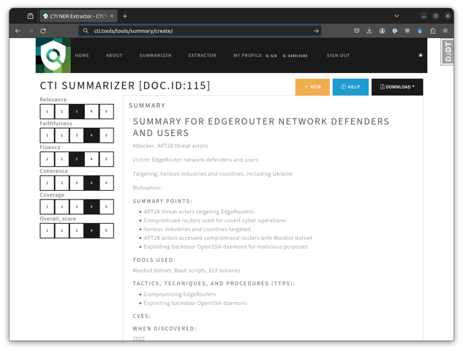
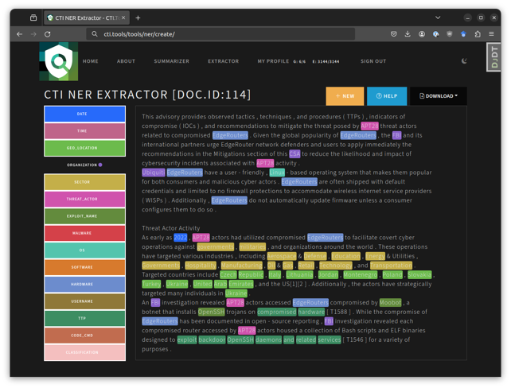
Goal: making AI for CTI accessible to everyone
Summaries and TL;DR for reports
Extract information from reports
Notes:
Jürgen

Slide 28
Recap & call to action!
AI powered workbench to turn CTI texts into actionable information
Built to help you, so you can help us in making it better!
It’s a crowed-sourced effort, we need you. Please get in touch with the authors if you can contribute labeling skills.
Even just quickly labelling 10 reports would help us.
All the results will be available to everyone who participates.
Invite code: HACKLU2024-CTITOOLS

Slide 29
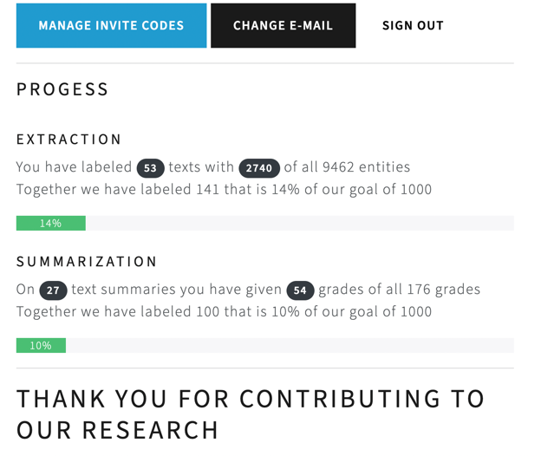
Lessons learned
Not enough data
We need more
And it will only be enough for benchmarking. Not fine-tuning

Slide 30
Solution
gpt-4o-mini to the rescue + batch processing
Cleaned up 10k orkl.eu reports from pyPDF to clean markdown
Costs 38 USD
We can fine-tune on that! Yay!

Slide 31
Training a local LLM

Slide 32
Our approach: LoRA on orkl.eu
Orkl.eu - ~ 10k CTI reports, slides, etc.
Problem: PDFs to text
We used 10k reports
→ train with it
But which base model?

Slide 33
Mistral AI
https://mistral.ai
https://github.com/mistralai/mistral-finetune/tree/main
Particularly interesting: MiXtral (MoE) model: 8x22b = 176b params
But that needs more GPU power than I have
Trained on 3 x RTX 4090 (@home)
Mistral 7B to start with
Credits for COMET score eval: @Kay

Slide 34
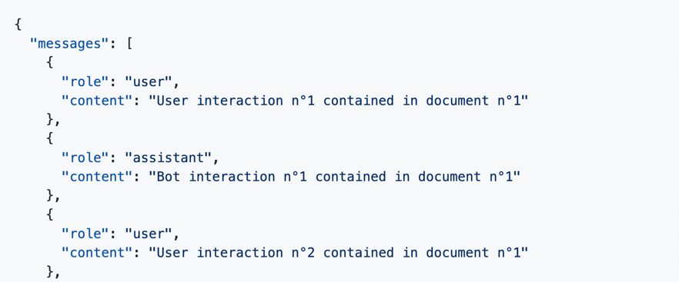
Training text
Raw (pre-training): → 122M tokens on 10k orkl.eu texts
{"text": "Text contained in document n°1"}
{"text": "Text contained in document n°2"}
Instruct fine-tuning:

Slide 35
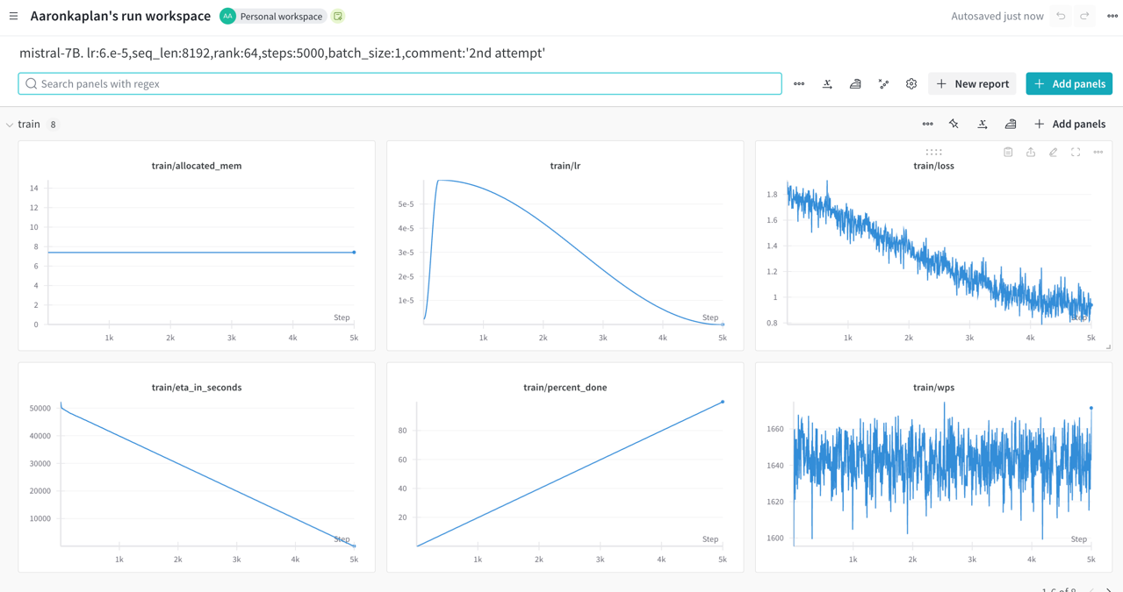

Slide 36
Status quo & Implications
Works very well with Mistral 7B
Next step: scale up to Mistral 70B (GPUs anyone?)
And then MiXtral 8x22B
Evaluate against the CTITools benchmark

Slide 37
Integration into MISP

Slide 38
Objectives
Want to have a generic and standardized RESTful API interface so that
We can talk with a local LLM
… also with a remote LLM (openAI, openAI vs. Azure, Anthropic (Claude), …)
Enforcing a consistent answer format (JSON)
Example: unstructured info into LLM → JSON out
Ensuring the analyst flow in the MISP platform and integration with the MISP event reports format

Slide 39
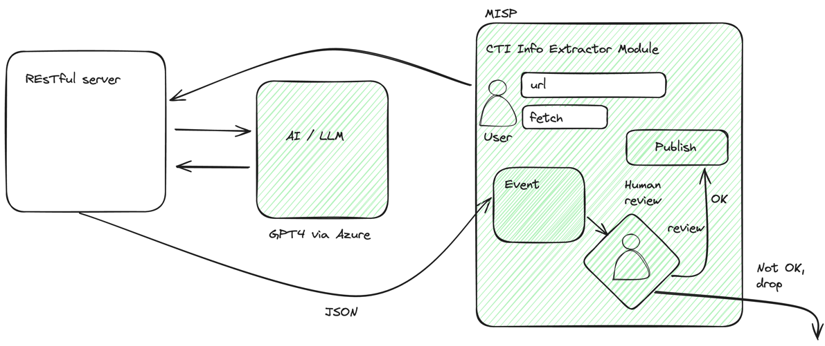
First integration with MISP

Slide 40
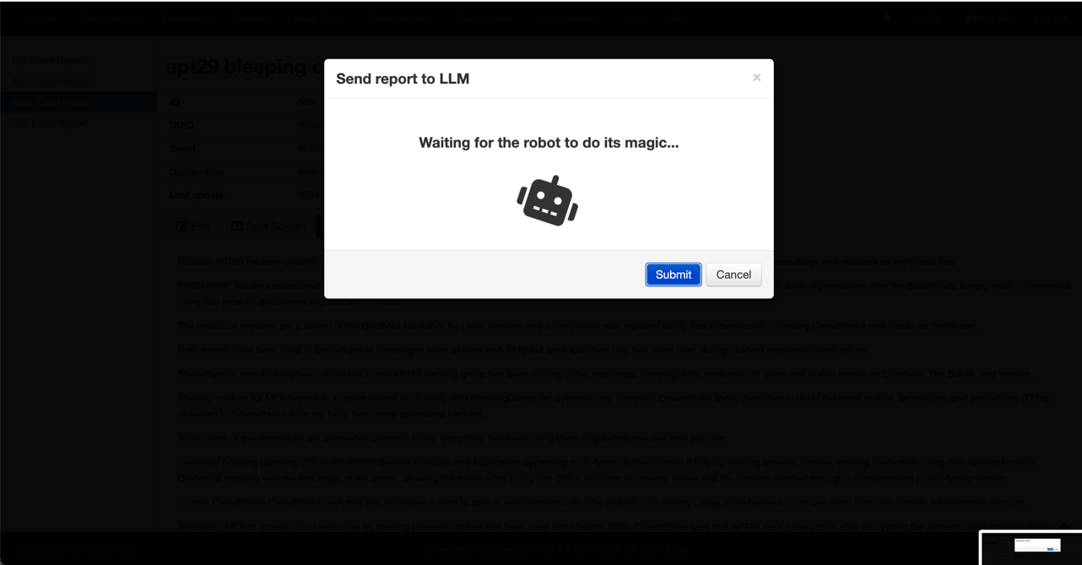
Send the report to the LLM

Slide 41
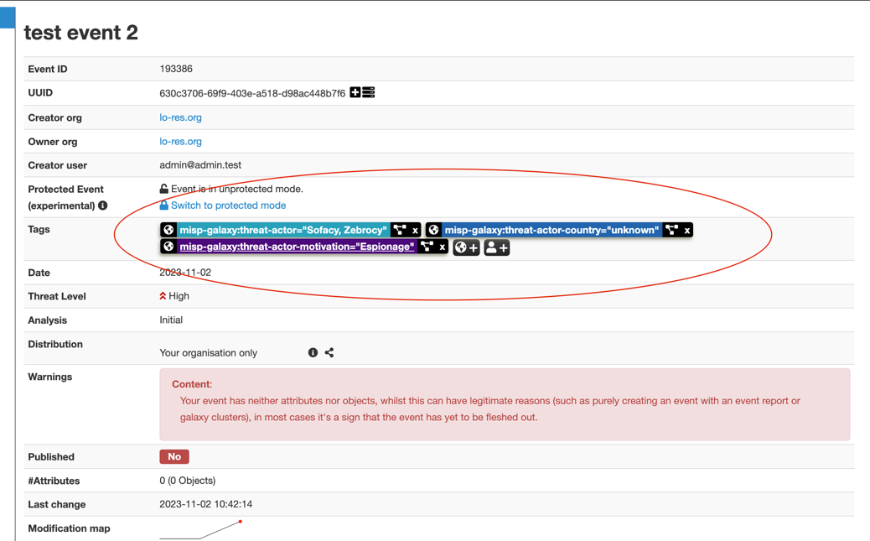
Voila! Context and tags

Slide 42
Call for action
We released benchmark data + models + code
Great help: GPUs, please! Need it for Mixtral training
And: your participation / expert knowledge
Participate in https://cti.tools
Documentation + Code: https://github.com/ctitools
Dataset: https://huggingface.co/datasets/ctitools/orkl-cleaned-small
Models: https://huggingface.co/ctitools
ALL MODELS, DATASETS, tools open source and reproducible!

Slide 43
Thank you!
Aaron Kaplan
Email: aaron@lo-res.org
Twitter/X: @_aaron_kaplan_
Mastodon: aaronkaplan@infosec.exchange

