Slide 1
Operationalization of Sigma Rules with Processing Pipelines
2024-10-22
Thomas Patzke

Slide 2
Agenda
Introduction: What & Why?
Setting up Prerequisites
Mapping Field Names
Value Transformations
Add Conditions
Placeholders
Embedding Queries into Structures
Q&A
Prerequisites:
Python 3.9 to 3.12
Sigma CLI: sigma-cli on PyPI
Install sigma-cli. Recommendation: separate Python virtual environment or pipx pipx install sigma-cli
Clone of the Sigma workshop repository: git clone https://github.com/SigmaHQ/sigma.git
Clone of the workshop repository: https://github.com/thomaspatzke/sigma-workshop-operationalization
Notes:
- Introduce yourself!
- Tell that this is a complete new workshop with the new toolchain.
- Ask who uses Sigma

Slide 3
Introduction: Motivation
Goal: utilize the SigmaHQ Sigma rule repository (or another one) to detect threats.
Sigma rules must be converted into the query language of your SIEM.
Challenges:
Field names in Sigma rules are different than in your SIEM or data model:
CommandLine
process
process.command_line
Values differ too:
C:\Windows\System32\cmd.exe
\Device\Harddiskvolume3\Windows\System32\cmd.exe
cmd.exe

Slide 4
Introduction: Advanced Use Cases
Additional conditions, often search restrictions to increase performance
index=windows-logs
Placeholders, e.g. domain controllers, vulnerability scanners etc.
Stored as list that should be integrated into query.
Dynamic via lookup in SIEM
Data structures for bulk import of rules or other purposes.
Splunk savedsearches.conf
Elastic NDJSON exports
Documentation
All these use cases don’t require to touch the Sigma rules, everything can be done with processing pipelines!

Slide 5
Prerequisites
You need:
Python 3.9 to 3.12
Sigma CLI: sigma-cli on PyPI
Install sigma-cli. Recommendation: separate Python virtual environment or pipx pipx install sigma-cli
Clone of the Sigma workshop repository: git clone https://github.com/SigmaHQ/sigma.git
Use it as working directory, all paths in the slides are relative to this repos root directory.
Clone of the workshop repository: https://github.com/thomaspatzke/sigma-workshop-operationalization
Notes:
Hint participants to open the workshop repo from the link, the prerequisites are also contained in the readme.

Slide 6
Target Query Language & Data Model
I will show everything with Splunk and sometimes Elasticsearch, but the workshop is mostly query language-agnostic.
The target data model is hypothetical. It’s chosen to show as much features as possible. Nevertheless, there are parallels to real existing data models.
If you want to “just follow”: sigma plugin install splunk elasticsearch
Feel free to use your favorite query language or some real challenges!

Slide 7
First Conversion
Let's start to convert a Sigma rule into a query.
Sigma rule: rules\windows\process_creation\proc_creation_win_rundll32_obfuscated_ordinal_call.yml
Command: sigma convert -t splunk --without-pipeline rules\windows\process_creation\proc_creation_win_rundll32_obfuscated_ordinal_call.yml

Slide 8
Conversion Result
Image="*\\rundll32.exe" OR OriginalFileName="RUNDLL32.EXE" OR CommandLine="*rundll32*" CommandLine IN ("*#+*", "*#-*")
In our target data model:
The field Image is named ImageFileName.
As the field name says, ImageFileName doesn’t contains a path but just the file name.
There’s no OriginalFileName field.

Slide 9
Writing a Processing Pipeline
Metadata
Field Mapping Transformation
Drop detection transformation
Field name condition restricts it to the defined field.
Value replacement path to file name:
Transformation with pattern & replacement
Restrict transformation to defined field.

Slide 10
Applying the First Pipeline
Command: sigma convert -t splunk -p pipeline-1.yml rules\windows\process_creation\proc_creation_win_rundll32_obfuscated_ordinal_call.yml
Result: ImageFileName="rundll32.exe" OR CommandLine="*rundll32*" CommandLine IN ("*#+*", "*#-*")
Just to Compare, the previous result: Image="*\\rundll32.exe" OR OriginalFileName="RUNDLL32.EXE" OR CommandLine="*rundll32*" CommandLine IN ("*#+*", "*#-*")

Slide 11
Fields & Values: Hints & Caveats
Caveat: removing detection items changes the detection logic!
If it removes an essential part this can result in a useless detection with many hits. Don’t use rule then (or try to improve it).
Here it was the original file name one of various attributes to identify the file.
Fields can be mapped 1:n results in OR-ing all fields.
Useful in migration scenarios between data models.

Slide 12
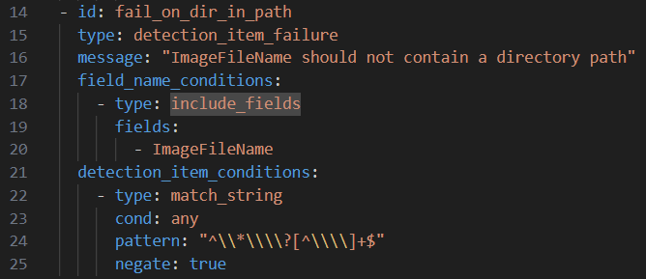
Controlled Failure
What’s if path also specifies directories and can’t be mapped to the data model?
Fail! It’s important that no detection query is emitted that is not functional. This gives a false sense of security.
Try it: sigma convert -t splunk -p pipeline-2.yml sigma\rules\windows\process_creation\proc_creation_win_appvlp_uncommon_child_process.yml

Slide 13
Rule Conditions
There’s another type of condition: rule conditions
Use Cases:
Restricting to log sources
Match on rule tags and (custom) attributes
Check existence of field or detection item on rule level.
Evaluation of conditions
Rule conditions: always, once for every rule
Detection item conditions: only for detection item transformations, once for every detection item
Field name conditions: additionally on field name list items of Sigma rule
Example: detection_item_failure vs rule_failure
Notes:
Example: replace detection_item_failure with rule_failure in pipeline-2 shows the effect. Rule_failure will always fail because no conditions are evaluated and it’s applied everywhere.

Slide 14
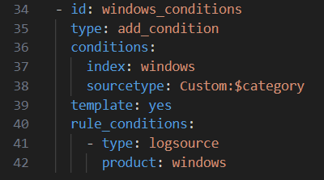
Add Conditions
Always searching everywhere isn’t efficient.
Example: searching Windows process creation events in Linux logs.
Solution: add conditions based on log source.
Example:
All logs are contained in the index windows (index=windows)
The sourcetype is corresponds to the category: sourcetype=Custom:<Sigma rule category>

Slide 15
Placeholders
Sigma supports %placeholders%
There are different possibilities to handle placeholders:
Replace with a value or a list of values (value_placeholders)
Replace with a query expression, e.g. lookup (query_expression_placeholders)
Ignore them by replacing with * as last resort (wildcard_placeholders)
Try it with: rules-placeholder\windows\process_creation\proc_creation_win_userdomain_variable_enumeration.yml
Notes:
Show that placeholders need some treatment, else the conversion fails.
Wildcard
Add value list before
Replace list with query expression transformation (only if time not escalated) – requires deletion of contains modifier

Slide 16
Query Postprocessing & Finalization: Generating Importable Output
Convert all process creation rules: sigma convert -t splunk -p pipeline-4.yml –s rules\windows\process_creation
It’s just a collection of queries, you can just copy&paste.
SIEMs usually have a data format to import queries:
Splunk: savedsearches.conf
Elasticsearch: NDJSON import
There’s a savedsearches output format in the Splunk backend, but it lacks flexibility.

Slide 17
Query Postprocessing & Finalization: Embedding Query in Use Case Framework
Usually, detections are embedded in some use case framework:
Results are enriched with detection information, e.g. rule metadata.
Results are written to an index or sent to other system (e.g. ticketing, SOAR) via API.
Different scheduling parameters depending on log source:
Near real-time search for real-time logs.
Query delay for logs ingested in batches.

Slide 18
Example: Splunk savedsearches.conf
Put query into structure
Extend query by enrichment & storage in notable events index
Prefix output with some defaults.

Slide 19
Recap: What have learned
Mapping field names
Transforming values
Fail if something is not possible
Adding conditions
Field name, detection item and rule conditions/transformations
Placeholders: make detections flexible
Post-processing and finalization: embedding generated queries into data structures

Slide 20
But there’s more…
Transformations:
Adding/removing/changing field lists ((add|change|remove)_field)
Mapping strings with a source/target value dictionary (map_string)
Stateful pipelines (set_state)
Nesting of multiple processing item in pipeline (nest)
Conditions:
Check processing state (processing_state)
Check if former transformation was applied (processing_item_applied)
Check if rule attribute is set to a value (rule_attribute)
Check for tags (tag)
…and many more!

Slide 21
Contact & Resources
thomas@patzke.org
Sigma Discord Documentation Sponsoring
Blog: Pipelines Blog: Post-Processing Blog: Placeholders

