Slide 1
Malware and Hunting for Persistence
How adversaries hacking your Windows?
Zhassulan Zhussupov aka @cocomelonc
Notes:
Thanks to the organizers for the invitation. This is only my second time in this wonderful country. Today I want to tell you a little about the persistence tricks that I discovered during my research.

Slide 2
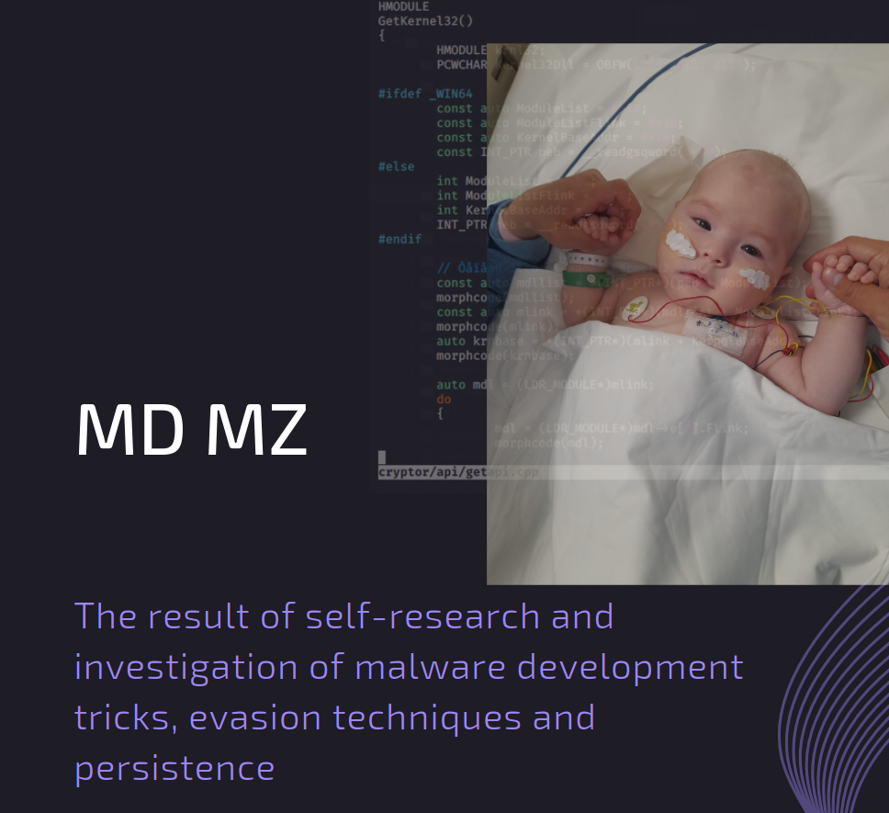
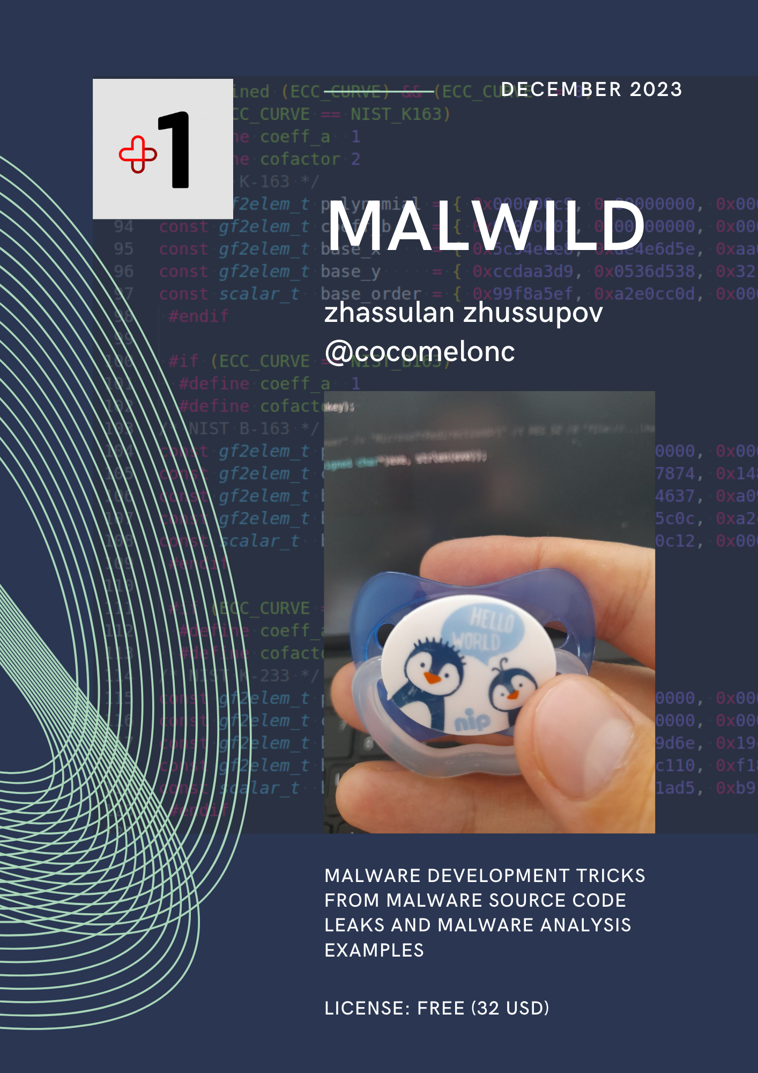
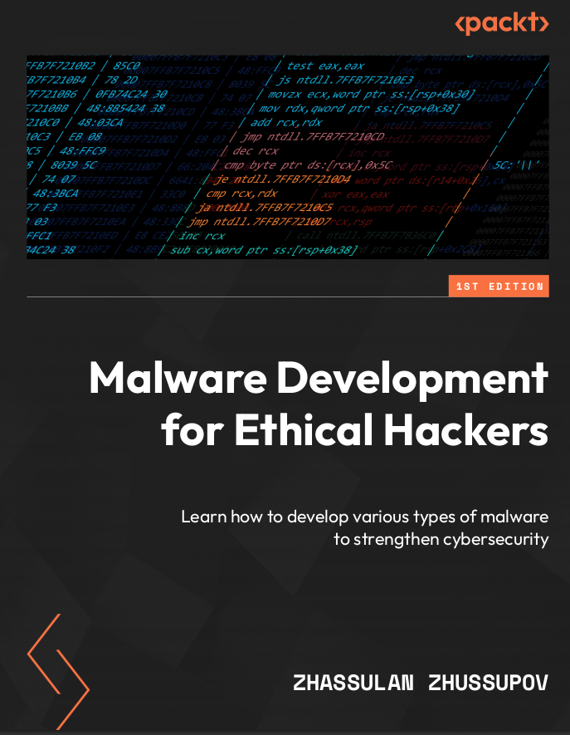
WHOAMI
@cocomelonc
Malware Analyst, Threat Hunter MSSP.GROUP
Cybersecurity enthusiast, BJJ practitioner
MALPEDIA project contributor
Author of MD MZ book (2022)
Author of MALWILD book (2023)
Malware Dev for Ethical Hackers (2024)
https://github.com/cocomelonc/
https://cocomelonc.github.io/
Speaker at Black Hat, DEFCON, BSides etc.
Notes:
My goal is to openly share knowledge, improving the quality of knowledge and general awareness, while providing the opportunity to remain oneself on the path of personal and universal improvement.
A few words about myself: I am the author of three popular and interesting books. Perhaps many of you have read or heard about them.

Slide 3
AGENDA
“Classic” persistence
Windows Cryptography
Hacking Process Hacker 2
Techniques, tricks and Windows Registry
Cryptography and persistence
Interesting persistence case and PoC
Notes:
We know that the stealth factor of malware increases significantly by achieving persistence on the infiltrated system. It allows the malware to continue its operations even after restarts, logoffs, reboots, some types of forensics etc., following a single injection/exploit.
I will only show some non-standard cases and also tell how you can abuse the cryptographic functions of the Windows Internals and also the Process Hacker 2.

Slide 4
persistence examples
Abusing Windows Registry and apps

Slide 5
Malware Techniques
Injection and code execution, obfuscation, C2 encryption
Bypass sandboxes, AV/EDR evasion, anti-analysis tricks
Malware persistence techniques!!!
Notes:
We know interesting tricks in malware development that are used in red team operations and pentests and also by cybercriminals. This techniques include injection and code execution tricks, obfuscation and payload or C2 communication encryption. Bypass sandboxes, AV/EDR evasion, anti-analysis tricks.
Malware persistence techniques.

Slide 6
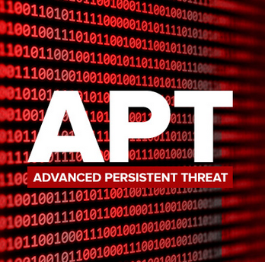
Malware Persistence
Persistence enables malware by allowing the malware to keep running
When a threat actor secretly maintains system access despite interruptions
Enables hackers who gain access into your environments to keep it
Notes:
There are some well-known persistence examples used by APT groups and cybercriminals. App Init DLLs, accessibility features, etc, but still the most popular and accessible is DLL hijacking as it is very difficult to guess and sometimes detect this method, because we don't know which application is being abused.

Slide 7
Persistence examples
used by various APT groups
App_Init DLLs
used by APT39
Accessibility Features
used by APT3, APT29, APT41
Alternate Data Streams
used by APT29, APT32, PowerDuke
Windows Services
used by APT38, Carbanak
Winlogon Helper DLL
used by Turla, Gazer, Bazar
DLL hijacking !!!
used by everyone
Notes:
There are some well-known persistence examples used by APT groups and cybercriminals. App Init DLLs, accessibility features, etc, but still the most popular and accessible is DLL hijacking as it is very difficult to guess and sometimes detect this method, because we don't know which application is being abused.

Slide 8
Hunting
APT?
“Classic”
easily reimplemented and researched
well-known and used by APT
Hunting for persistence
Hunting for persistence ?
Using procmon, is it really possible to find new methods? let’s try to investigate Windows Registry …..

Slide 9
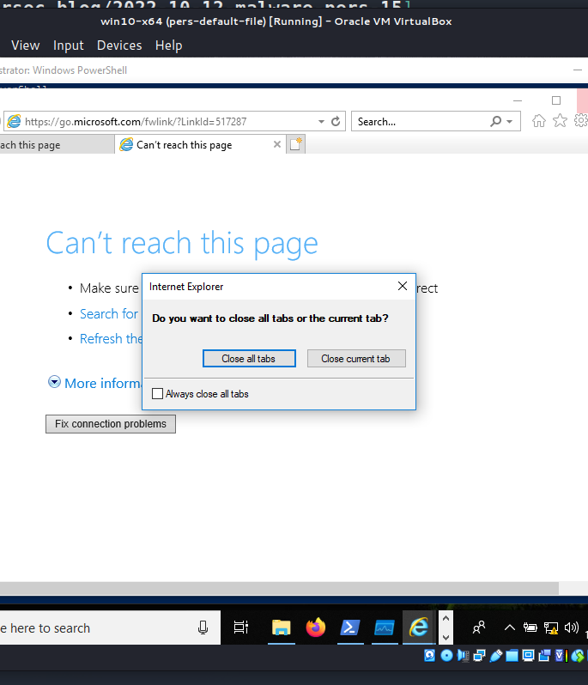
Internet explorer case
Persistence via DLL hijacking vulnerability, found via Procmon (windows Sysinternals suite)
Vulnerable DLL - suspend.dll, this DLL is used by Internet Explorer only, malicious DLL will launch anytime user starts IE.
Proof of Concept - worked on Windows 10 x64, Windows 11 x64, IE work correctly, not crashed.
Notes:
Many of you may argue that no one uses Internet Explorer anymore but as practice shows it still works and also works for Microsoft Edge.

Slide 10
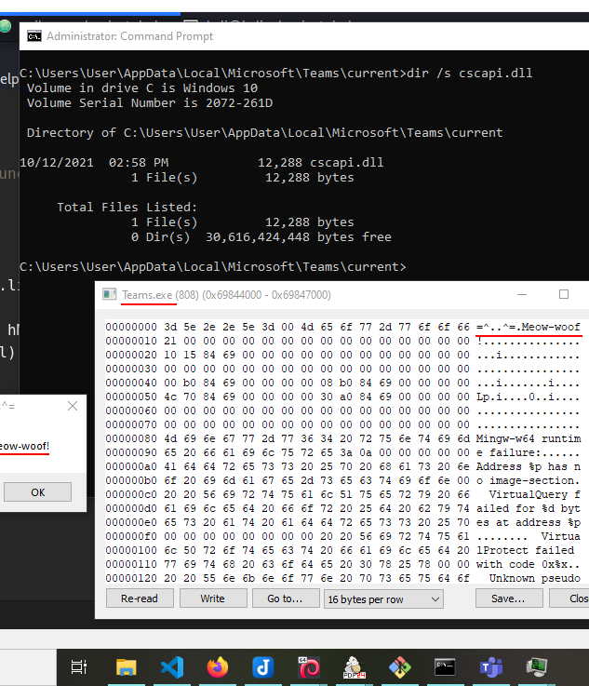
Microsoft Teams case (2022)
Persistence via DLL hijacking vulnerability, found via Procmon (windows Sysinternals suite)
Vulnerable DLL - cscapi.dll, in Microsoft Teams v.1.3.00.24758, was found when searching for the library.
PoC - worked on Windows 10 x64, 11 x64, if performing some cryptographic operations at the background but sometimes OS freezed
Notes:
The process Teams.exe is missing several DLLs which possibly can be used for DLL hijacking. For example cscapi.dll

Slide 11
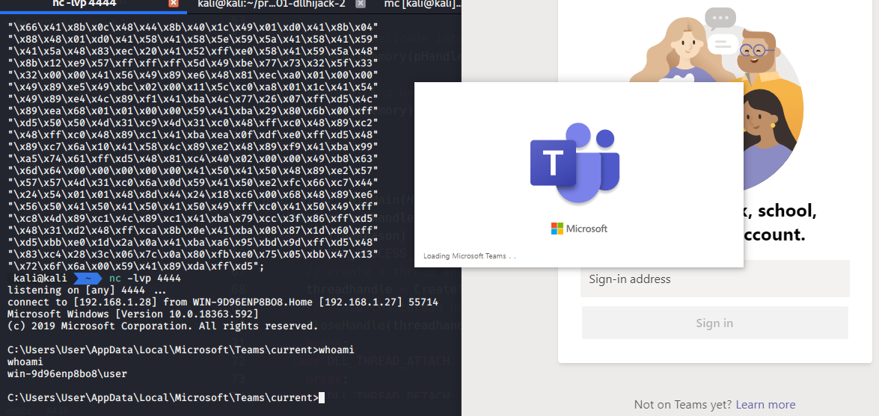
Microsoft Teams case (2022)
Notes:
Microsoft Teams will continue working as normal without any crashes!

Slide 12
Windows Error Reporting case (2023)
WerFault.exe -pr <value>
- This command run WerFault.exe on mode which is called “reflective debugger”
Notes:
If we run command
```powershell
WerFault.exe -pr <value>
```
it is read `HKLM\Software\Microsoft\Windows\Windows Error Reporting\Hangs\ReflectDebugger=<path_value>`.
This command run `WerFault.exe` on mode which is called "reflective debugger" and it is very interesting.
The good news for us that `WerFault.exe` not only read this value but also run it. And of course we can use it for persistence.

Slide 13
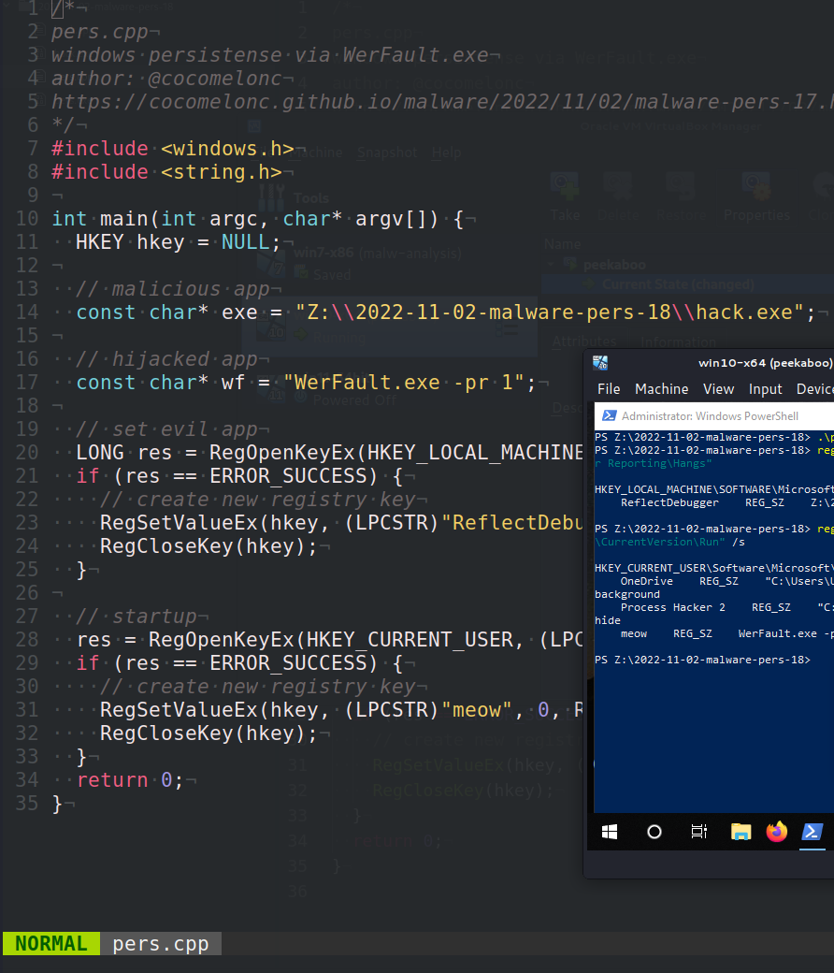
Windows Error Reporting case (2023)
Persistence via Registry path: HKLM\SOFTWARE\Microsoft\Windows\Windows Error Reporting\Hangs
“Vulnerable” DLL - WerFault.exe not only read this value but also run it. And of course we can use it for persistence.
PoC - worked on Windows 10 x64, not worked on 11 x64, admin privileges required for hijacking Windows Error Reporting

Slide 14
winapi cryptography
Abusing Windows Cryptography for persistence

Slide 15
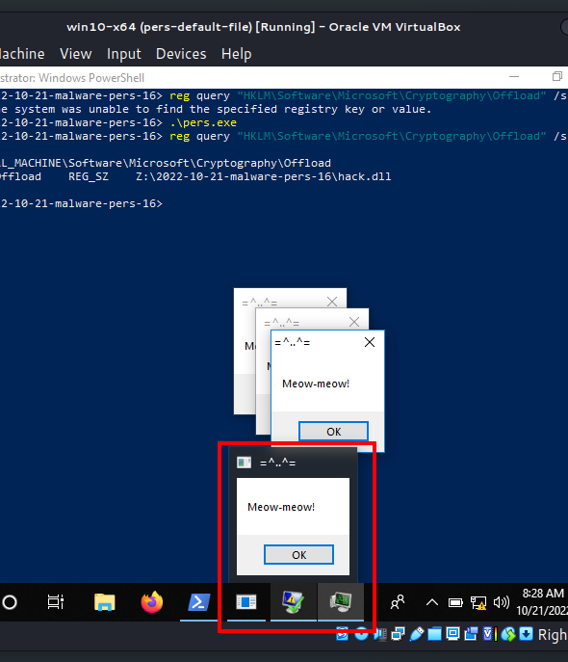
Windows Cryptography case 1
Persistence via investigating Registry HKLM\Software\Microsoft
\Cryptography\
DLL in Registry -: HKLM\Software\
Microsoft\Cryptography\Offload and key value (OffloadModExpo)
Proof of Concept - worked on Windows 10 x64, Windows 11 x64, if performing some cryptographic operations at the background
Notes:
In the course of studying the registry, I came across an interesting path:
```bash
HKLM\Software\Microsoft\Cryptography\
```
And there is a such function `OffloadModExpo`. If I understand correctly, this function is used to perform all modular exponentiations for both public and private key operations.
I didn't go into too much detail, the very opportunity to experiment with this key and value in the Windows registry is enough for me. So, I tried to hijacking this DLL path.
But the caveat is that the entire operating system froze after this and even the antivirus started freeze.

Slide 16
Windows Cryptography case 2
Persistence via investigating Registry HKLM\Software\Microsoft
\Cryptography\
DLL in Registry -: Microsoft Enhanced RSA and AES Cryptographic Provider
and key value (ImagePath)
PoC - worked on Windows 10 x64, 11 x64, if performing some cryptographic operations at the background but sometimes OS freezed

Slide 17
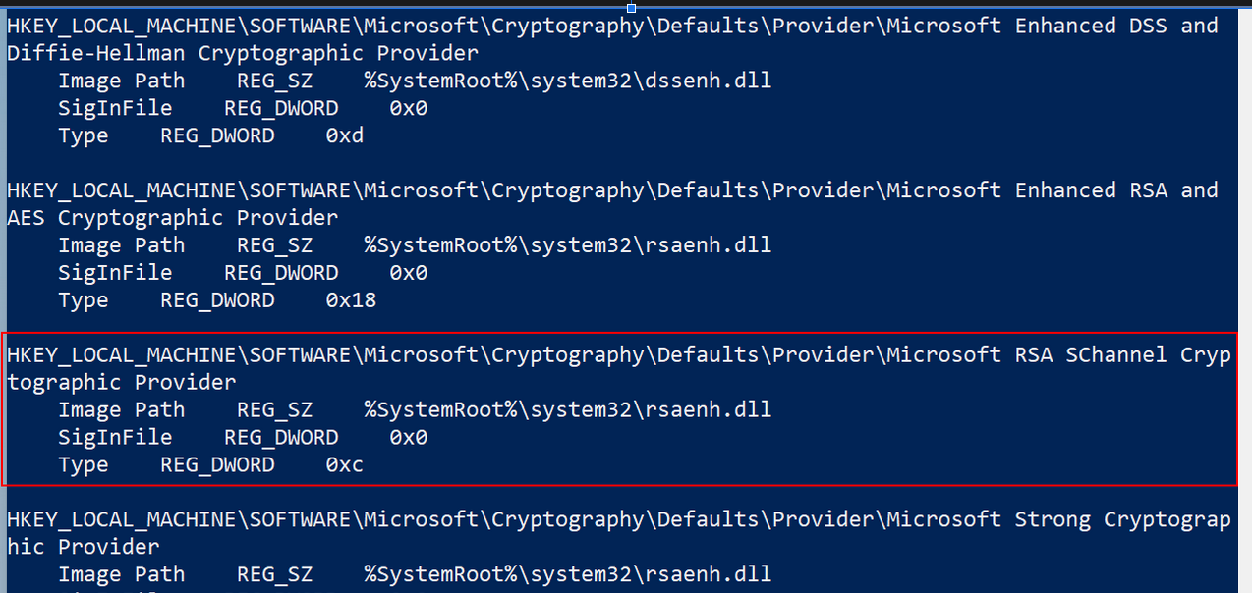
Windows Cryptography case 2

Slide 18
Process Hacker 2
Abusing Process Hacker 2 and PoC

Slide 19
Hunting Persistence
Windows malware persistence hunting research: I researched various registry keys and found many interesting features in the internal structure of the Windows OS and software

Slide 20
Process Hacker 2 structure
phnt - NT system calls and structures
phlib - algorithms implementation and interface functions
plugins - plugins for interaction with Process Hacker 2
external - various functionalities from UI to system operations

Slide 21
MD5 and SHA-1? (cryptography)
AVL-tree and json-wrap? (data structures)
Process Hacker 2 challenges
Calling convention issues - In Process Hacker sources some functions have the calling convention __stdcall (example: PhOpenProcess, PhOpenProcessToken)
Crashing during Reverse engineering
- crashes appeared only on x86, on x64 everything was ok
Own implementation of algorithms/ structures - many re-implementations of known data structures and algorithms were found (like: md5, sha AVL-tree, json-wrap)

Slide 22
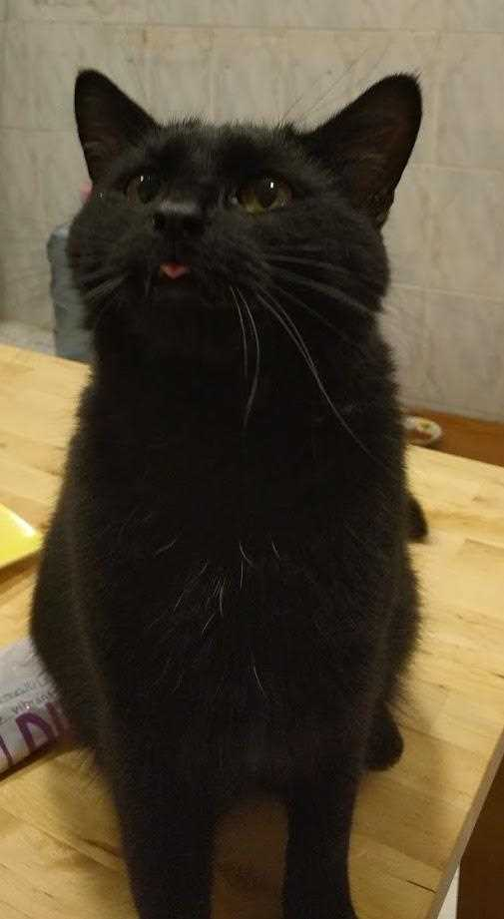
Process Hacker 2 vulnerability
PhLoadLibrary - prevents the loader from searching in an unsafe order by first requiring the loader try to load and resolve through System32. Then upping the loading flags until the library is loaded.

Slide 23
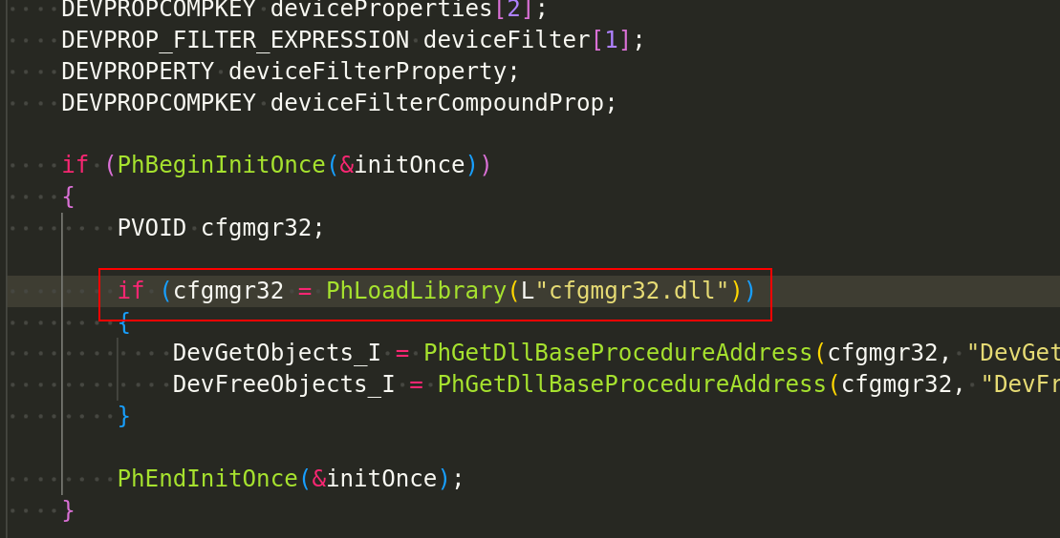
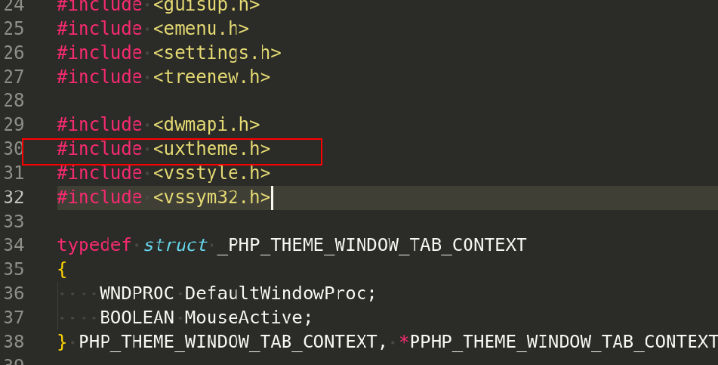
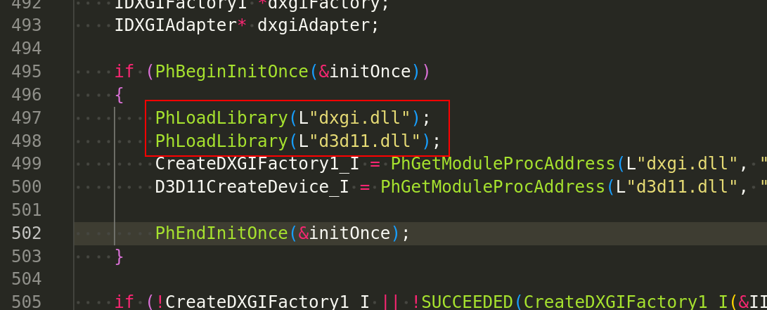
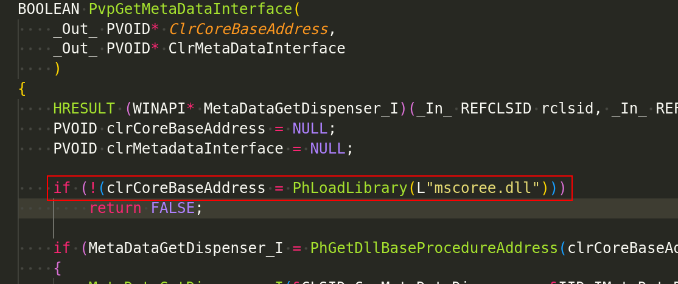
Process Hacker 2 vulnerability
Hypothesis! - In Process Hacker sources, calls to these functions have potential DLL hijacking vulnerabilities.

Slide 24
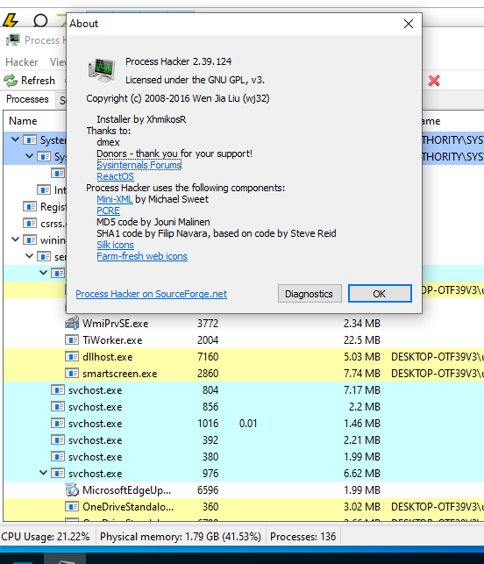
Process Hacker 2 vulnerability
Investigation - Process Hacker 2 version investigation: looks like vulnerable versions from 2.37 to 2.39.124

Slide 25
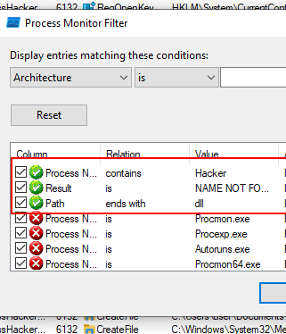
Process Hacker 2 vulnerability
Set filters on Procmon from Microsoft Sysinternals:
Process Name contains ProcessHacker
Result is NAME NOT FOUND
Path ends with .dll

Slide 26
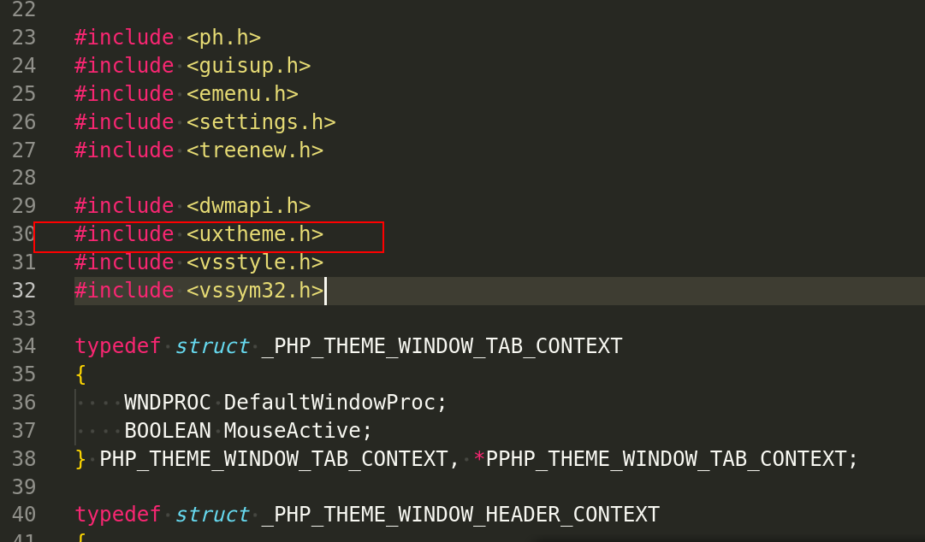
Process Hacker 2 vulnerability
Result - ProcessHacker.exe is missing several DLLs which possibly can be used for DLL hijacking:
UxTheme.dll????

Slide 27
Process Hacker 2 vulnerability
Investigation - Then, let’s go to move C:\ and search legit DLL:
dir /b /s UxTheme.dll

Slide 28
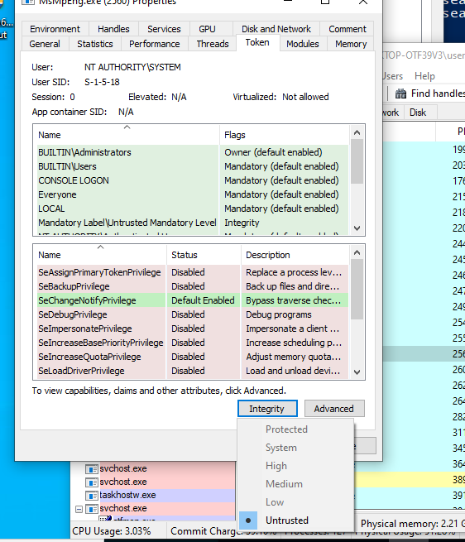
Process Hacker 2 Proof of Concept
Enable the SeDebugPrivilege in our process security token.
Get a handle to Defender using PROCESS_QUERY_LIMITED_INFORMATION.
Get a handle to the Defender token using TOKEN_ALL_ACCESS.
Disable all privileges in the token using SetPrivilege
Set the Defender token Integrity level to Untrusted.

Slide 29
PoC
demo
https://cocomelonc.github.io
cocomelonckz

Slide 30
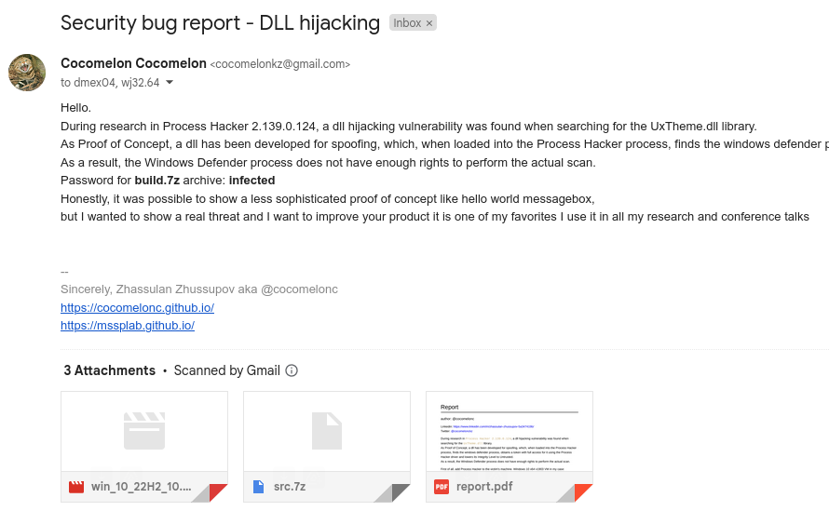
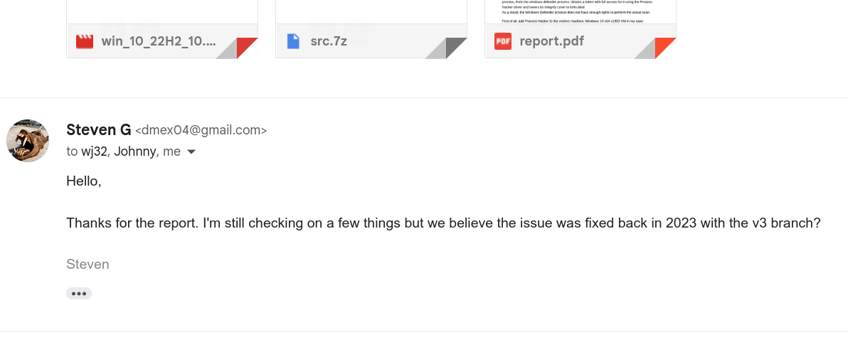
Process Hacker 2 security bug report
In February 2024 I sent a bug report to the authors of the Process Hacker 2 with PoC
Answer: We believe the issue
was fixed back in 2023 with the v3 branch

Slide 31
Summary
Everything is very bad but there is a trick!
deep dive into Windows internals ?
DLL hijacking, meow…
maybe try to do reverse/find srcs!
01
Windows internals
Analysing registry and reveng soft - potential options for persistence
02
DLL ”hijacking”
still can used for finding and achieving persistence
03
A lot of work
more complex mechanisms need to be researched and tested

Slide 32
Malware Development Book
Malware Development for Ethical Hackers
The logic of real malware developers
Malware evolution over the years with examples.
Understanding the process of reconstructing APT attacks and their methods
More than 80 practical examples

Slide 33
Thank you!
https://cocomelonc.github.io
cocomelonckz

