Slide 1
About Me
Head of Appsec at JaJa Finance
I was a Java Developer for ~10 years prior to moving to AppSec
Been in Appsec for 6 years
@josephbeeton
Notes:
My name is Joe Beeton
I started out as a Java Developer I did that for 10 years.
But after a while building pretty much the same microservice again and again lost it’s appeal so I moved to AppSec about 5 years ago.

Slide 2
How it Started
Found two vulnerabilities in Togglz Web Console
CVE-2020-28192 XSS
CVE-2020-28191 CSRF
Notes:
So back in 2020 I found a couple of vulnerabilities in the togglz web console. a XSS and CSRF vulnerability.

Slide 3
Togglz
Open Source framework for creating Feature Toggles
Has several ways to enable/disable features
Percentage
By IP Range
Custom rules written in JS and executed on the Server
Notes:
The Feature Toggle design pattern enables a feature to be deployed to production turned off and then launched post deployment.
This launch can then be done based on certain rules
Percentage of requests get routed to the new functionality
Ip range
Username
Or Custom rules written in Javascript. The Javascript is executed in Java’s Nashorn Javascript engine and can call Java code.

Slide 4
Togglz
But how to exploit in the real world?
CSRF is interesting, but would need to know location of the Togglz web console.
As well as the Enum name of the toggle.
So realistically hard to do.
Notes:
So while I can execute code if I can access the console. CSRF allows that but hard to target
For example I knew the target user was logged in to a server with auth ( which the console should be in production ).
And I knew the name of the feature.
I could craft some sort of way to get that user to make the POST request to edit toggle and trigger a RCE.
But in reality this is hard to do.

Slide 5
Togglz
Worked with the Togglz team to fix.
But it kept bugging me.
Notes:
But I worked with the Togglz team to fix these issues, infact I implemented to CSRF fix myself.

Slide 6
Accessing Localhost
About the same time there was a paper on port scanning localhost and the internal network from Simple Requests using JS in the browser
As the result of the request could not be read by the JS. Open port detection was done by timing the response
Commonly used for fingerprinting users. ( eBay uses/used it )
Notes:
There was a paper on portscanning localhost / localnetwork by websites, the website was able to make a request to localhost, ignoring same origin policy
But with restrictions.
It turned out it was possible for Javascript in the browser to make requests to localhost or any other host on the user’s private network. With that Javascript loaded from a website. But with caveats.
The returned data cannot be read by the javascript
That includes HTTP status codes
But the Javascript can infer if the request was successful or not e.g something was running on that hostname/port by analysing the time it takes for the request to return.
There are other limitations.
So the port scanners cannot see the response, but can infer if a port is open by timing the response.

Slide 7
Limitations of Simple Requests
Can only be of type
              HEAD
              POST
              GET
        Content Type
          application/x-www-form-urlencoded
          multipart/form-data
          text/plain
          Null
          Other allowed headers
          Accept
          Accept-language
          Content-Language
          Range
          No returned data or HTTP Status Code
Notes:
So pretty limited
For content type. This can sometimes be fudged. While on the browser end, it will only allow you this., its quite strict. The webserver may be a bit more lax on checking content type.
Sometimes you can access endpoints that require a non supported content type by simply not specifying it. Either by not setting a Content-Type header or setting it to null.
This is especially true if you are making a POST request that doesn’t contain a message body.
For returned data. There is none. You can only infer based on timings or by other side effects.
( Like a RCE calling back to your server ).

Slide 8
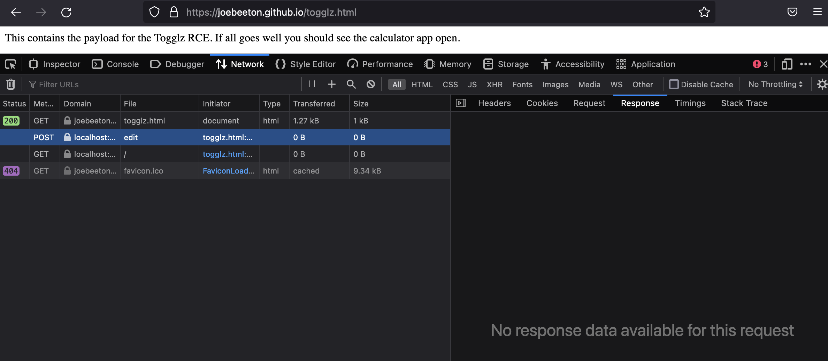
Limitations of Simple Requests

Slide 9

Accessing Localhost
Togglz Server
localhost:8080
localhost:8080/togglz-console/edit
localhost:8080/togglz-console/edit
HTTP OPTIONS
HTTP POST
evil.example.com
JS
HEADER : Access-Control-Allow-Origin: *
Response not readable by JS
localhost:8080/togglz-console/edit
HTTP POST
Notes:
Normal Requests trigger a preflight
And only if the proper CORS header is returned will the actual request be made.
But for simple requests. This doesn’t happen.

Slide 10
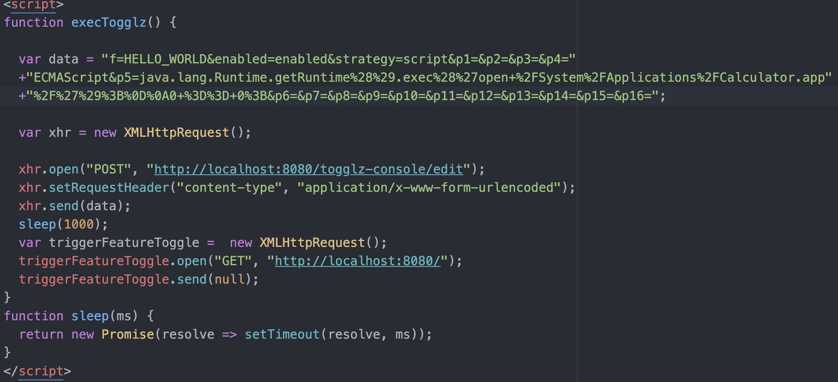
Togglz Localhost
Notes:
So it turns out the Togglz Web Console’s edit functionality could be triggered by a Simple Request.
So here it s.
Here I’m modifying the toggle use the Scripting functionality and then executing the Java code
Runtime.exec( “ open calculator.app ” )
Then making a get request to the root of localhost to trigger the toggle evaluation.

Slide 11
Togglz RCE Demo
Notes:
Spin up server
Go to console
http://localhost:8080/togglz-console/index
Go to https://joebeeton.github.io/
Go to togglz
Hit refresh
Shop calc pop.
Go back to view console.

Slide 12
Togglz Attack Limitations
Requires the attacker to be able to inject JS into a website that the developer is accessing
Requires knowledge of the name of one of the feature toggles.
This can be overcome by creating a tutorial website.
Or finding a way to inject a malicious advert into an already existing website.
Notes:
This still requires knowledge of the target. So useful in a spearfishing kind of attack where you know the developer is working on a project that is using this library and knows the name of a feature.
But there is another way. Which is what would happen if a developer was going through a tutorial website.
The developer will have that page open while running through the tutorial code.
The malicious javascript just has to sit there waiting until the developer spins up the demo app…

Slide 13
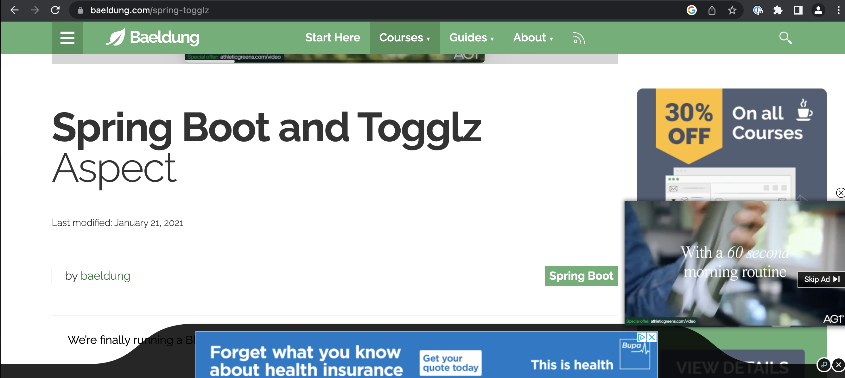
Togglz Attack Limitations
Notes:
Not that I did…

Slide 14

Actuators
Spring Actuators are used to expose information about a Spring application
Most are read only
/health ( health check endpoint )
/env ( list of environment variables, sometimes modifiable )
/trace ( lists the last n http request/responses from this server )
/heapdump ( a dump of the heap )
Some modify the application state
/env ( sometimes )
/restart
/reload
/shutdown
Notes:
Spring Actuators deserve a talk all by themselves.
They range from read only and usually harmless like /health or /info
To
/Restart
/env
/heapdump
/trace
There commonly used by developers to pull information out of the application.
Most shouldn’t be exposed in production, or indeed any environment.
But people assume if a service is bound to localhost it is inaccessible and so may well leave all actuators enabled.

Slide 15
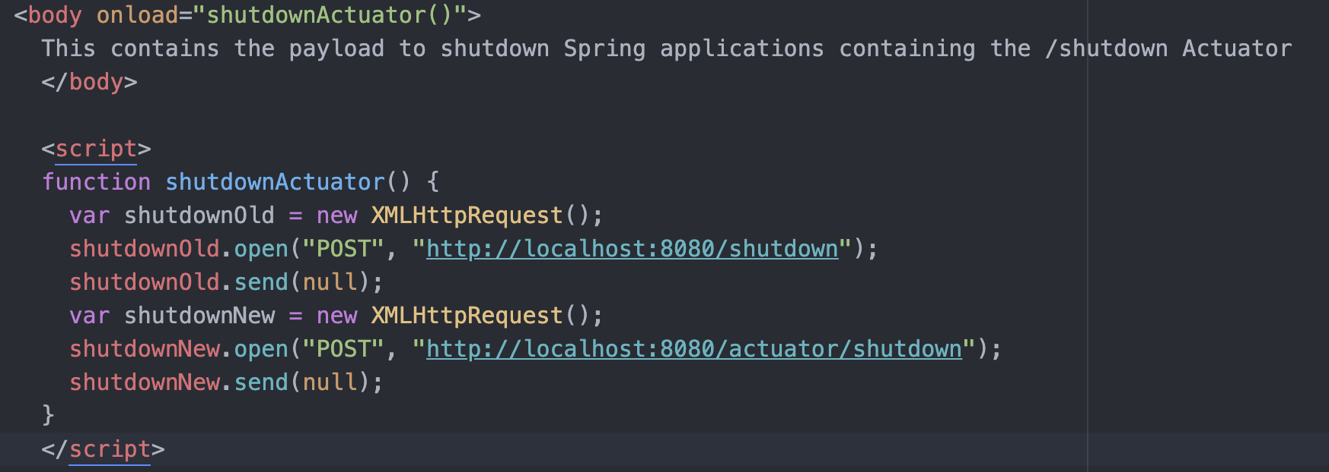
Shutdown
Notes:
Shutdown
Now this payload shows both the old location in Spring 1 and the location in spring 2. In spring 2 the actuators were moved to under a /actuator path.
Its very useful as the /actuator is a endpoint itself which tells you which actuators are enabled.
This works with the latest version of Spring. I did tell Pivotal ( now VMWare, Now Broadcom ) about this. But they didn’t think it was an issue. And unless you are viewing websites from your production server. They have a point. It’s only really useful for annoying developers.
Imagine the annoyance of a developer that happens to have a tab open to a website with the above payload. Configured to randomly shutdown your app. I think it would drive them crazy trying to work out what was happening.
There is also a restart actuator which the same issue. Not as annoying, but still would drive you crazy trying to work out what was happening.

Slide 16
Actuator RCE
Requires
Spring-Boot 1.x
Spring-Cloud-Dependencies
H2 Database
/env and /restart actuators enabled
Notes:
Spring Boot V1 actuators allowed content type of application/json or application/x-www-form-urlencoded.
Spring Boot V2 only supports application/json so it doesn’t work.
spring-cloud-dependencies provides the /env actuator the ability to modify env variables within the application.
/Restart is required to restart the app for those changes to take effect
Spring Boot 1.x was EOL 2019.

Slide 17
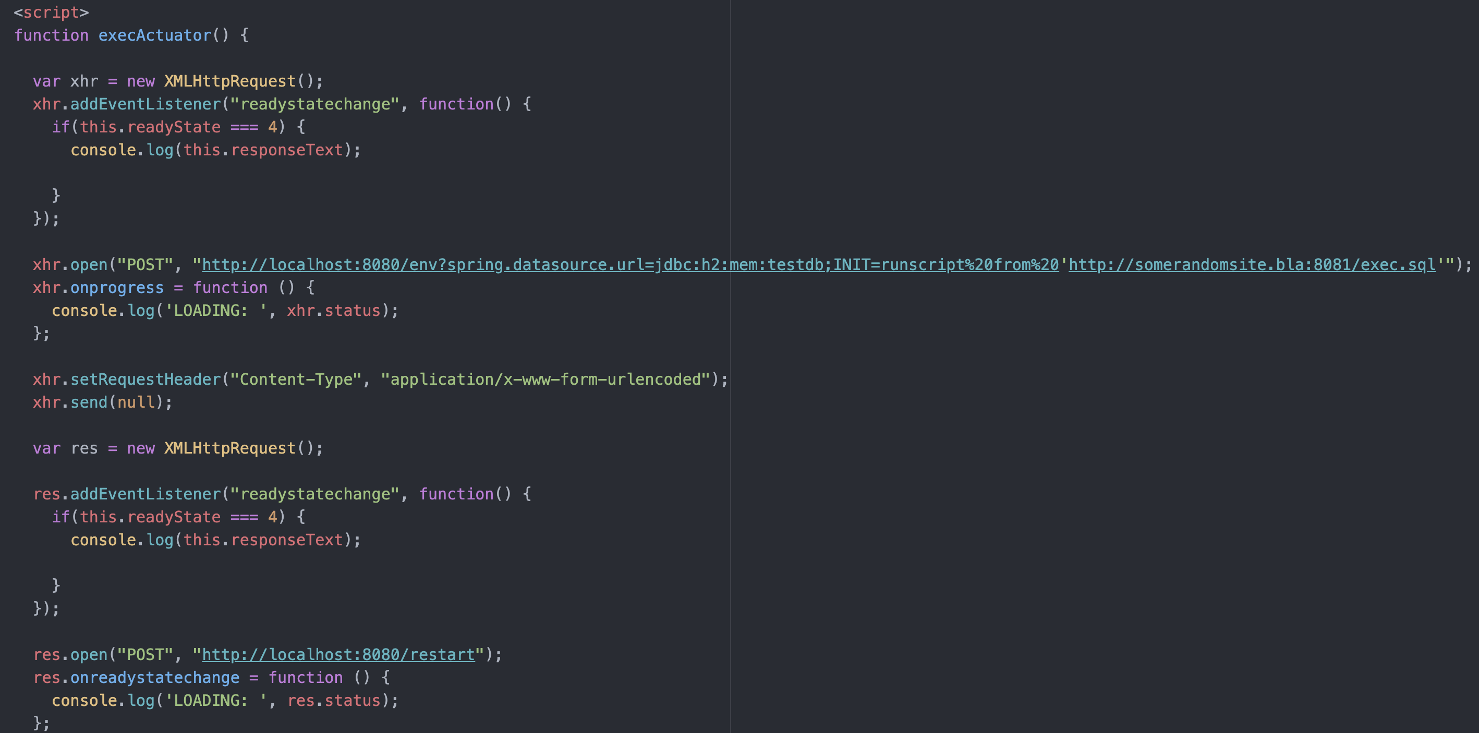
Actuator RCE
Notes:
So on page load we are doing the following.
Making a POST request to modify the spring.datasource.url to a in memory h2 database. The JDBC URL specifies a INIT flag where it will download and exec a sql script from the website.
Once this is modified a POST request to /restart is issued to reload the application so the change will take effect. On startup the JDBC connection will be made and the exec.sql will be downloaded and executed.

Slide 18
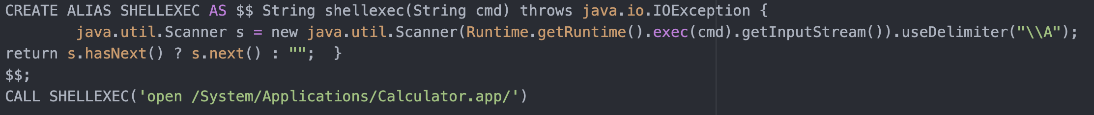
Actuator RCE
Notes:
This is the SQL that is executed.
The H2 database has a useful feature called ALIAS.
This can be used to compile and execute Java code.
So here we are creating a method in Java called shellexec() which takes a command as a argument and passes it to Runtime.exec().
The H2 Database is interesting. You may not have heard of it. It’s a in memory or file based Database. Not meant for production use. It’s mainly used in development and testing.

Slide 19
Demo
Notes:
Show actuator endpoints.
RCE
Shutdown

Slide 20

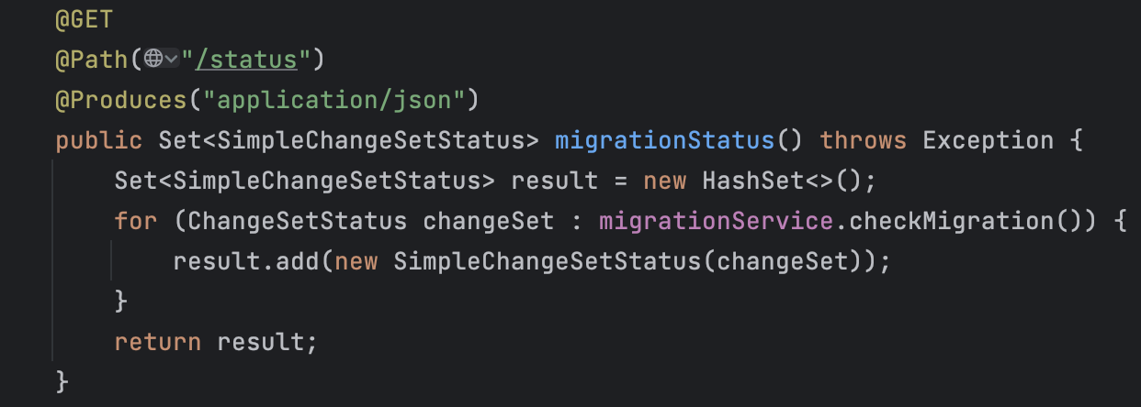
CVE-2022-4116
Spring Like Web Framework
Open Source
Owned by Redhat
Notes:
Quarkus is a Redhat owned OSS framework, similar to Spring but has a focus on applications built for running in a container.
So creates a small build artifact and fast start up times.
This is what it looks like in code.
Very similar to Spring, if you are familiar with that. You have HTTP endpoints specified by annotations, values passed into the http request.
Path pararms
Request params
http body
Are added as arguments to the method.

Slide 21
CVE-2022-4116
Has a Developer UI deployed when in Developer Mode
UI is under a fixed path of
http://localhost:8080/q/dev/io.quarkus.quarkus-vertx-http/config
Notes:
Quarkus has some useful features for developers.
When Quarkus is run in Developer mode. Features are enabled that are not available in production
Including a Dev UI
This UI amongst other things allows the developer to modify properties on the fly.
As it is designed to run on a developer’s machine, bound to localhost, the developers did not add any security around it.
Luckily for me. Property changes can be made via a POST request of type application/x-www-form-urlencoded. So again it is possible to attack the developer using Quarkus.

Slide 22
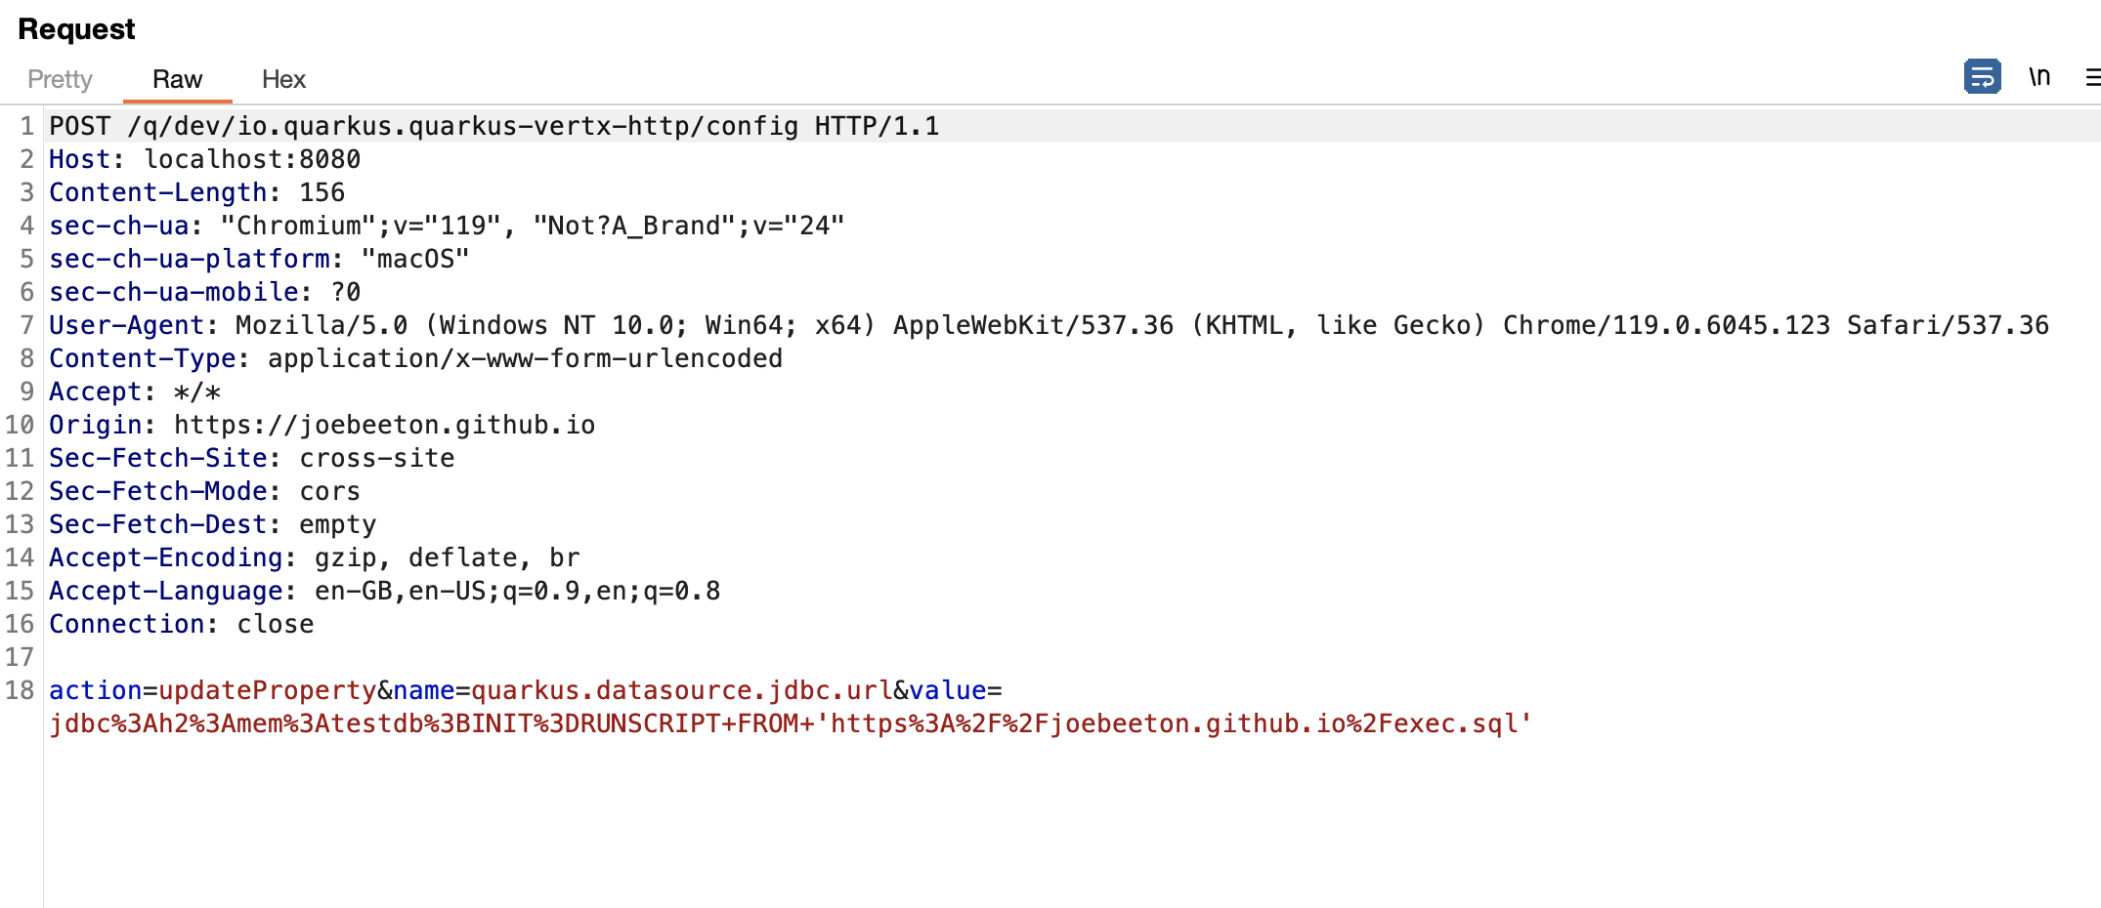
CVE-2022-4116
Notes:
Quarkus has some useful features for developers.
When Quarkus is run in Developer mode. Features are enabled that are not available in production
Including a Dev UI
This UI amongst other things allows the developer to modify properties on the fly.
As it is designed to run on a developer’s machine, bound to localhost, the developers did not add any security around it.
Luckily for me. Property changes can be made via a POST request of type application/x-www-form-urlencoded. So again it is possible to attack the developer using Quarkus.

Slide 23
Demo
Notes:
Show UI
Run Payload

Slide 24
CVE-2022-4116
Took a bit of convincing but eventually the Quarkus/Redhat security team understood the problem
Issued Fix in Quarkus 2.14.2
CVE-2022-4115 was given a CVSS score of 9.6!
Notes:
It took a bit of convincing to get the quarkus/redhat security team to understand the issue and take it seriously.
I think they were a bit confused as its not a normal class of vulnerability.
But once they understood and realised the severity of the issue, they quickly pushed out a fix.
The fix in the short term was to block all requests that did not contain a origin header of localhost.

Slide 25

CVE-2023-43472
Mlflow is a AI training tool written in python
Has a UI deployed to localhost under a path of
  http://127.0.0.1:5000/#/
Notes:
MLFlow Is a python framework for training ML models.

Slide 26
CVE-2023-43472
  Has a Web UI
  Has a REST API
  REST API uses JSON so shouldn’t be vulnerable
  But…

Slide 27
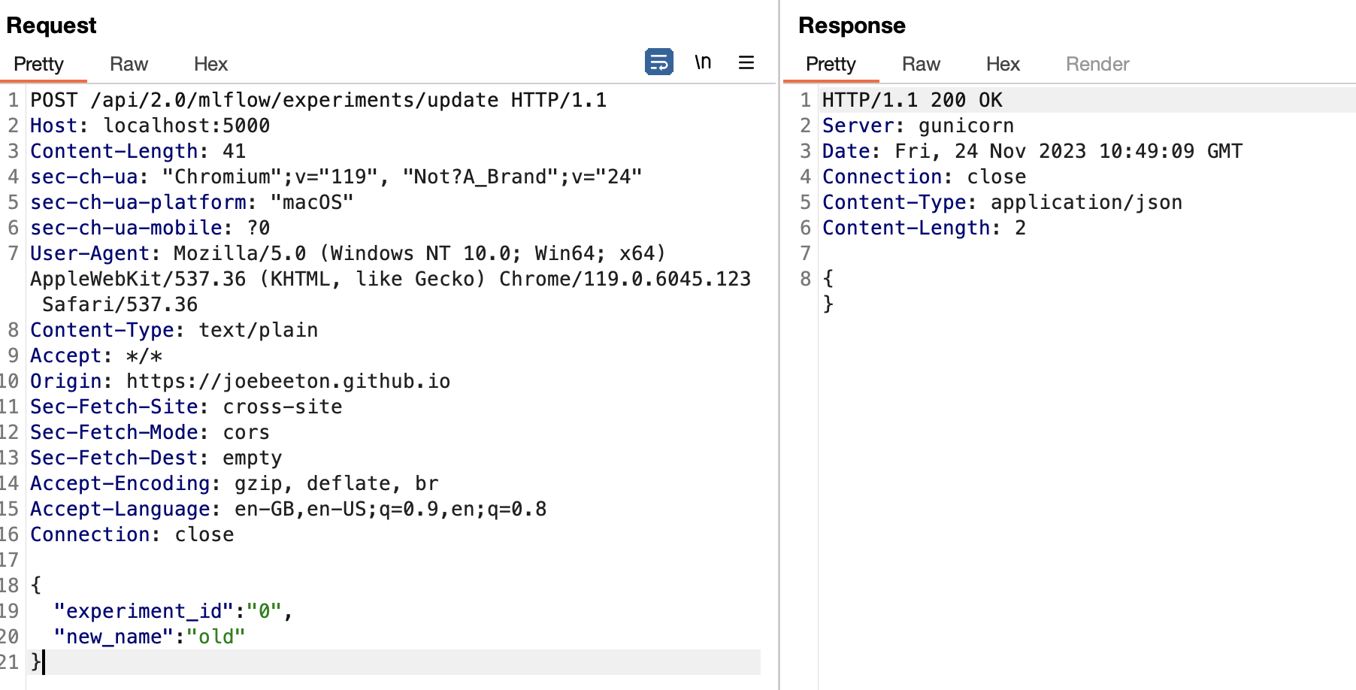
CVE-2023-43472
Notes:
While the api uses JSON, it doesn’t check the content type. So we can specify a content type of plain text. Then a json body.
What this is doing is changing the name of the Default experiment to ”old”

Slide 28
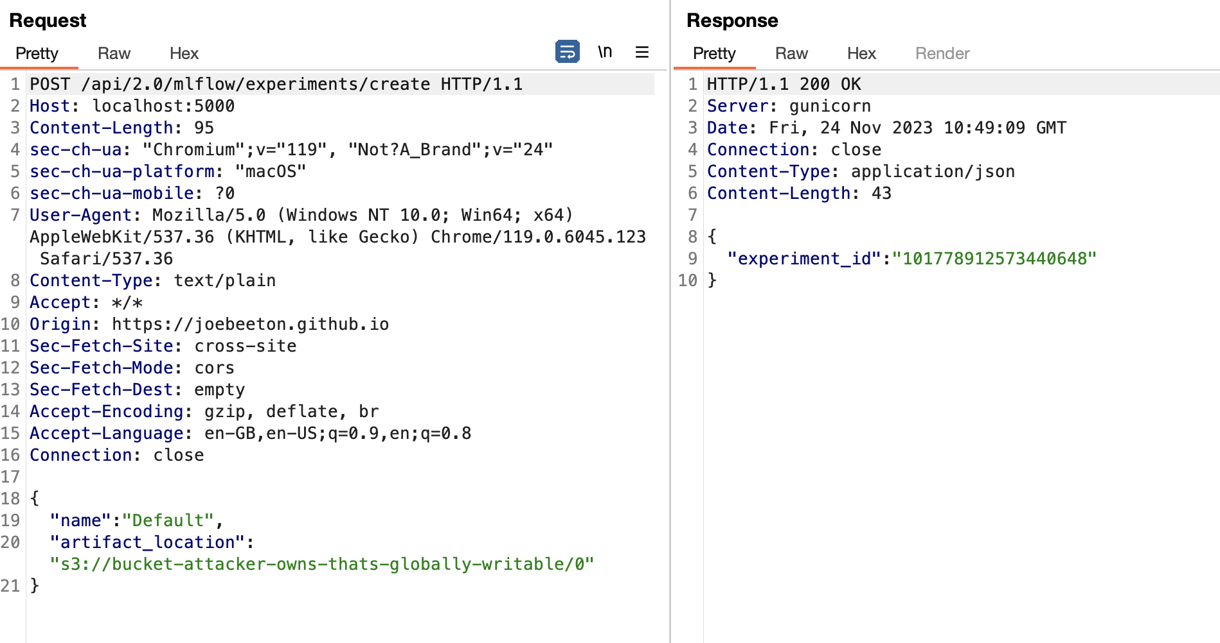
CVE-2023-43472
Notes:
Then we create a new default experiment which the original experiments name.

Slide 29
CVE-2023-43472
  The Attack renames the Default experiment to old
  Creates a new experiment named “Default”
  Sets Artifact Location where the model data will be saved to to a S3 bucket that you control.
  Set global read/write on the S3 bucket so mlflow can write to it
  Profit
Notes:
The actual set of APIs available is limited. Also this only works realistically with the the default experiment name. As we can’t know what other experiments the ML engineer used and you can modify using a the ID of the experiment. Which is normally a large number.
The Default is aways 0.

Slide 30
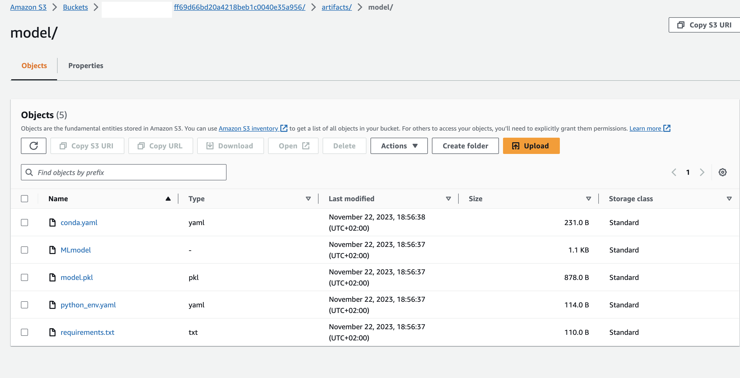
CVE-2023-43472
Notes:
Screenshot of the AWS S3 console showing the uploaded artifacts.

Slide 31


Notes:
MLFlow
This is a a new vulnerability, I originally found in late august/early September. And now being made public!
I reached out to MLFlow maintainers, got a reply saying they would look into it, but then.. Nothing.
I’ve tried to reach out to them both on the original github issue I opened and via their security email address. Not had any reply, I even told them on sept 5 I would be demoing it today.

Slide 32
  MCP is a Protocol created by Anthropic to allow LLM Agents to interact with resources
  There is a MCP Client that sits within the LLM Agent.
  The MCP Server is a service which provides the LLM with Resources.
  Communication can be done over HTTP SSE and utilizes JSON-RPC

Slide 33
MCP HTTP/SSE
LLM Agent
MCP Server
localhost:8080
/mcp/message?sessionID= 5ae352e7-18f9-4efe-a66f-10283f9e94a7
/sse
HTTP POST
HTTP GET
Connection Left Open
MCP Client
Content-Type: application/json
{
"jsonrpc": "2.0",
"id": 1,
"method": "tools/
call",
"params":
{
"tool": "write_file",
"arguments":
{
"path": "/tmp/file_to_write_to",
"content": "this is the content of the file"
}
}
{
"jsonrpc": "2.0",
"id": 1,
"method": "tools/
call",
“File Written OK”
}
id:5ae352e7-18f9-4efe-a66f-10283f9e94a7
event:endpoint
data:
/mcp/message
Notes:
Normal Requests trigger a preflight
And only if the proper CORS header is returned will the actual request be made.
But for simple requests. This doesn’t happen.

Slide 34

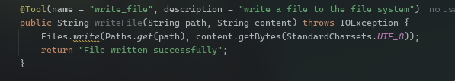
  Spring created the Spring-AI-MCP framework in collaboration with Anthropic
  It utilizes Anthropic’s Official Java MCP SDK

Slide 35
DEMO

Slide 36
An attack with a limited shelf life
Private Network Access ( CORS-RFC1918 )
Original attempt to fix this was W3C Spec on controlling access to Private Networks from Browsers
Designed to block access to internal or private IP ranges by resources loaded from the Internet
Will be implemented in Chrome 101, 109, 114, 117, ?
Notes:
Some protections against this attack are standard
Keep dependencies/services upto date.
CSRF Protection for endpoints
But the underlying issue is an attacker can hit localhost and that is something most people don’t realise. So they don’t build protections into services designed to just be bound to localhost.
However a solution is coming in the form of Private Network Access Spec from w3c
Its on the backlog for Firefox but nothing scheduled. I think they are waiting to see if this change causes problems for anyone in chrome/chromium before doing anything.
As this removes functionality that people may be relying on in certain edge cases.
I’ve not been able to find anything on Edge, but as edge is built on chromium it may get it at some point.

Slide 37
Private Network Access
Togglz Server
localhost:8080
localhost:8080/togglz-console/edit
HTTP OPTIONS
Access-Control-Request-Private-Network: true
evil.example.com
JS
HEADER : Access-Control-Allow-Private-Network: true
localhost:8080/togglz-console/edit
HTTP POST
Notes:
Simple Requests trigger a preflight
But where a request originates from a less private network to a more private network. This will no longer be the case by default.
The least private is internet
Next is private network
Most private is localhost
How this works for IPV6 if that ever happens?

Slide 38
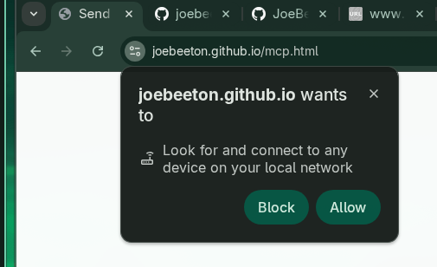
An attack with a limited shelf life
Local Network Access
Much simpler
Notifies the user when an attempt to access local resources
Notes:
Some protections against this attack are standard
Keep dependencies/services upto date.
CSRF Protection for endpoints
But the underlying issue is an attacker can hit localhost and that is something most people don’t realise. So they don’t build protections into services designed to just be bound to localhost.
However a solution is coming in the form of Private Network Access Spec from w3c
Its on the backlog for Firefox but nothing scheduled. I think they are waiting to see if this change causes problems for anyone in chrome/chromium before doing anything.
As this removes functionality that people may be relying on in certain edge cases.
I’ve not been able to find anything on Edge, but as edge is built on chromium it may get it at some point.

Slide 39




Browser Status
Local Network Access should be enabled by default at some point in the future
Downstream of Chromium, should get fix soon after.
Will implement at some point
No longer supported, never going to be implemented.
Simple Requests to localhost never worked.

Slide 40
Conclusion
Frameworks and the Developers that use them assume services bound to localhost are safe
This is not a correct assumption ( yet )
I’m sure there are many more frameworks and services common in the developer environment that are vulnerable to this kind of attack
I’ve looked at some frameworks but there are many more out there…
Demos available at joebeeton.github.io
Notes:
But I’ve only really looked at Java as that is the language I’m most comfortable with. I’ve not looked at all at any other language. I’m pretty sure there are equivalent issues to be found in node/python/.net etc.

