Slide 1

Deep Dive in Palo Alto Networks Global Protect CVE-2024-5921 CVE-2025-0118

Slide 2


Who Are We
Maxime Escourbiac
Red Team Leader
@Michelin
Yassine Bengana
Pentester
@Abicom

Slide 3
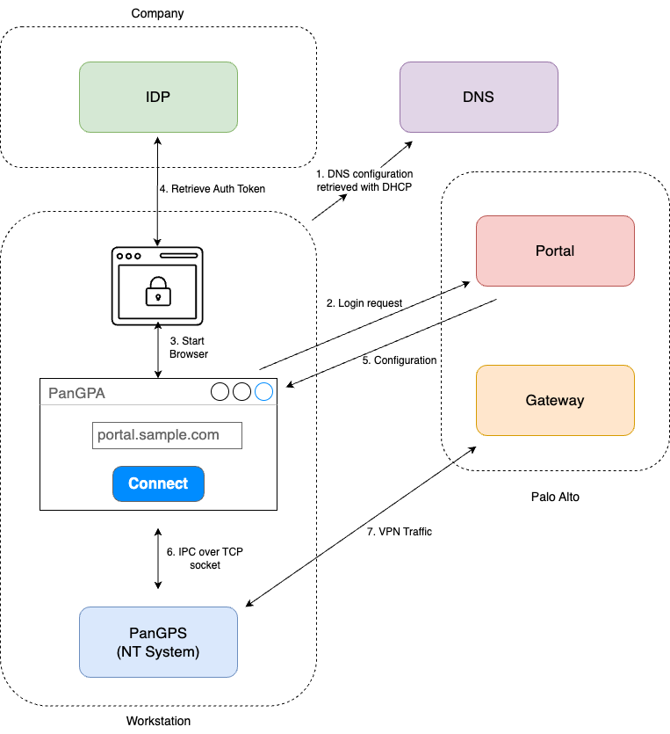
Global Protect

Slide 4
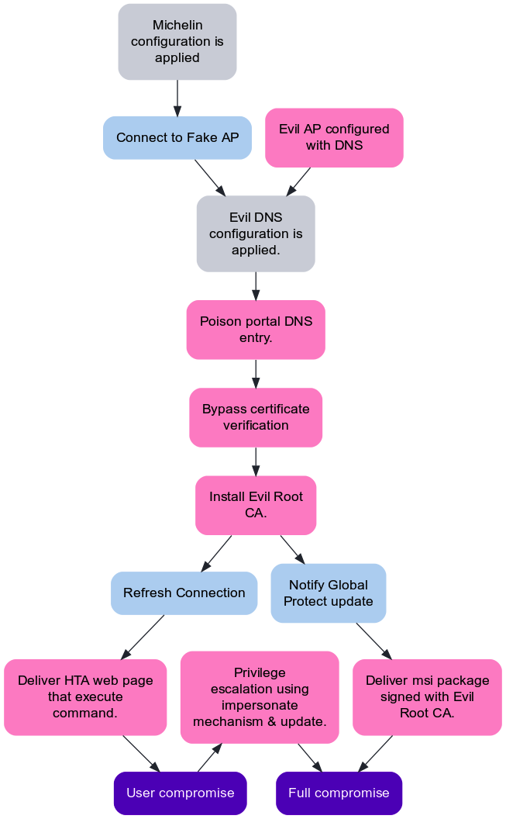


Attack Scenario
RCE
LPE

Slide 5
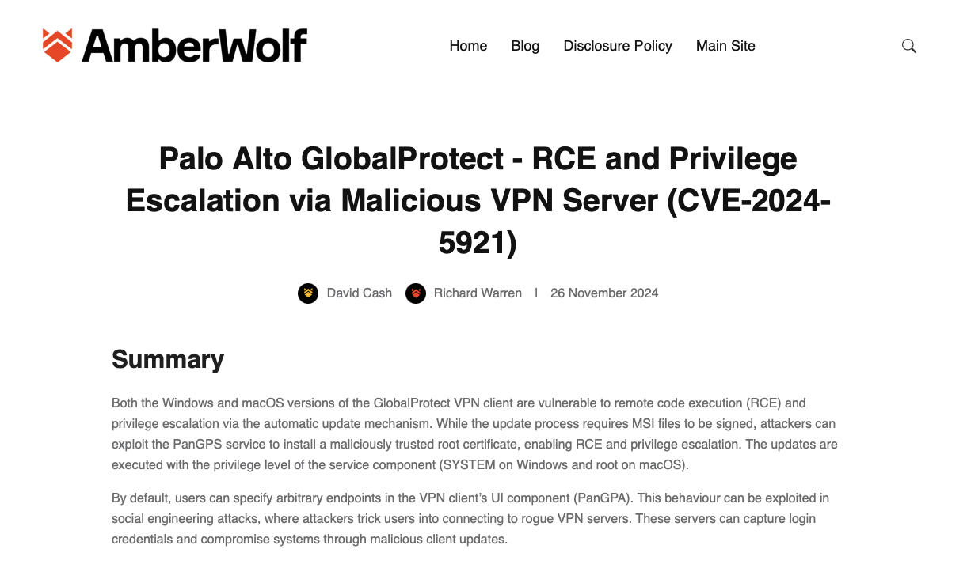
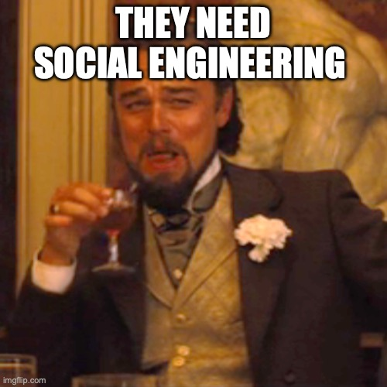
CVE-2024-5921by Amberwolf

Slide 6

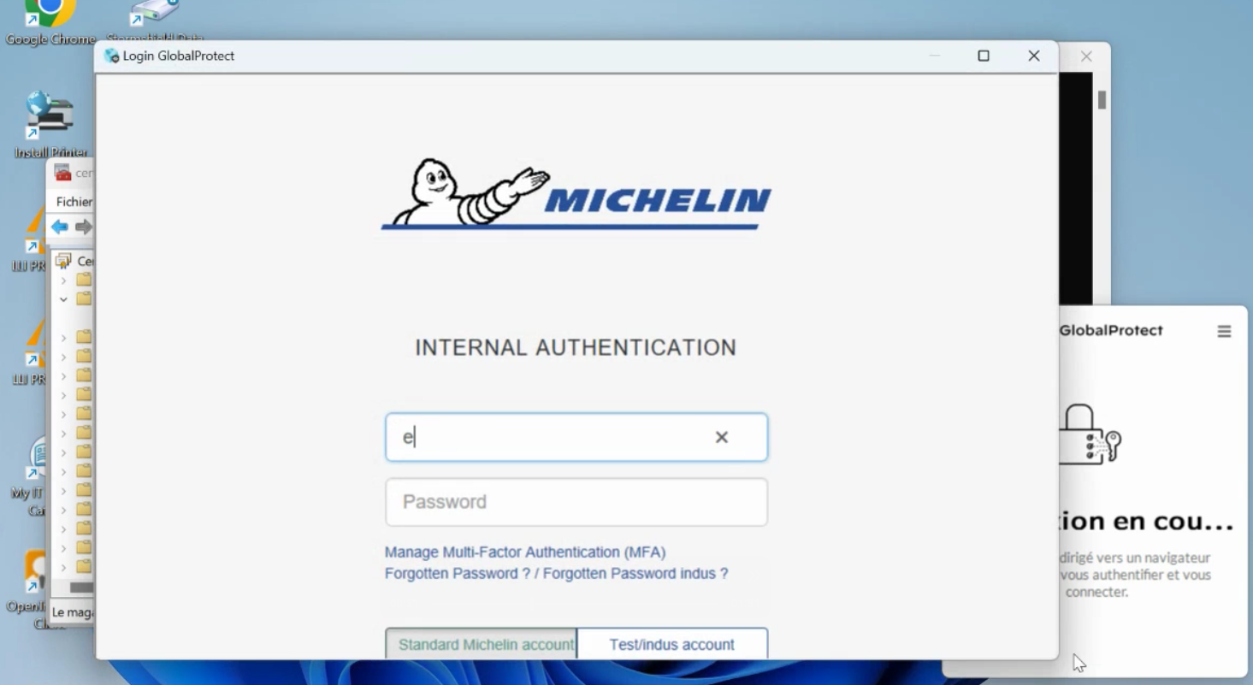
Embedded Browser Ecosystem

Slide 7
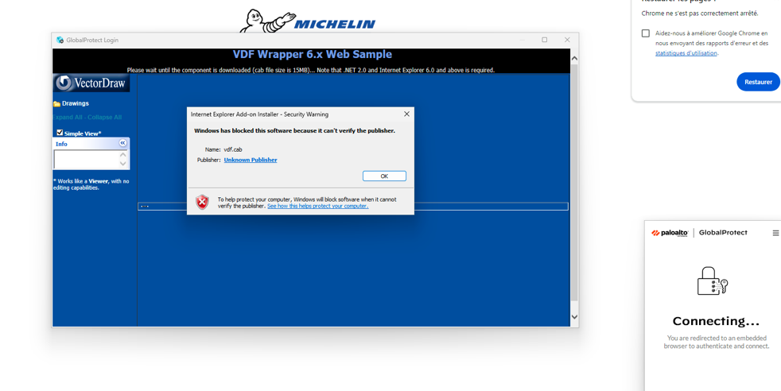
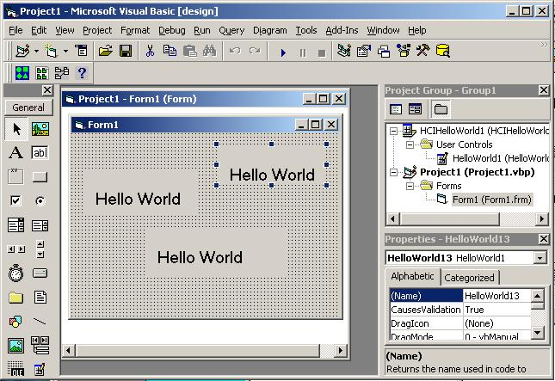
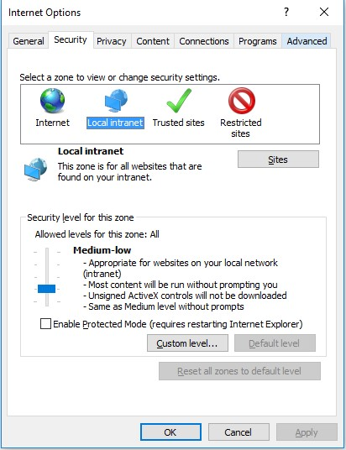
Embedded Browser Ecosystem
Not a big deal when you can insert Root CA

Slide 8
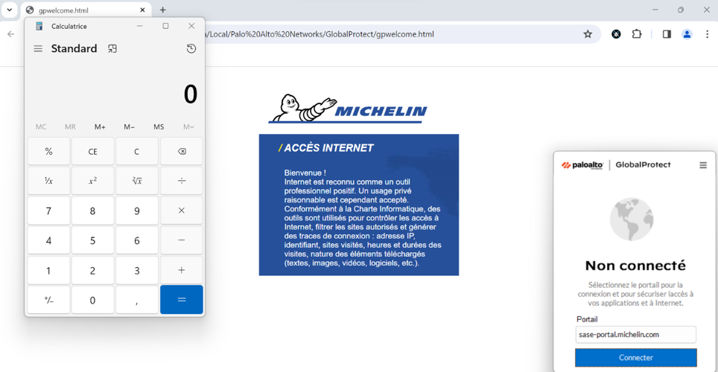
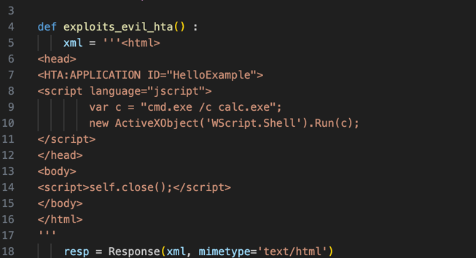
Embedded Browser Ecosystem
🔍 What is an HTA file?
- Extension: .hta
- Technology: HTML + scripting (VBScript/JS) executed via mshta.exe
- Behavior: Runs as a native Windows application (not sandboxed like a browser)
🚩 Why is it dangerous?
- No web security restrictions
- Can read/write to disk, access registry, run system commands
- Used as a dropper or loader in many malware campaigns
💥 Offensive use cases
- Delivered via embedded browser (IE/Edge)
- Exploitable in trusted zone or overly permissive configurations
- Commonly combined with forged certificates or malicious Root CAs

Slide 9
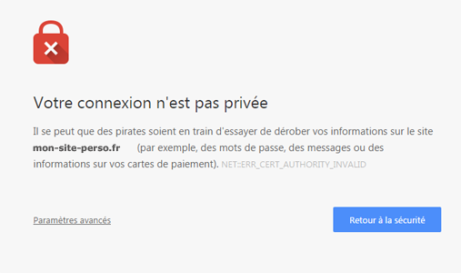
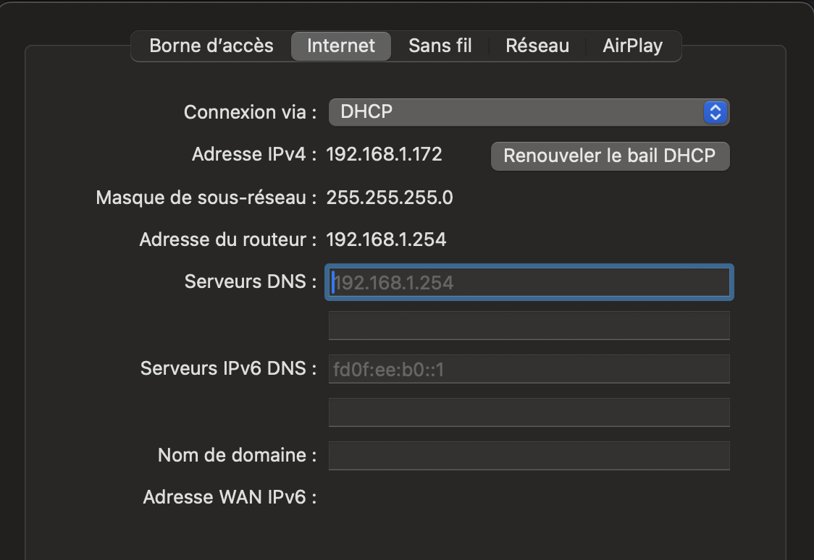
Untrusted DNS Usage
DNS could be assigned using a DHCP Server
Not a big risk for HTTPS traffic

Slide 10

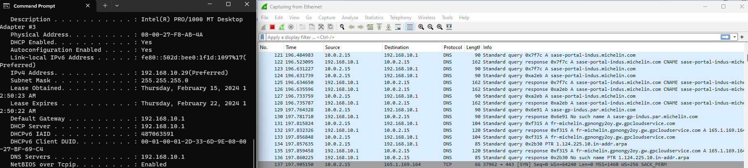
Untrusted DNS Usage
VPN Clients allows configuration of trusted DNS
(normally)

Slide 11
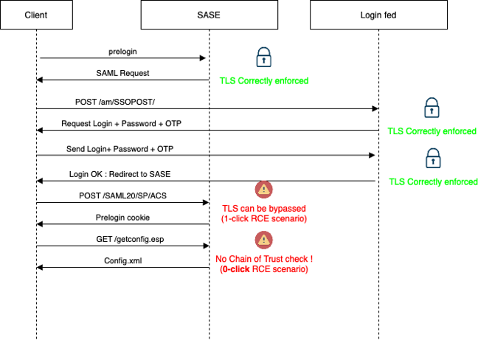
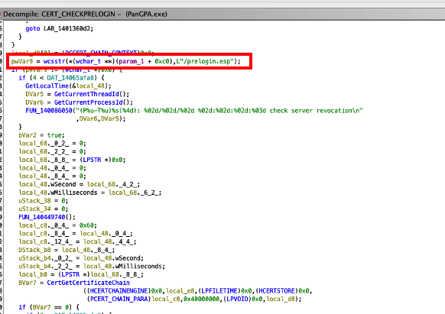
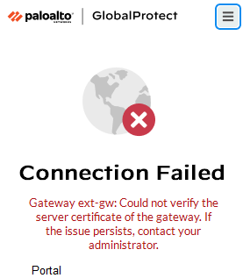

Certificate Verification Bypass

Slide 12
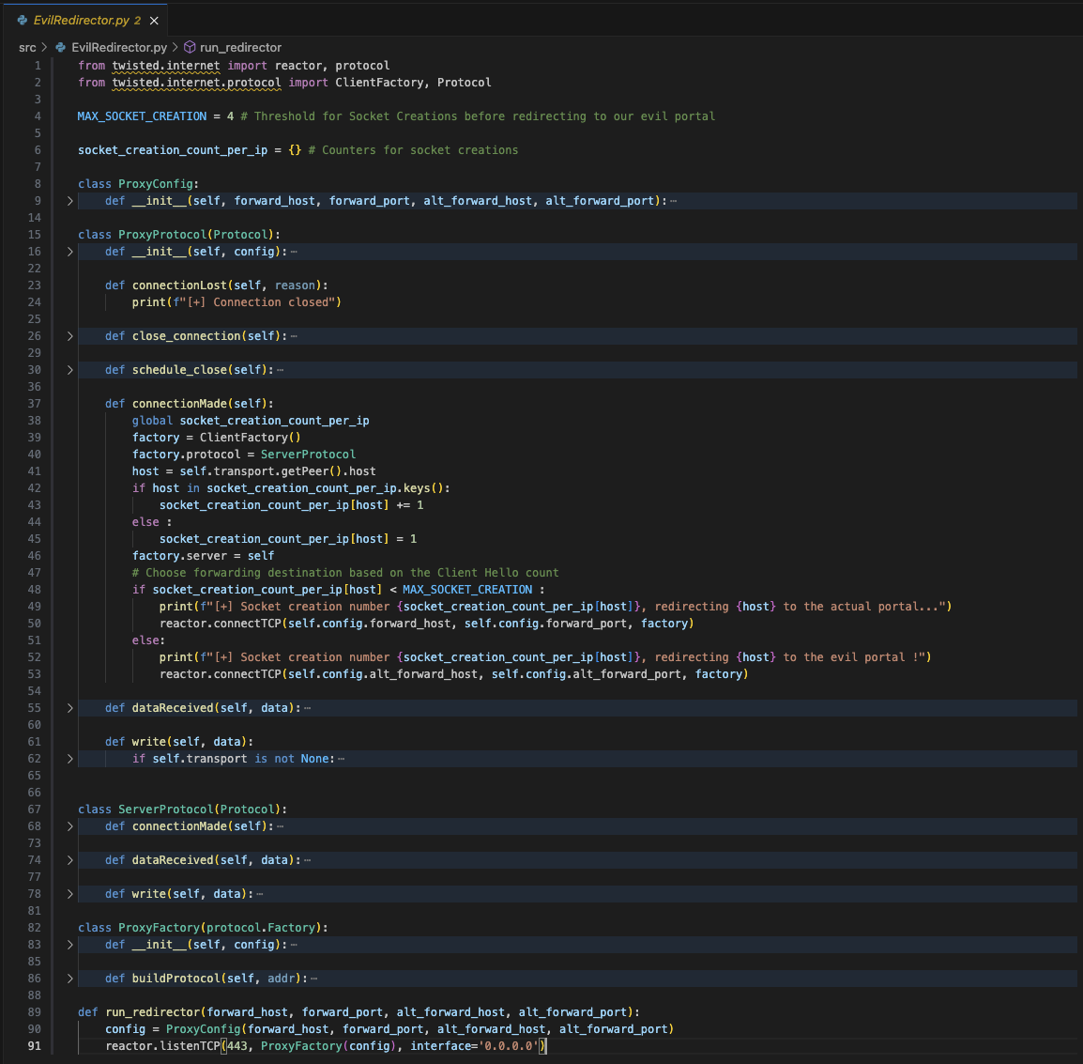

Slide 13
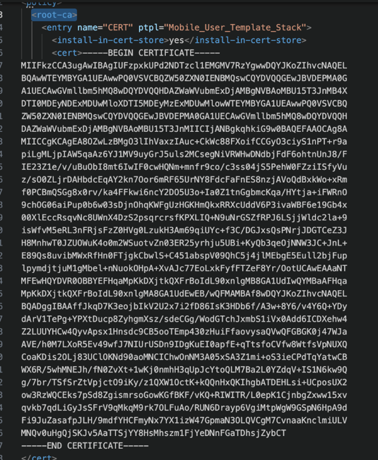
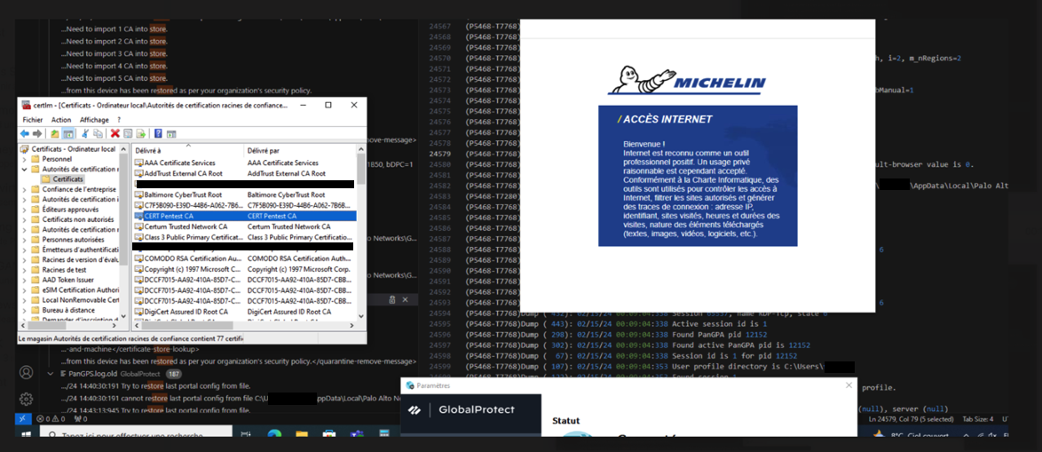
Evil Root CA Injection

Slide 14
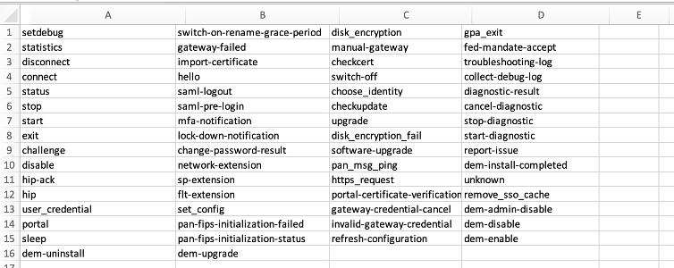
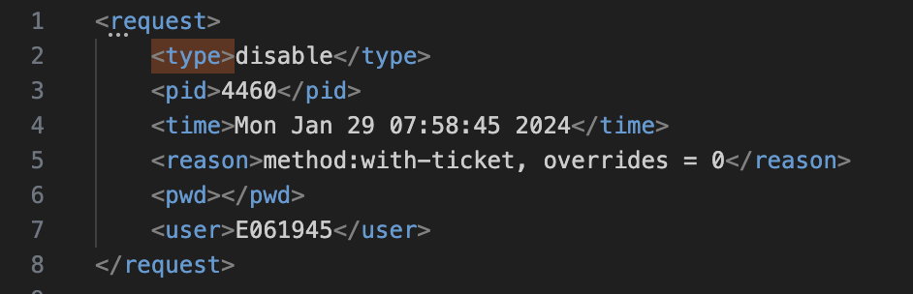
Weak IPC
Article from RotaryDrone was not yet released. (sic)
GP uses local TCP communications over the locally exposed port 4767.
AES-256-CBC with a null IV, and a static 128 bit key, repeated twice.
Captain Laziness : Extract key instead of reversing the whole process.

Slide 15
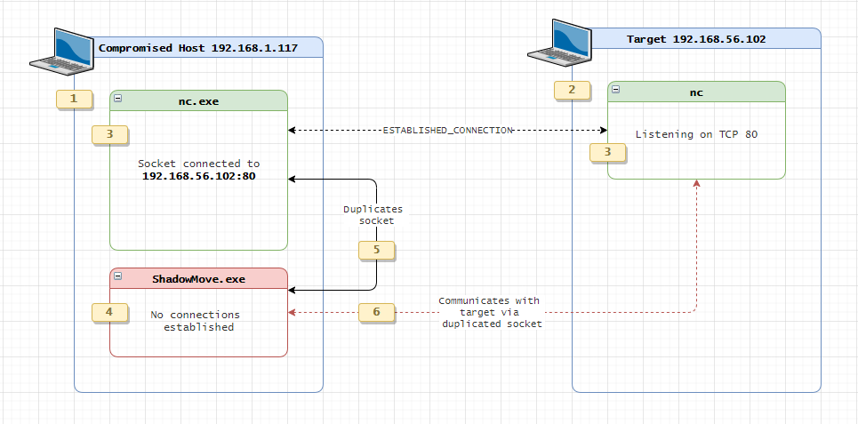
Bypass network restriction
PanGPS block tcp traffic from other applications.
ShadowMove rescued us !
Abuse WSADuplicateSocketW to duplicate the socket used by PanGPA.exe.
😈 Succeed to send arbitrary messages.

Slide 16
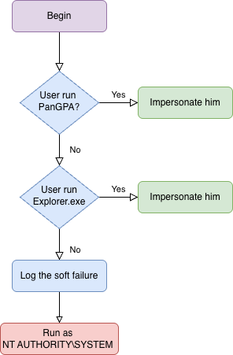
Soft failure on impersonation mechanism

Slide 17
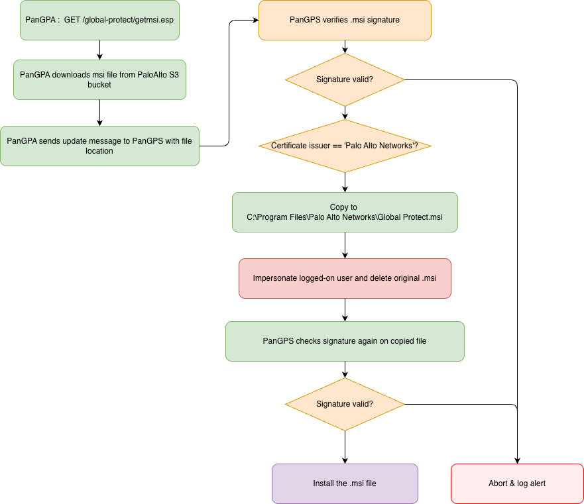
Update mechanism

Slide 18
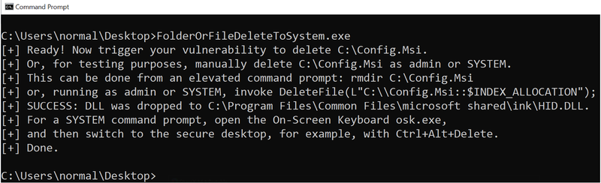
LPE using file deletion
Famous trick discovered by Abdelhamid Naceri (halov).
Based on James Forshaw works (again).
Arbitrary file delete as SYSTEM led to LPE.
https://www.zerodayinitiative.com/blog/2022/3/16/abusing-arbitrary-file-deletes-to-escalate-privilege-and-other-great-tricks

Slide 19
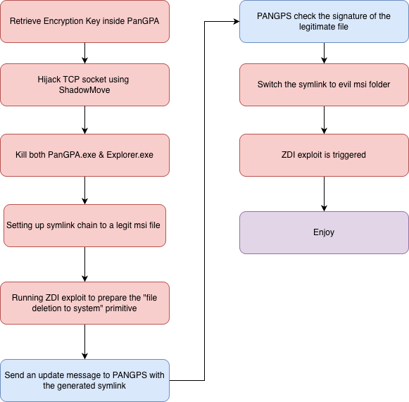
LPE Full Exploit

Slide 20
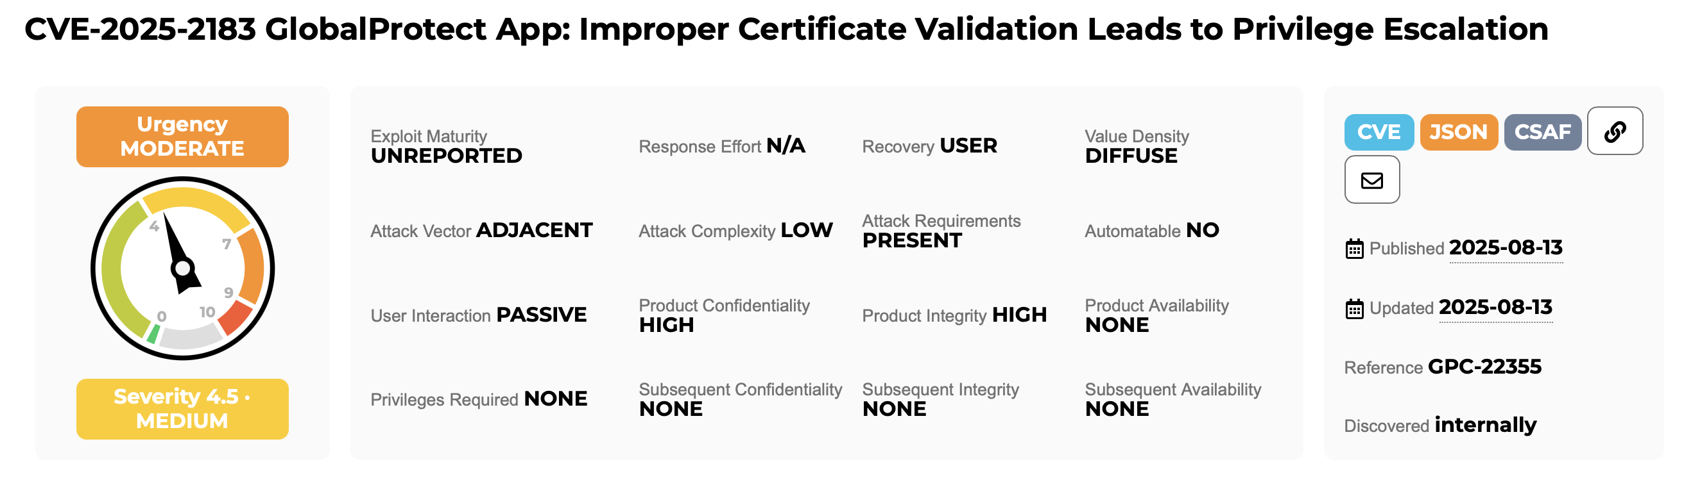

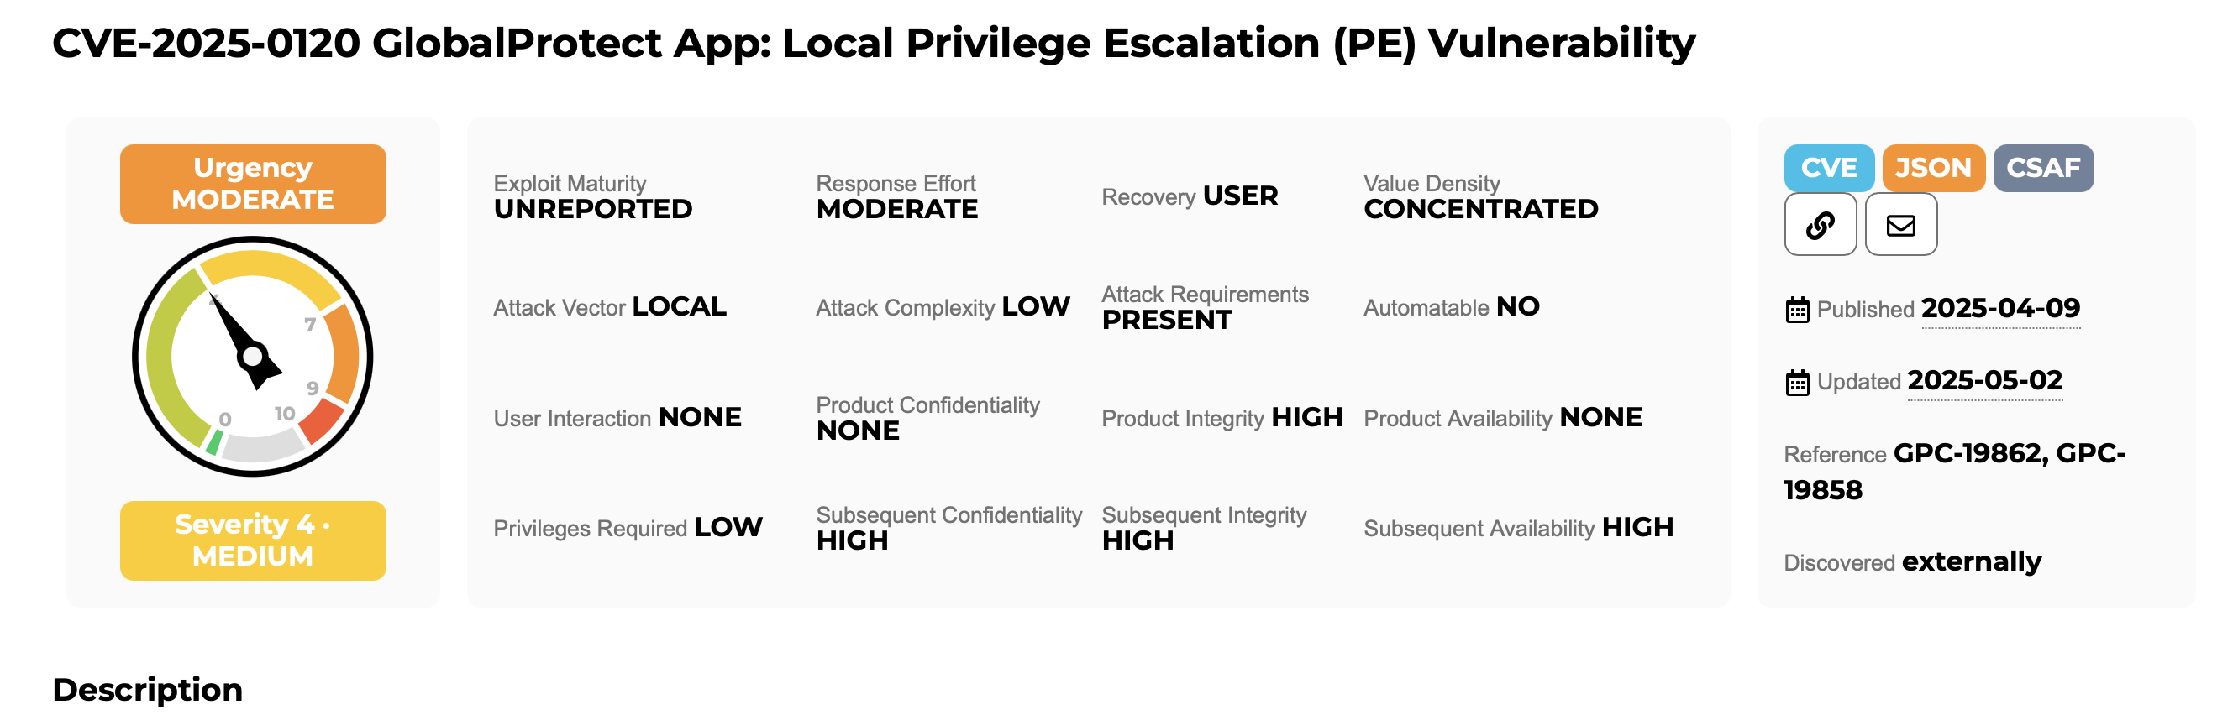
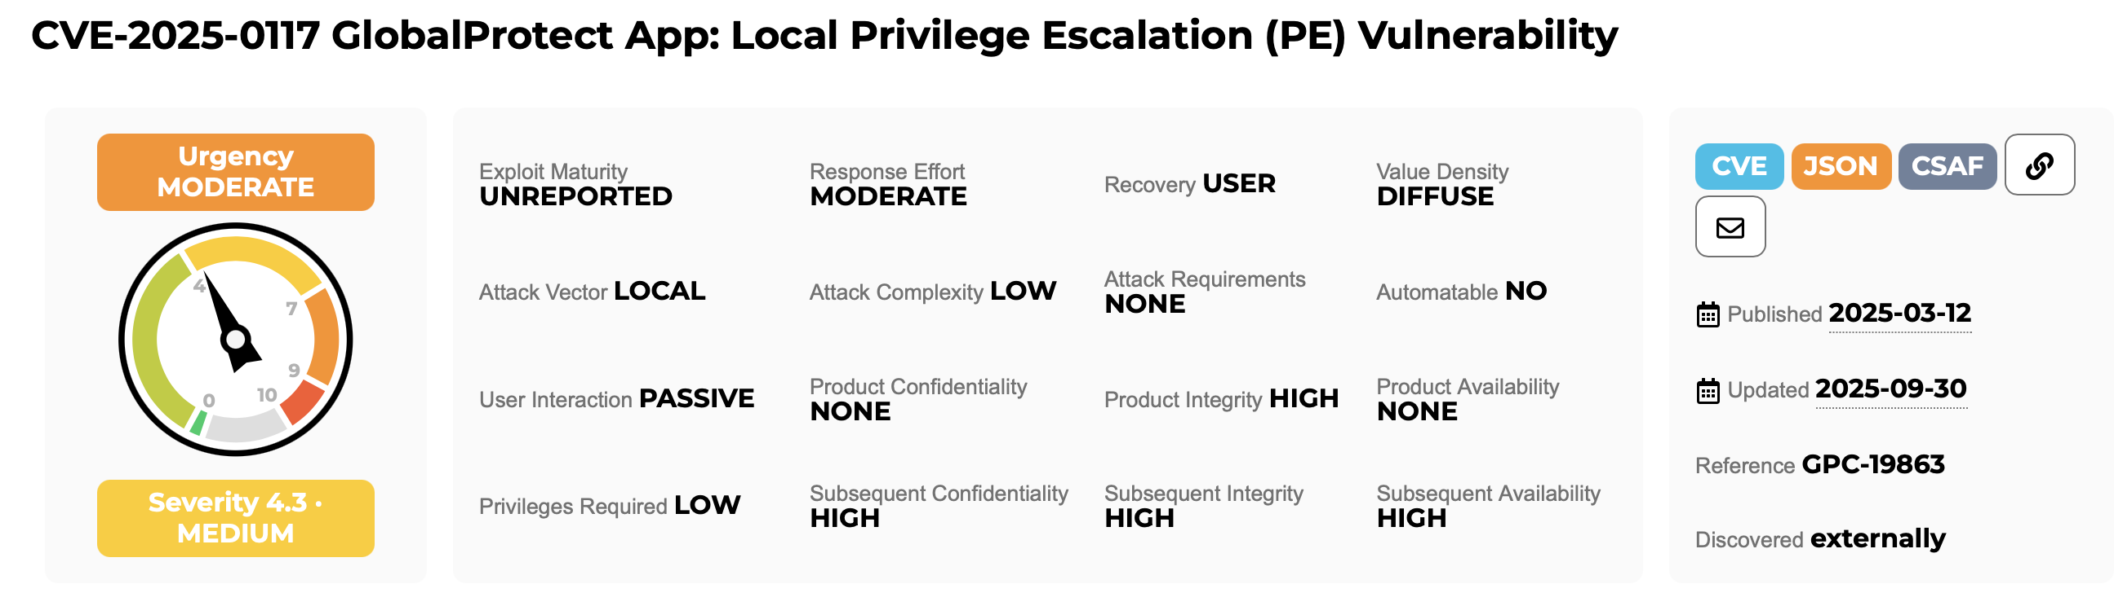
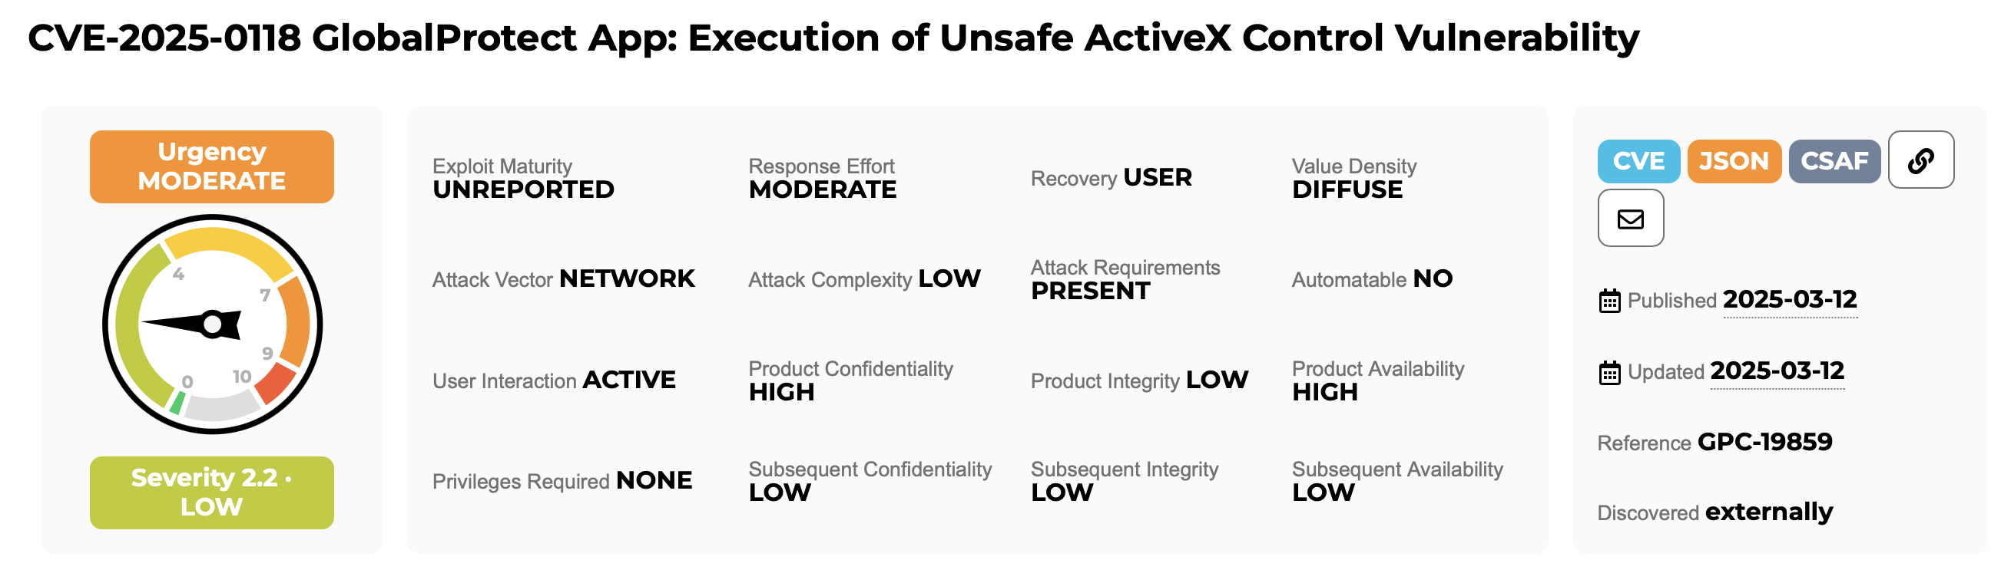
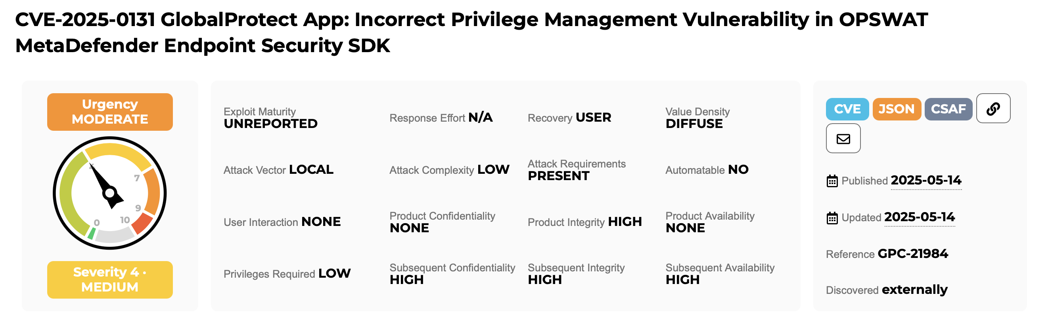
Not the only one LPE

Slide 21
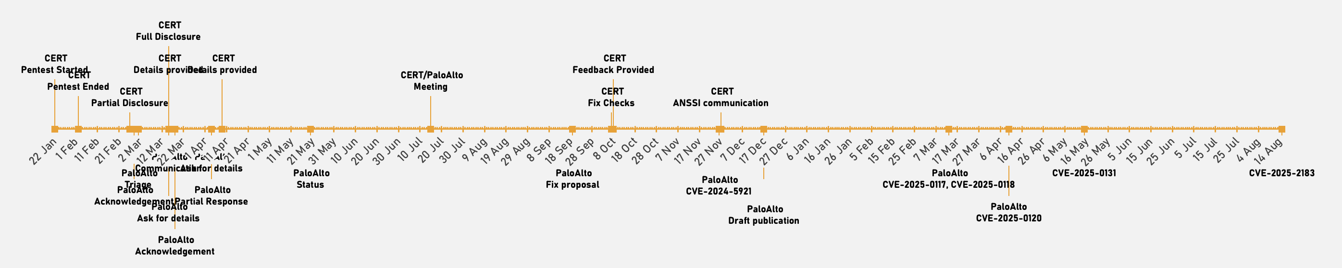

Timeline & Conclusion
🔐 Anyone who can act as man-in-the-middle could fully compromise the system !
🧠 The current patch breaks our attack scenario with recommended configuration‼️
☣️ Lot of LPE scenarios still present.

Slide 22
Questions ?

